Slide 1
TESA UPC / UPD
Gauge block comparator
PMI department
February 2013

Slide 2
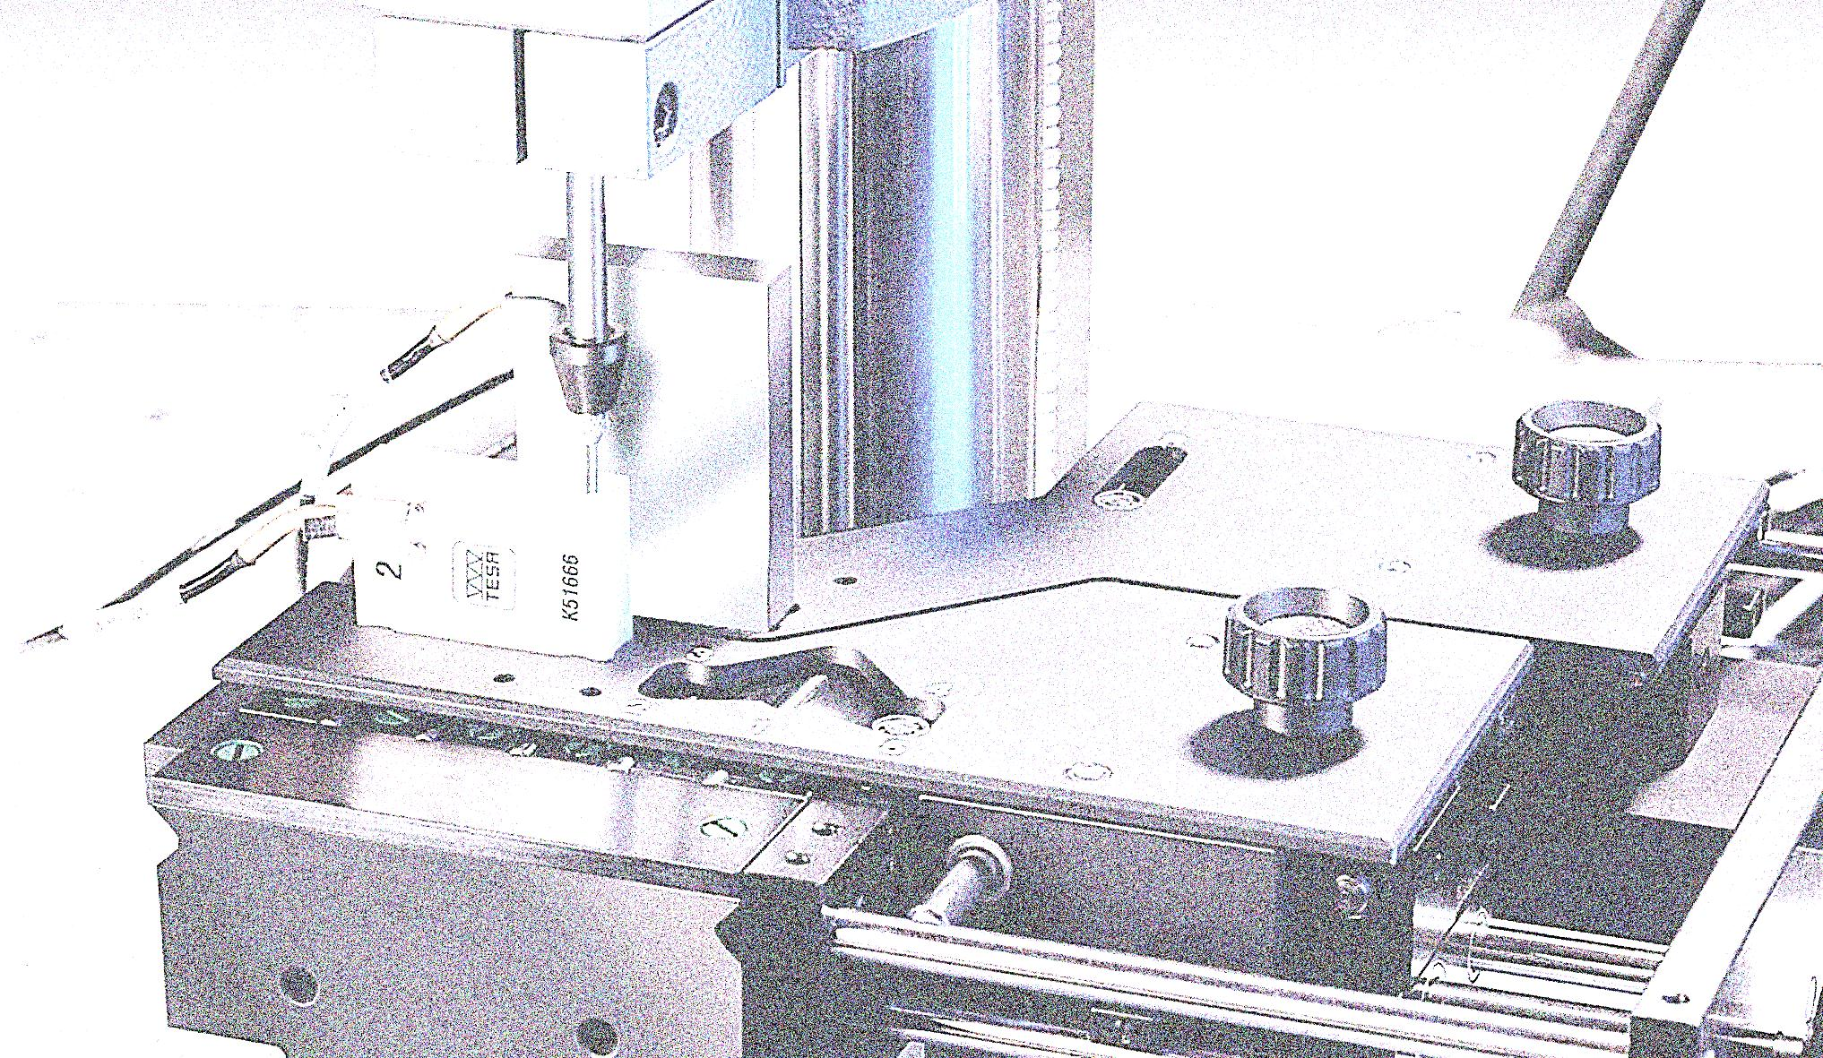
Summary
Gauge Blocks Introduction
TESA UPC / UPD Configuration
TESA UPC Gauge Block Comparator
        - For comparative measurements
TESA UPD Gauge Block Comparator
- For comparative and direct measurements
TESA UPT Temperature Device
TESA UP The Software Programme
TESA UPC / UPC System Components
Marketing Delivery Programme / Maintenance / Investments

Slide 3
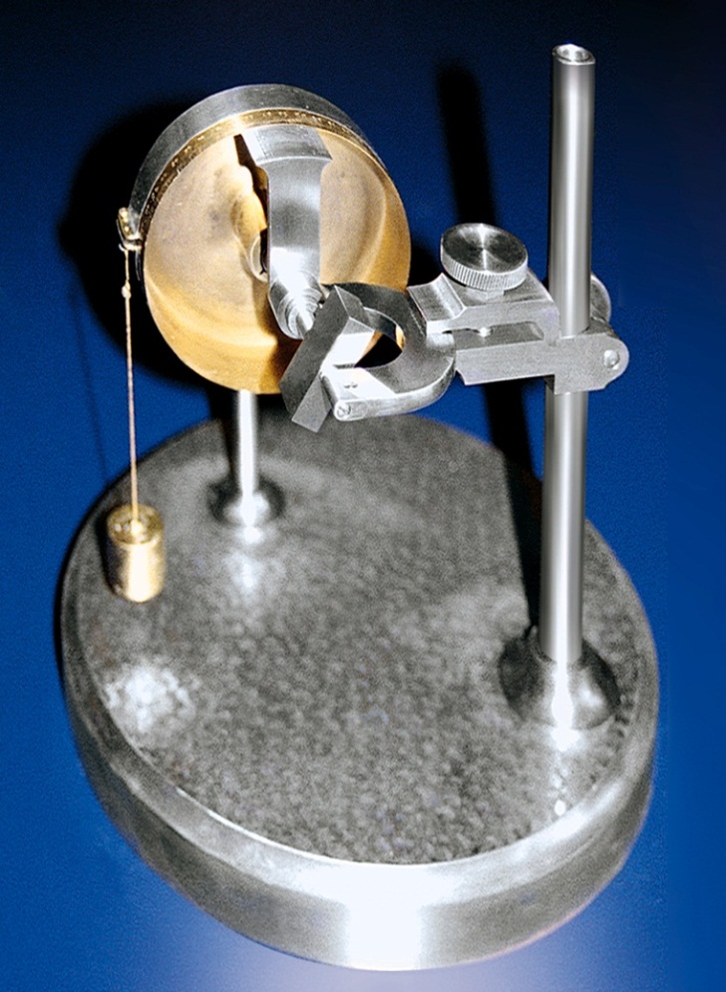
Gauge Blocks - Introduction
Welcome to the world of gauge block calibration
TESA Technology offers two instruments for two different ways of calibration
I was the first
Made by Brown & Sharpe for Mr. C.E. Johansson

Slide 4
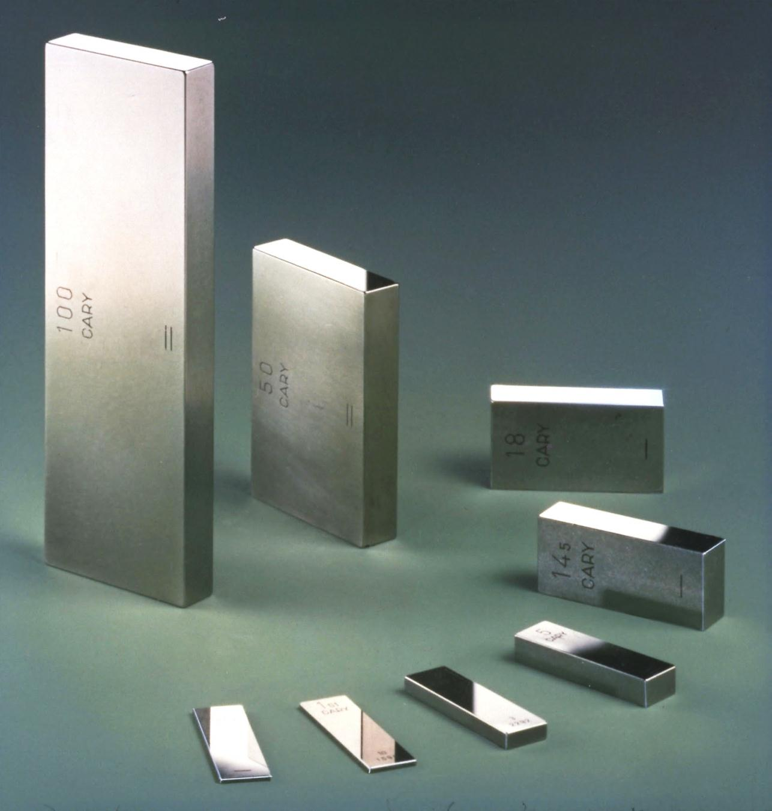
Gauge Blocks - Introduction
Gauge blocks:
The most significant material measures in dimensional metrology
Their periodic calibration ensures that they remain permanently reliable

Slide 5
Gauge Blocks - Introduction
as per ISO 3650:1998
L_{n} = nominal length
t_{e} = limit deviation at any point proceeding from the nominal length
lc = central length
fu & fo = variation v
t_{v} = tolerance of the variation v

Slide 6
Gauge Blocks - Introduction
Tracing gauge blocks (material measures) to the unit of length (meter)

Slide 7
TESA UPC / UPD - Configuration
Acquisition of the gauge length with use of two probes.
Measuring support
Measuring table
Upper probe
Lower probe
Electornique module
Pneumatic probe retraction (only for UPC)
Reference gauge block
Calibrated gauge block
Configuration layout

Slide 8
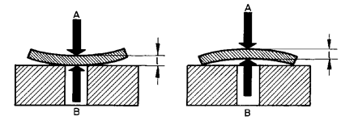
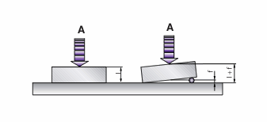
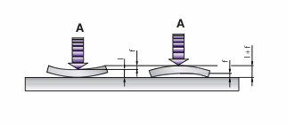
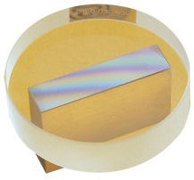
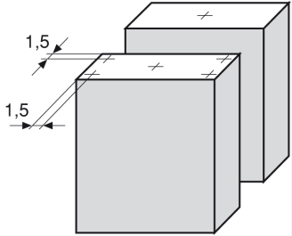
TESA UPC / UPD - Configuration
The economic and metrologic advantages
of a dual probes measuring system:
The two probes in «sum measurement»
mode ensure a correct measurement.
No form and position errors influences.
Especially for small thickness gauge blocks.
No surface apposition makes the measuring cycles faster.
Templates systems measuring lc point on the reference block and
lc plus 4 other points on each corner of the block being measured

Slide 9
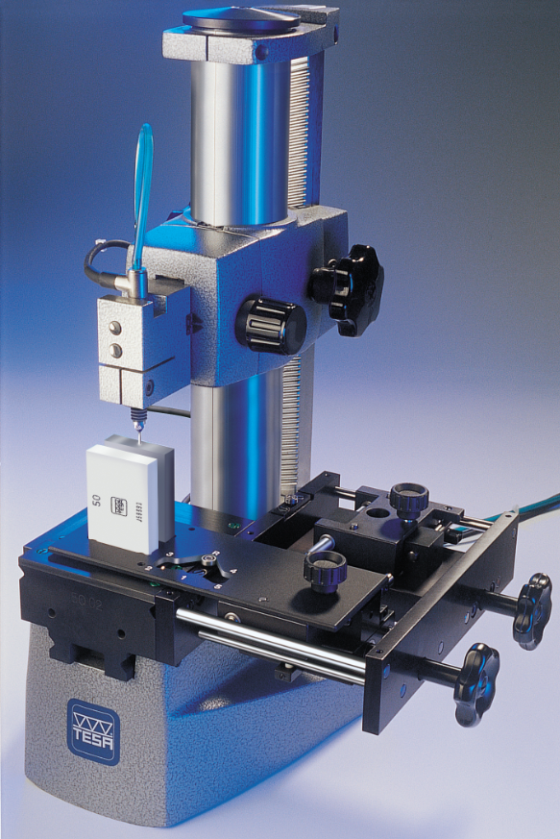
TESA UPC – Gauge Block Comparator
For Comparative Measurement
Measuring gauge block of same nominal length.
Application ranges from 0,5 up to 100 mm
(up to 500 mm in specialty.)
TESA high-precision inductive probes.
Template system for gauge block positionning.
Computer-aided data processing software available
Ultra-precise temperature device can be integrated.
Transfer on-line all length (and optionally the temperature).
Performs calibrations by meeting ISO standards as well as EA guidelines.
Greater accuracy execution available with a calibration certificate.

Slide 10
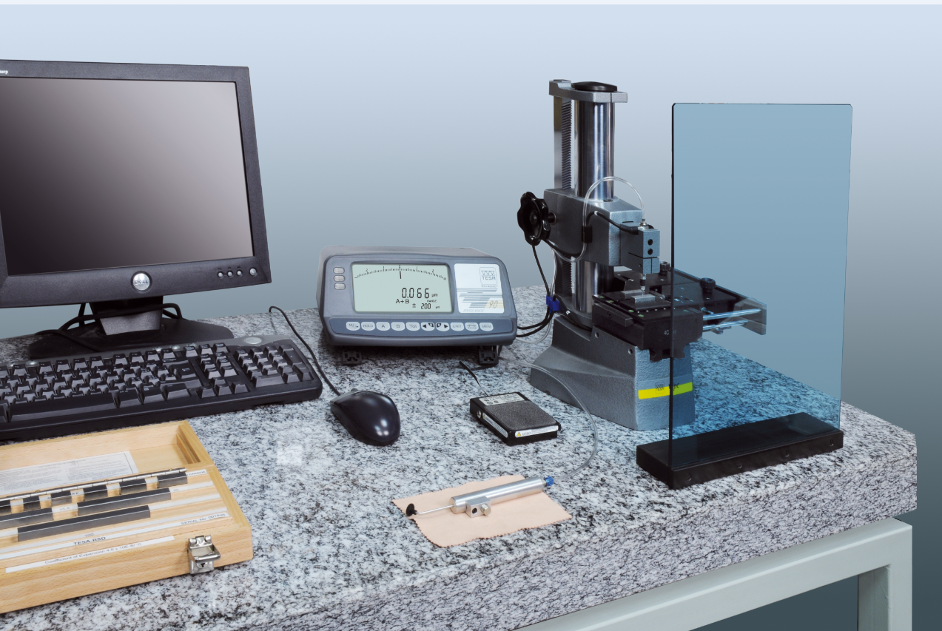
TESA UPC – Gauge Block Comparator
TESA UPC execution ref. 05930014

Slide 11


TESA UPC – Gauge Block Comparator
Errors of measurement
Repeatability limit
Uncertainty of measurement
• Execution for
greater accuracy
*¹0,015 µm
*²U = ± (0,05 + 0,5 x L) µm
( L in m )
• Standard execution
*¹0,025 µm
*²U = ± (0,10 + 1,0 x L) µm
( L in m )
*¹ Without influence of the temperature
*² Condition involves the use of reference standards whose uncertainty of measurement is:
U ≤ ± 0,015 µm
for the comparator calibration
U ≤ ± (0,02 + 0,2 x L) µm
for the gauge block calibration

Slide 12
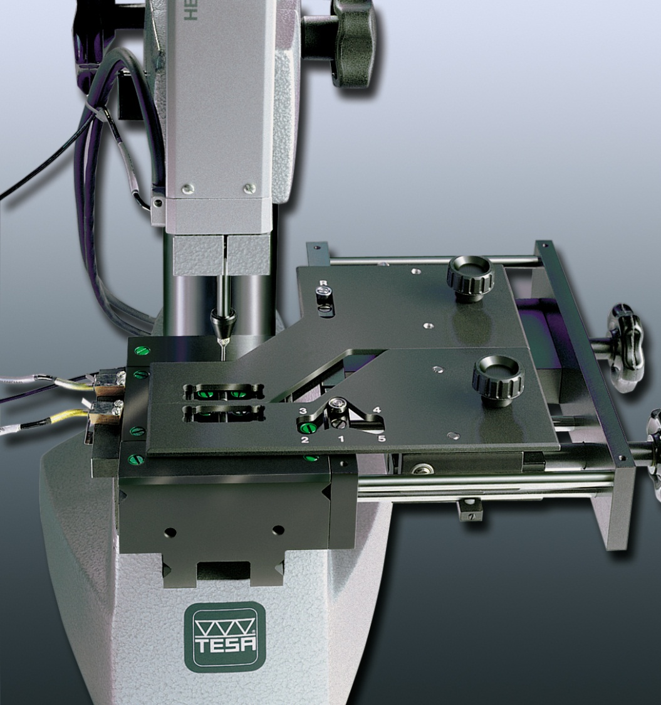
TESA UPD – Gauge Block Comparator
For Direct and Comparative Measurement with a 25mm span
The flexible concept that provides distinctive metrological features with substantial savings at the end of it all

Slide 13
TESA UPD – Gauge Block Comparator
For Direct and Comparative Measurement with a 25mm span
Measuring gauge block of same or different nominal length.
Application ranges from 0,5 up to 100 mm
(up to 500 mm in speciality.)
TESA & HEIDENHAIN high-precision incrementale probes.
Template systems for gauge block positionning.
Computer-aided data software available.
Ultra-precise temperature device can be integrated.
Transfer on-line all lengths (and optionally the temperature).
Performs calibrations by meeting ISO standards as well as EA guidelines.

Slide 14
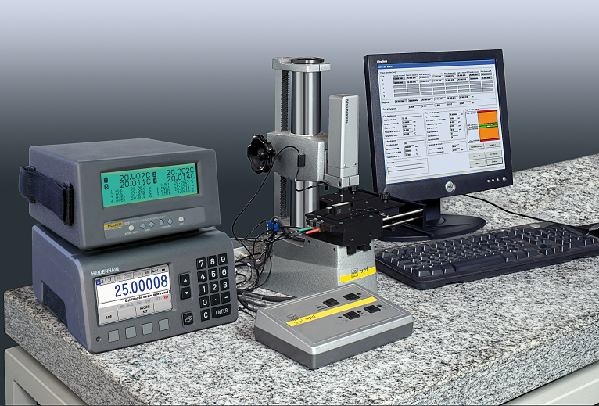
TESA UPD – Gauge Block Comparator
TESA UPC execution ref. S59300102

Slide 15
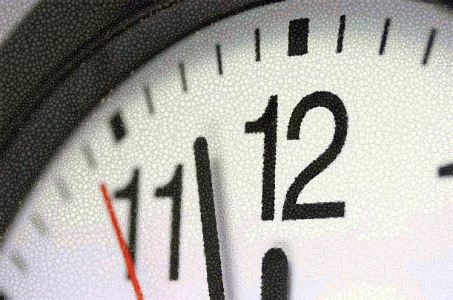

TESA UPD – Gauge Block Comparator
The advantages that make it leader and unrivaled:
The Time:
The Costs:
Number of probing points is thus reduced drastically.
Measured value immediately displayed after the probe insert has come into contact.
Number of calibrated gauge blocks increased with a single probed reference gauge
Allows to calibrate over 90% of a 122-pieces gauge block set with the same reference standard.
Consequently, it allows to reduce the reference set compared to the UPC.
Reduce significantly the cost of purchase or maintenance on the references.
No need to buy specific reference for an unusual nominal length (e.g. 17.6mm)

Slide 16
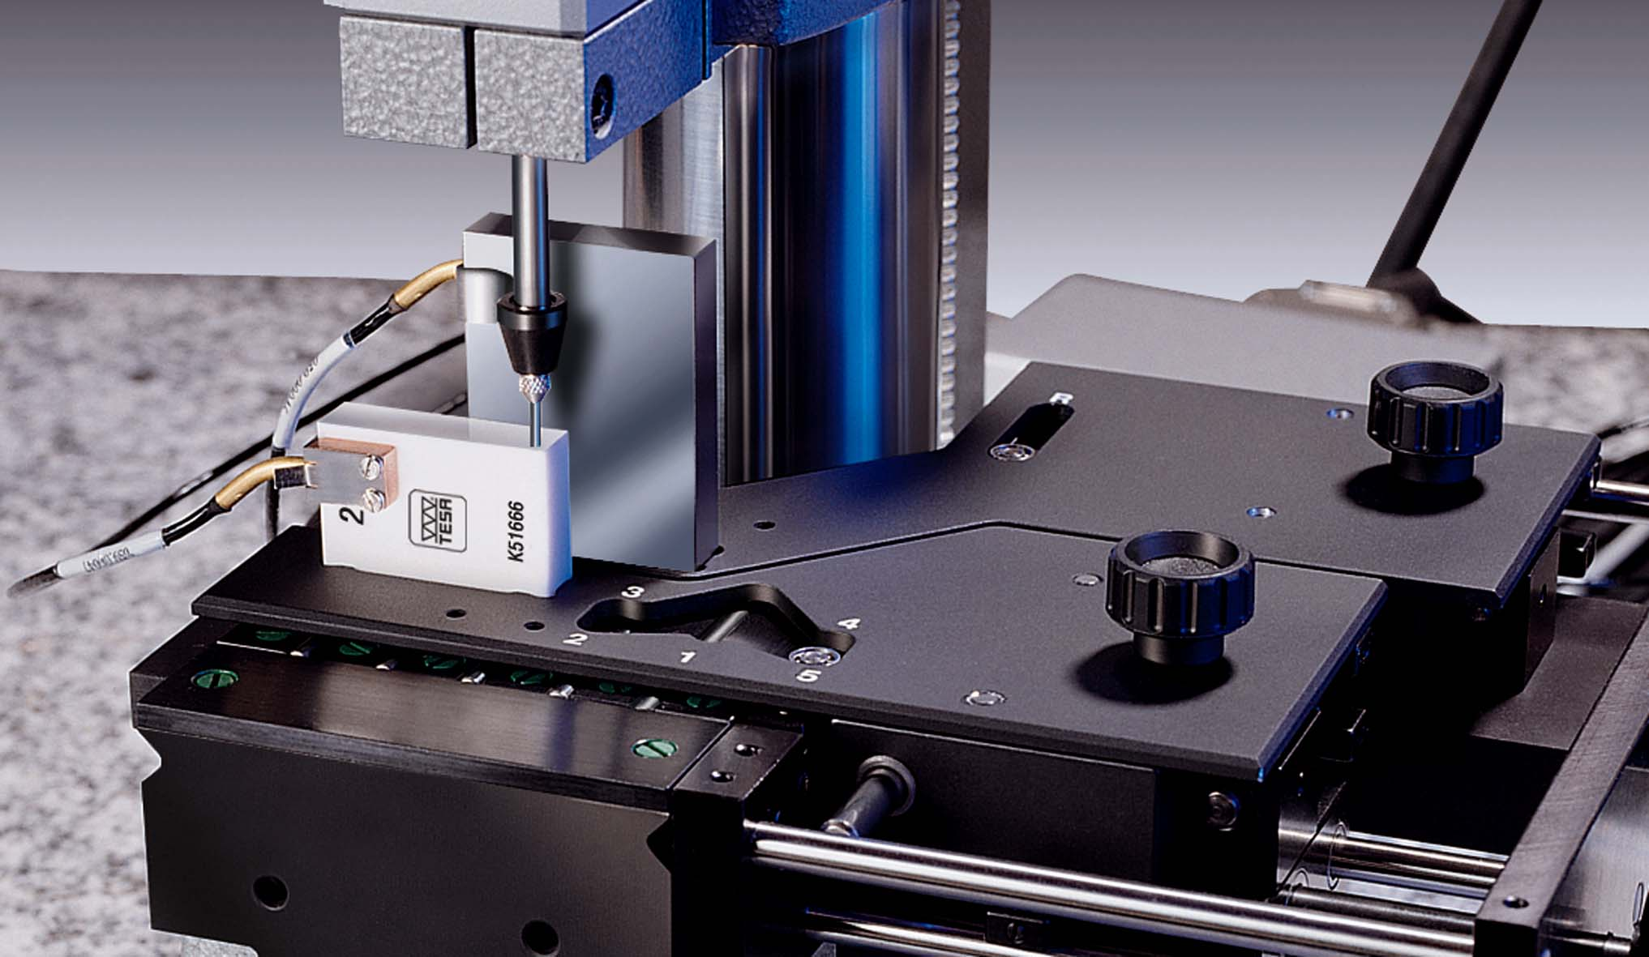
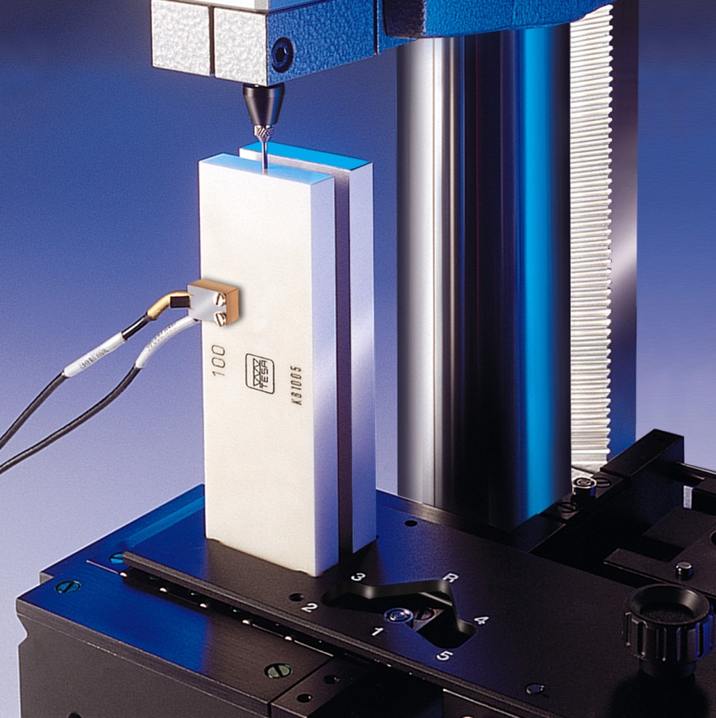
TESA UPD – Gauge Block Comparator
Comparative measurement
Comparison of gauge blocks when same nominal length
Direct measurement
Comparison with a variation in nominal length of 25mm
for smaller systematic errors

Slide 17
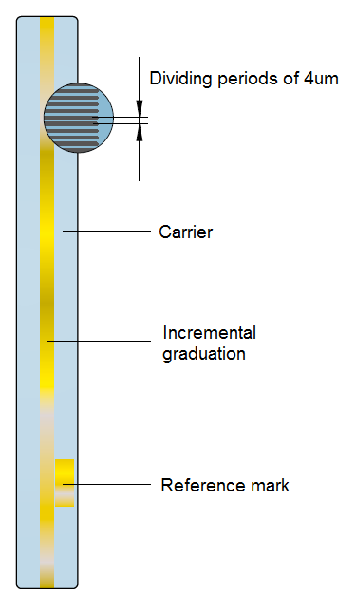
TESA UPD – Gauge Block Comparator
Upper HEIDENHAIN high-precision axial probes
- 25mm measuring span
11111100110
- Opto-electronic measuring system
- ZERODUR glass ceramic scale with incremental divission
- ABBE’s principle fully respected
- Motorised measuring bolt activation
- 0.000005 mm (5 nm) numerical interval
- Accuracy ≤ 5 nm

Slide 18
TESA UPD – Gauge Block Comparator
Errors of measurement
Repeatability limit
Uncertainty of measurement
*¹0,015 µm
*²U = ± (0,05 + 0,5 x L) µm
( L in m )
*¹ Without influence of the temperature
*² Condition involves the use of reference standards whose uncertainty of measurement is:
U ≤ ± 0,015 µm
for the comparator calibration
U ≤ ± (0,02 + 0,2 x L) µm
for the gauge block calibration

Slide 19
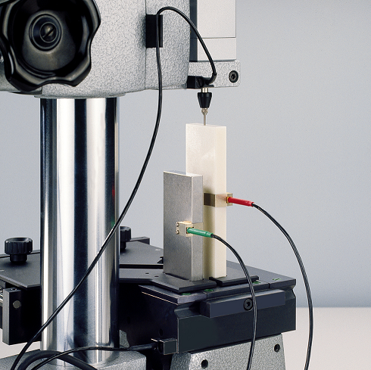
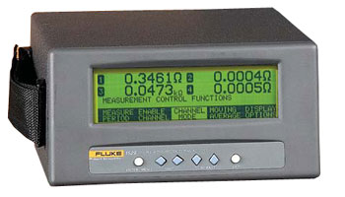
TESA UPT – Temperature Device
For TESA gauge block comparators UPC and UPD
4 temperature sensors PT100 (4-wires type).
2 of them with clamps for the gauge blocks
Numerical interval: 0.001°C
Calibrated for the measuring range from 19°C up to 24°C
Uncertainty of measurement: U = +/- 0.03°C
Delivered with SCS calibraiton certificate
… also used on measuring equipments such as horizontal measuring benches or height gauges.

Slide 20
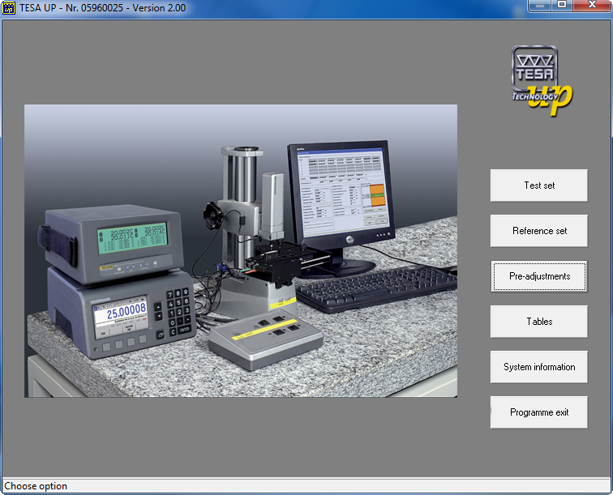
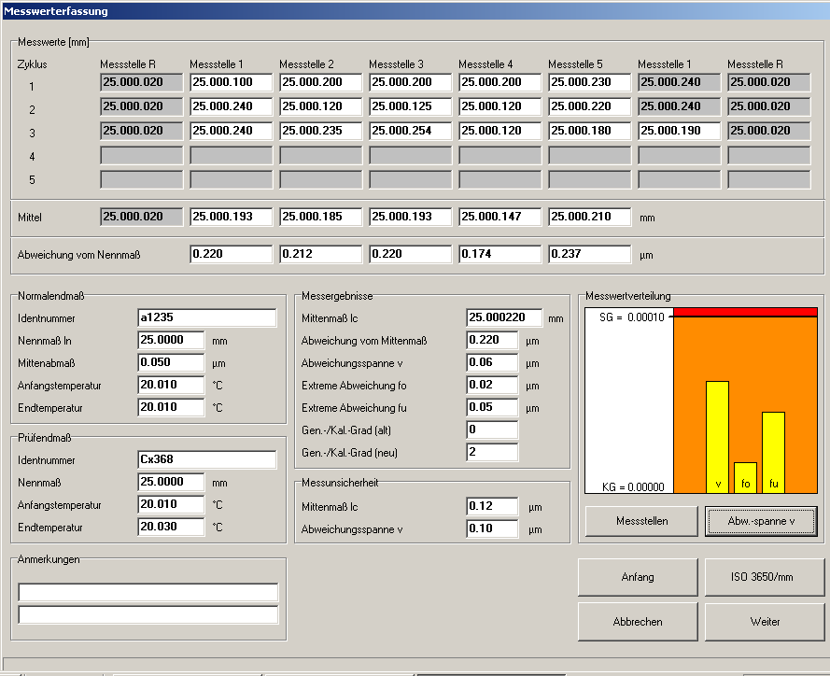
TESA UP – Software Programme
For TESA gauge block comparators UPC and UPD
On-line processing of length and temperature values.
Automatic execution of all relevant corrections.
Large possibilities for a self-creation of certificates and calibration modes.
Result outputs according to ISO 3650:1998, to 6 other standards and to a personnalized one.
Available in 11 languages.
Compatible with Win 7 (32 bits) and lower.
Compatible for comparators from competitors.
Delivered with protective dongle (hard-key) in USB

Slide 21
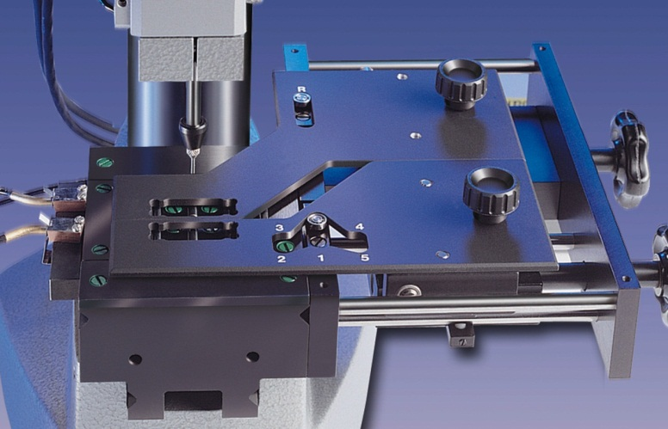

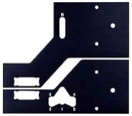
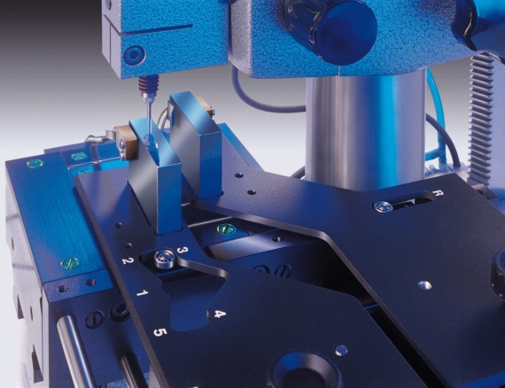

TESA UPC / UPD – System Components
Dual Template: a patented pending system for TESA UPD and optionnaly for UPC
Main target: to protect the expensive reference gauge blocks.
How: by reducing the travel of the reference gauge blocks of about 70%.
This contribute to lower the risks of damaging and wearing the the measuring faces.
This double protection blocks leads to significant cost savings by reducing needs for:
Recalibration
Restoring measuring faces, replacing worn or damaged referenced gauges
Life extension of the full reference sets.
Longer life of the pins of the table of the UPC or UPD.

Slide 22
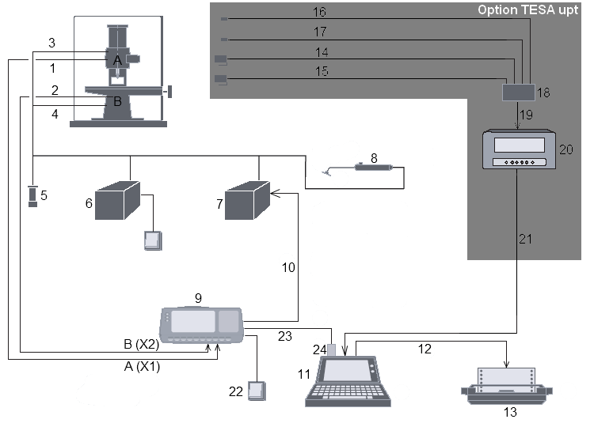
TESA UPC – System Components

Slide 23
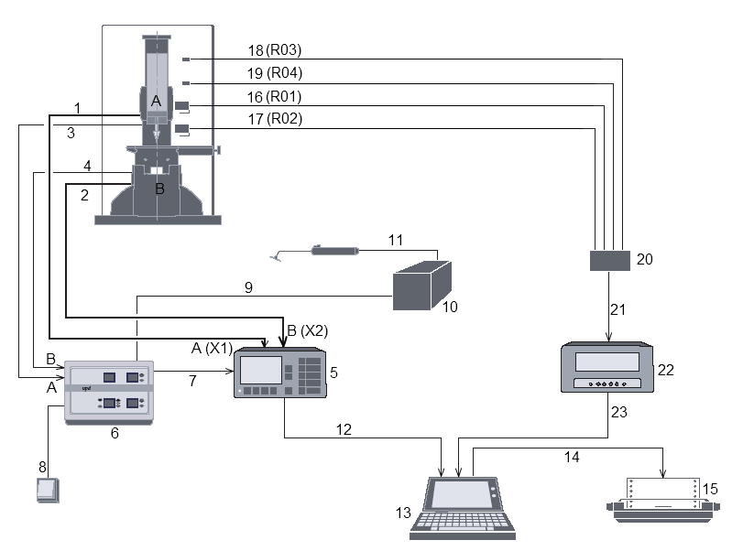
TESA UPD – System Components

Slide 24
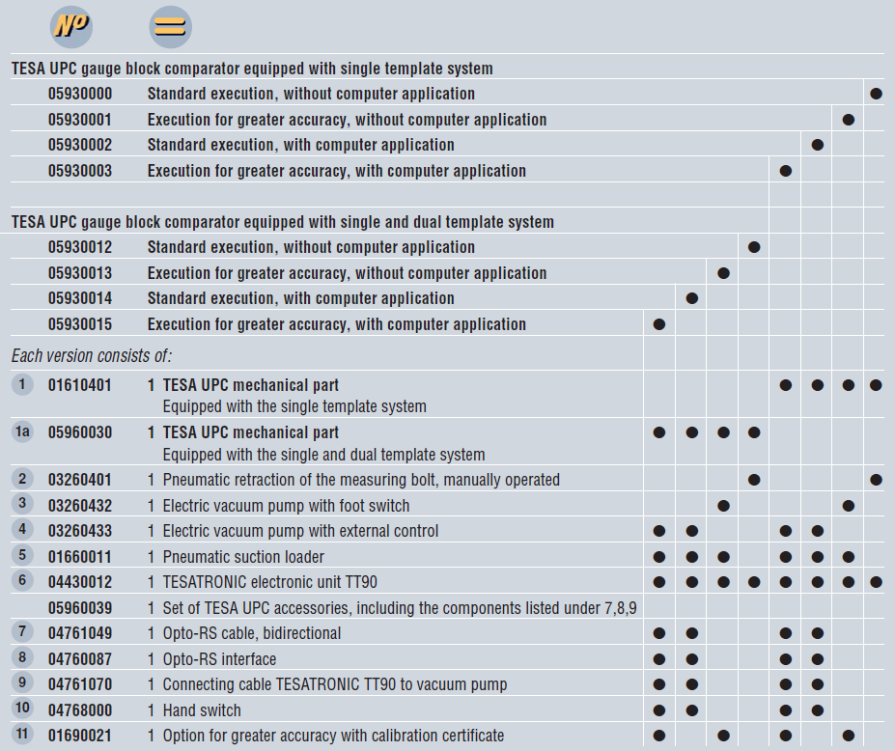
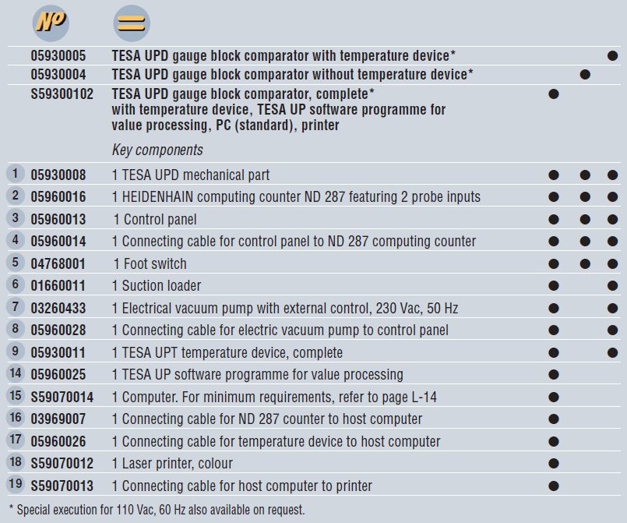
TESA UPC / UPD – Delivery Programmes
TESA UPC: 8 Ordering variations
TESA UPD: 3 Ordering variations

Slide 25
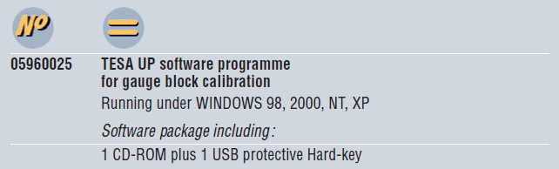
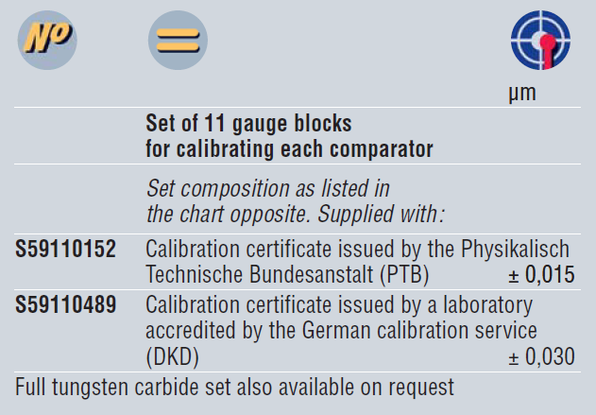
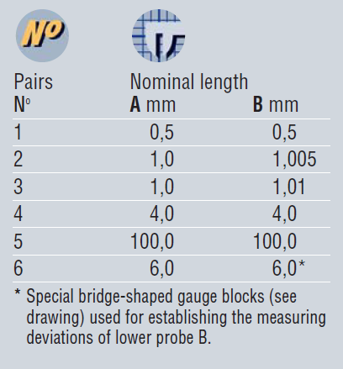
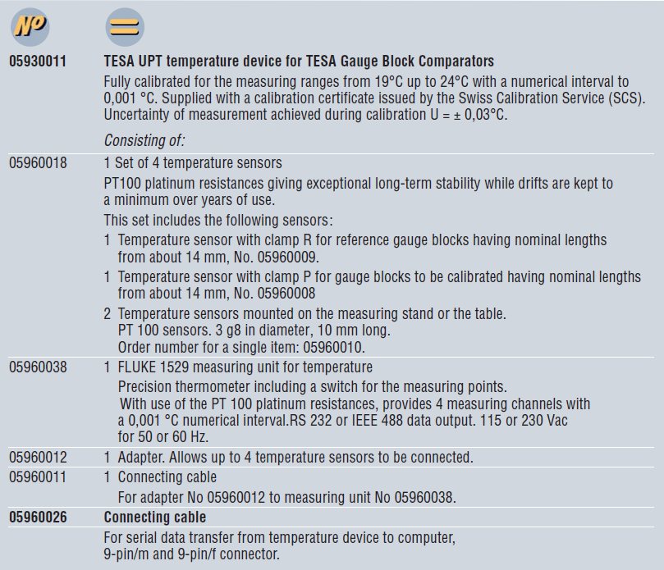
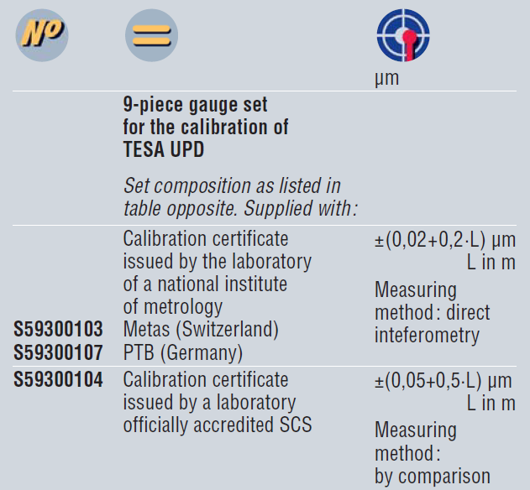
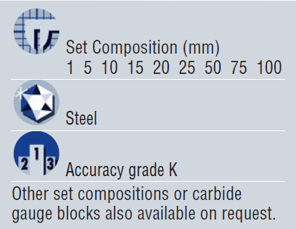
TESA UPC / UPD – Delivery Programmes
Options (depending the delivery programme) and Accessories:

Slide 26
– TESA offer the widest range of measuring equipments for gauge block calibration Worldwide.
- TESA UPD Gauge Block Comparator is the only one of its class that has no competitor.
TESA UPC / UPD - Conclusion
Precision – our identity
You have more questions. A team of Enginneers is at your dispositon at:
tesa.service@hexagonmetorlogy.com => for technical requests / questions
tesa.specialites@hexagonmetorlogy.com => for non standard products quotation
Thanks !

