Slide 1
TESA TWIN-SURF
Product presentation
25.03.2022

Slide 2
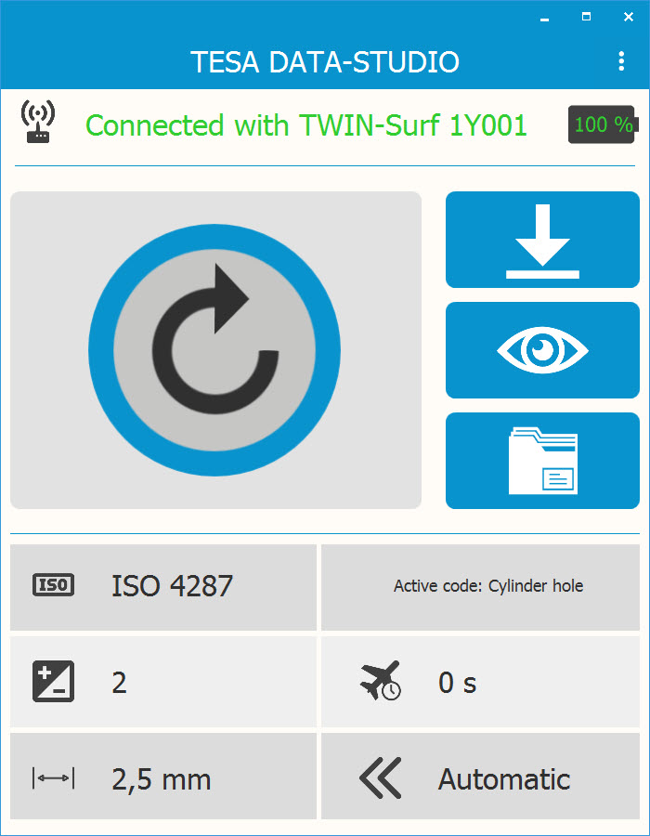
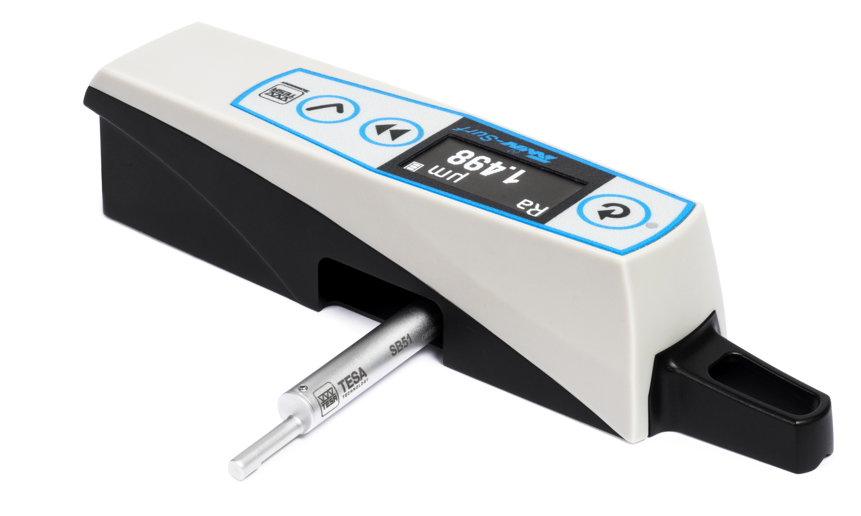
Key features
Compact, light et robust
90° probe orientation for transverse measurements
Store of the measured parameters
Wireless model available
Free software included for creating measurement reports

Slide 3
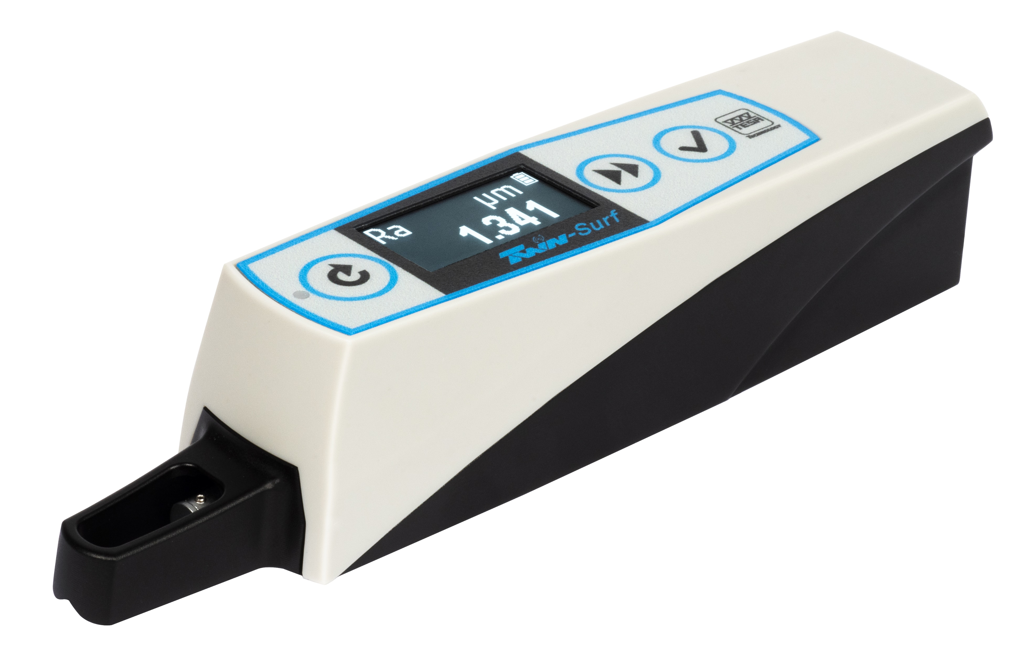
Functions
Each measurement parameter can be activated / deactivated individually
Adjustable upper and lower tolerance for each parameter
Store of the measured parameters
Probe can be automatically returned to the starting position after each measurement
Menu available in 9 languages: English, French, German, italian, Spanish, Portuguese, Chinese, Japanese, Korean

Slide 4
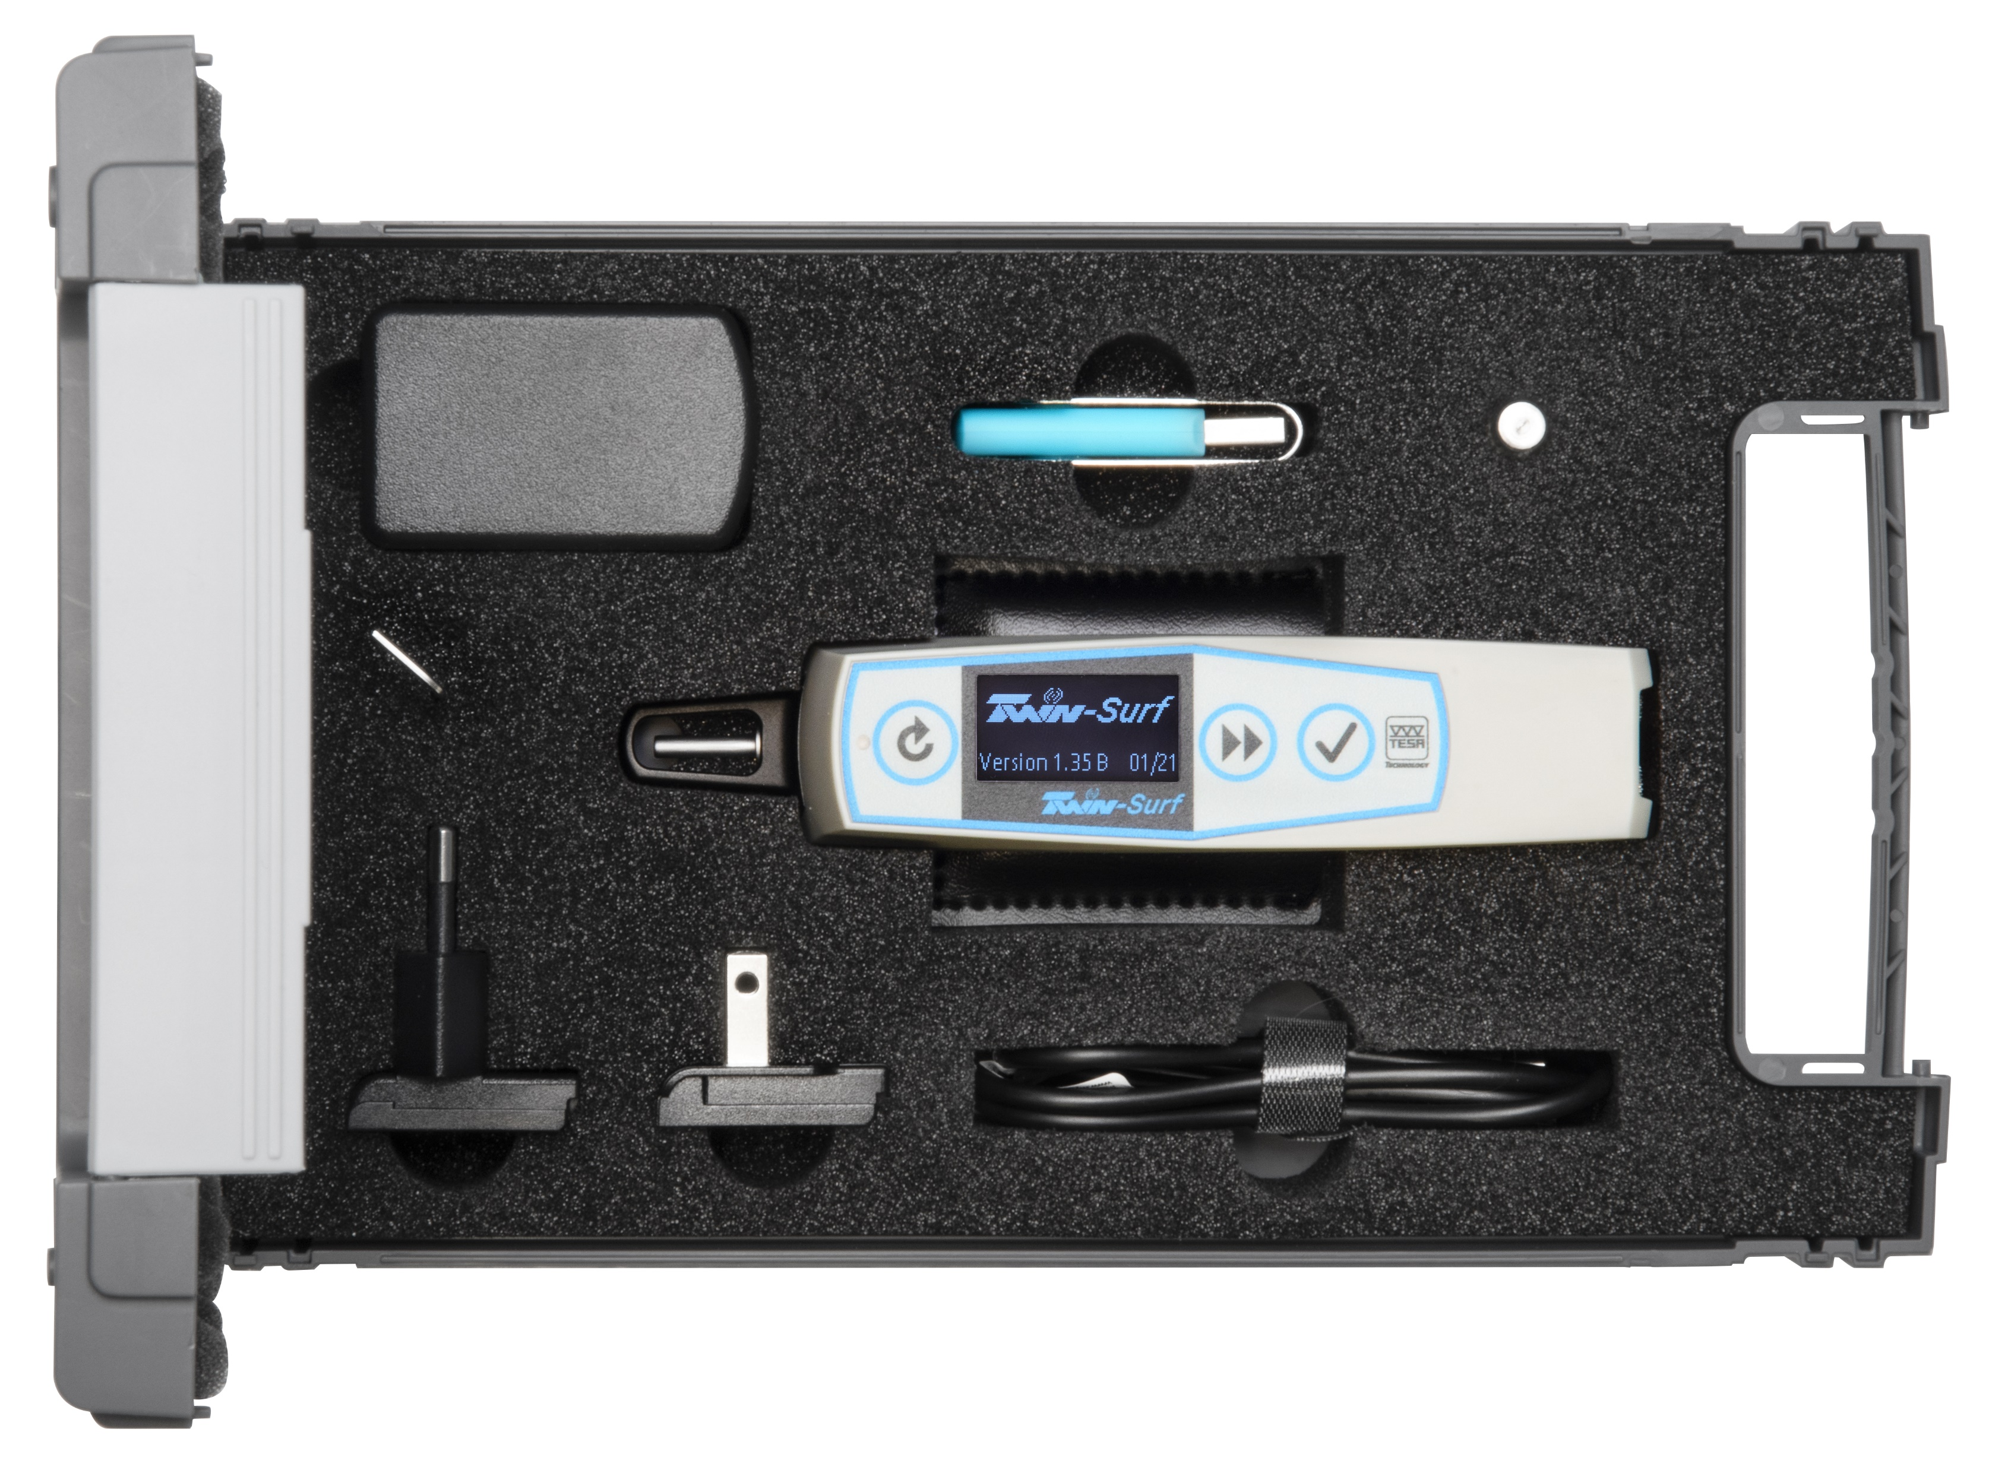
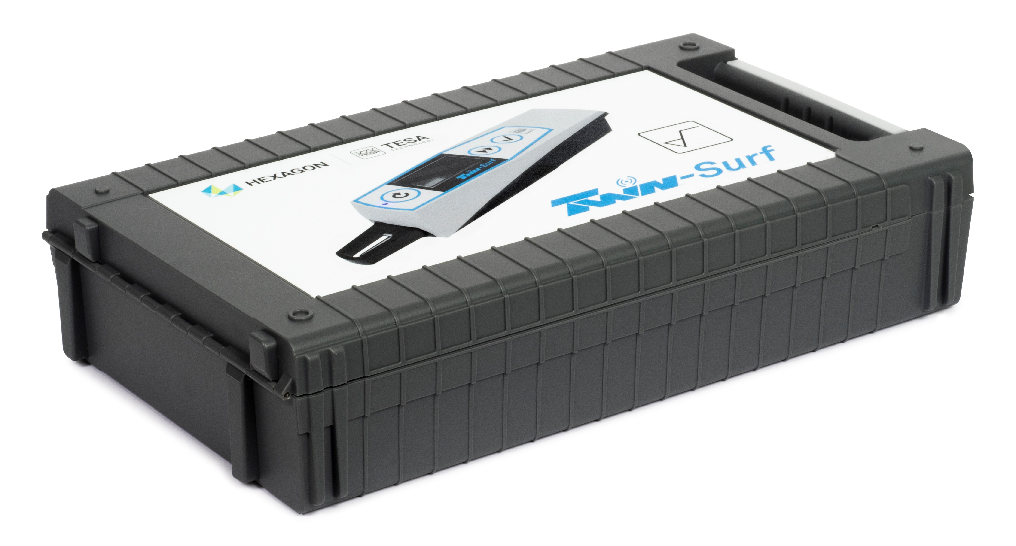
Scope of delivery
TESA TWIN-SURF 06930014 | TESA TWIN-SURF BT (integreated Bluetooth®) 06930015
TWIN-SURF portable roughness gauge
SB 51 probe
Main charger with EU and US charger adaptor
Roughness setting standard Ra = 2,97 µm
Adaptor for 8 mm diameter holder
Key to remove the probe protection
USB A-C cable
USB key including: User manual Measuring report Declaration of conformity TESA DATA-STUDIO software (basic version)

Slide 5
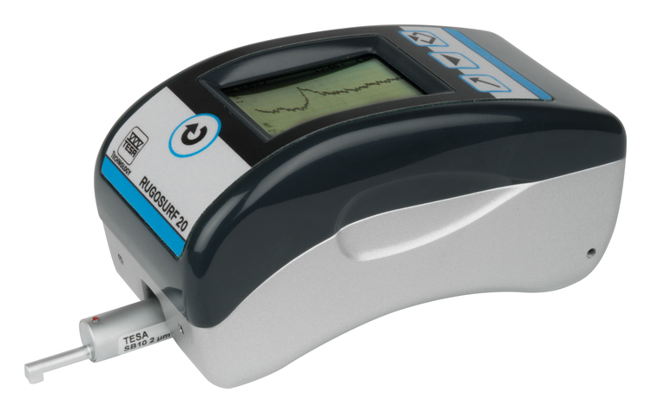
TESA DATA-STUDIO software
TESA DATA-STUDIO | Basic version (no icence) | Premium version (with licence) Part N° 06960091
Parameters | 13 parameters | 51 parameters
Charts | Roughness R | R, P, Rk
Code management | Max 10 codes | Unlimited
Statistics | Max 10 mesurements | Unlimited
Functions
Display of roughness profiles
Storing of values
Save codes with custom measuring settings
Customized report in EXCEL or PDF with company logo
Compatible RUGOSURF 20

Slide 6
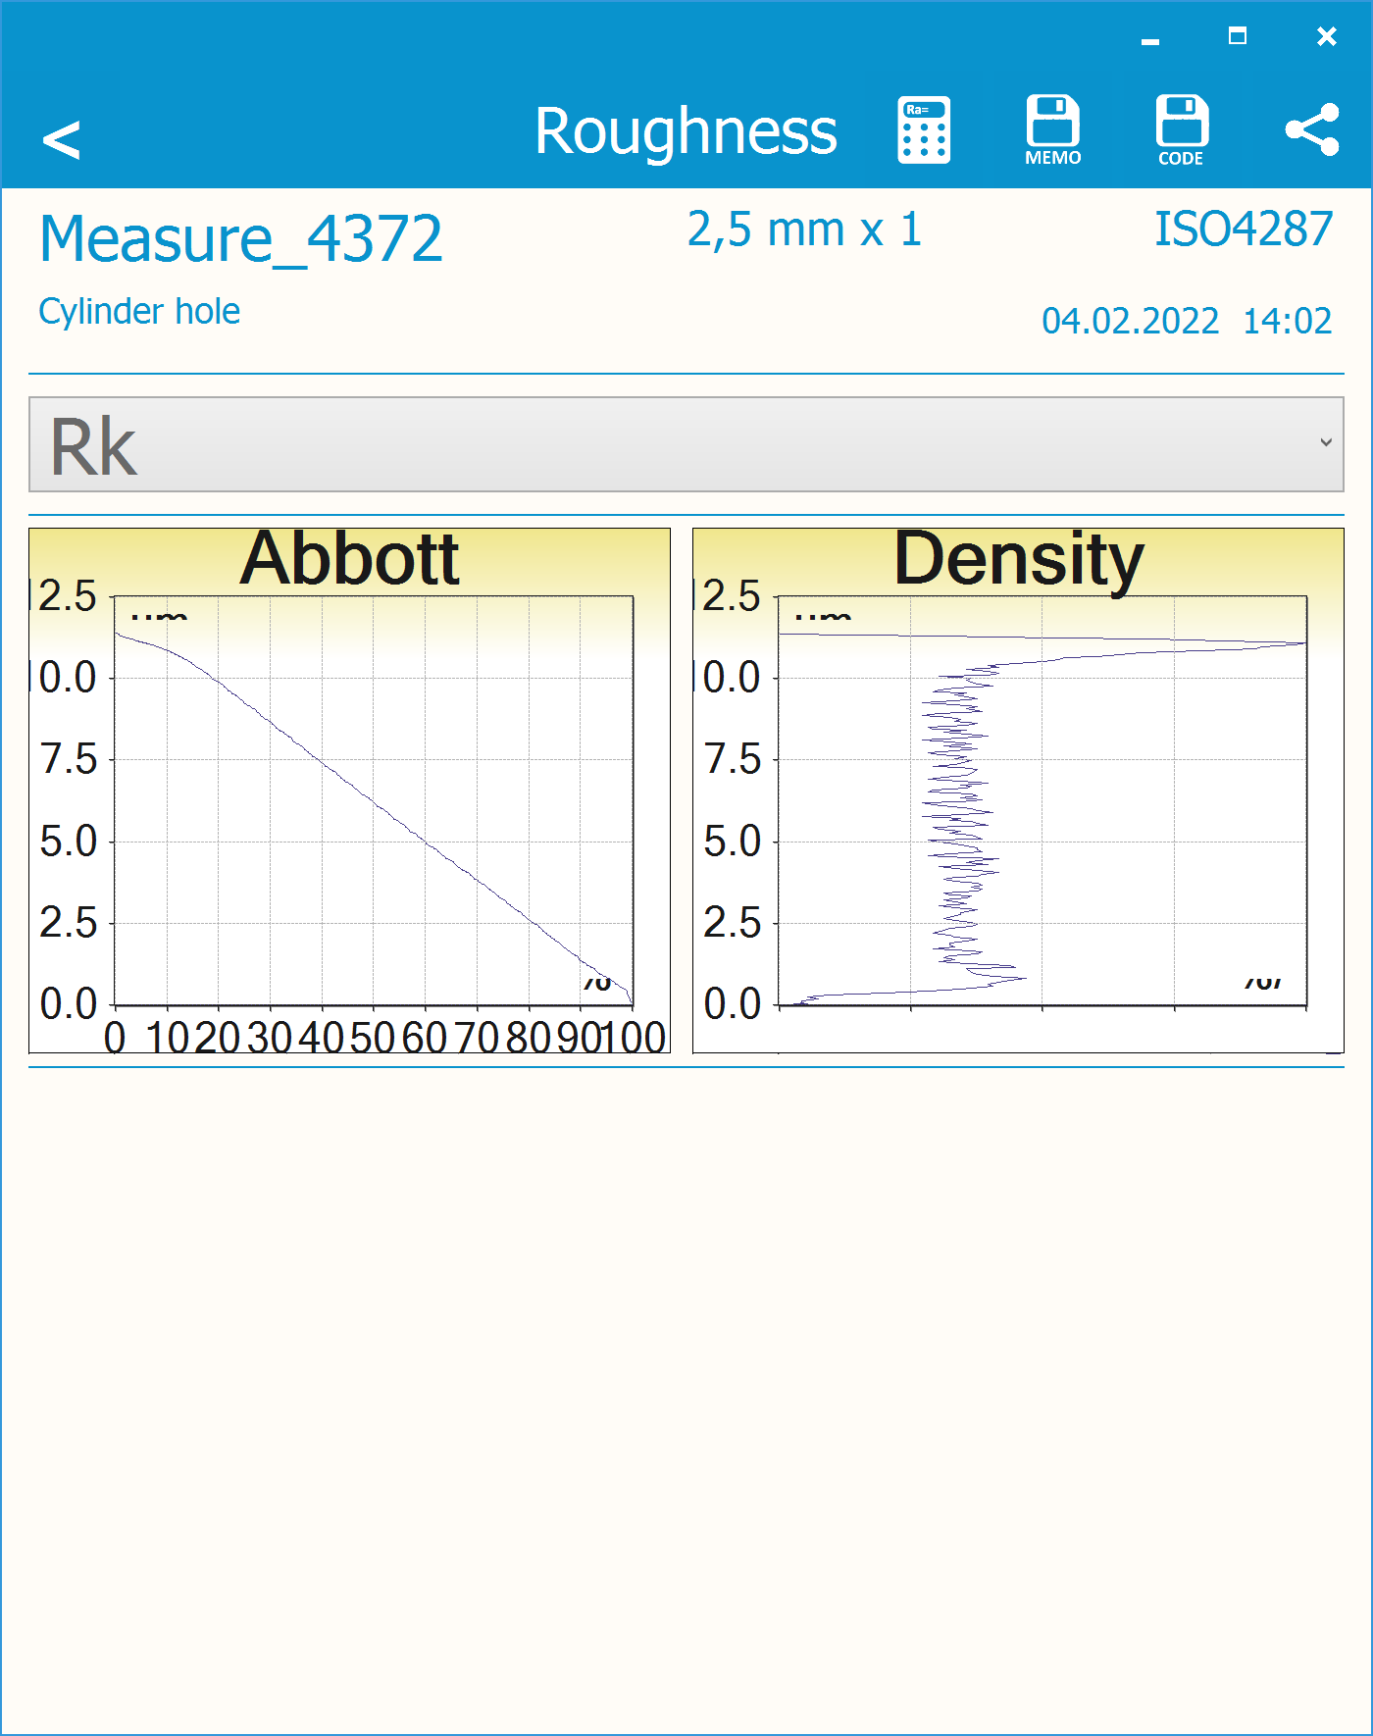
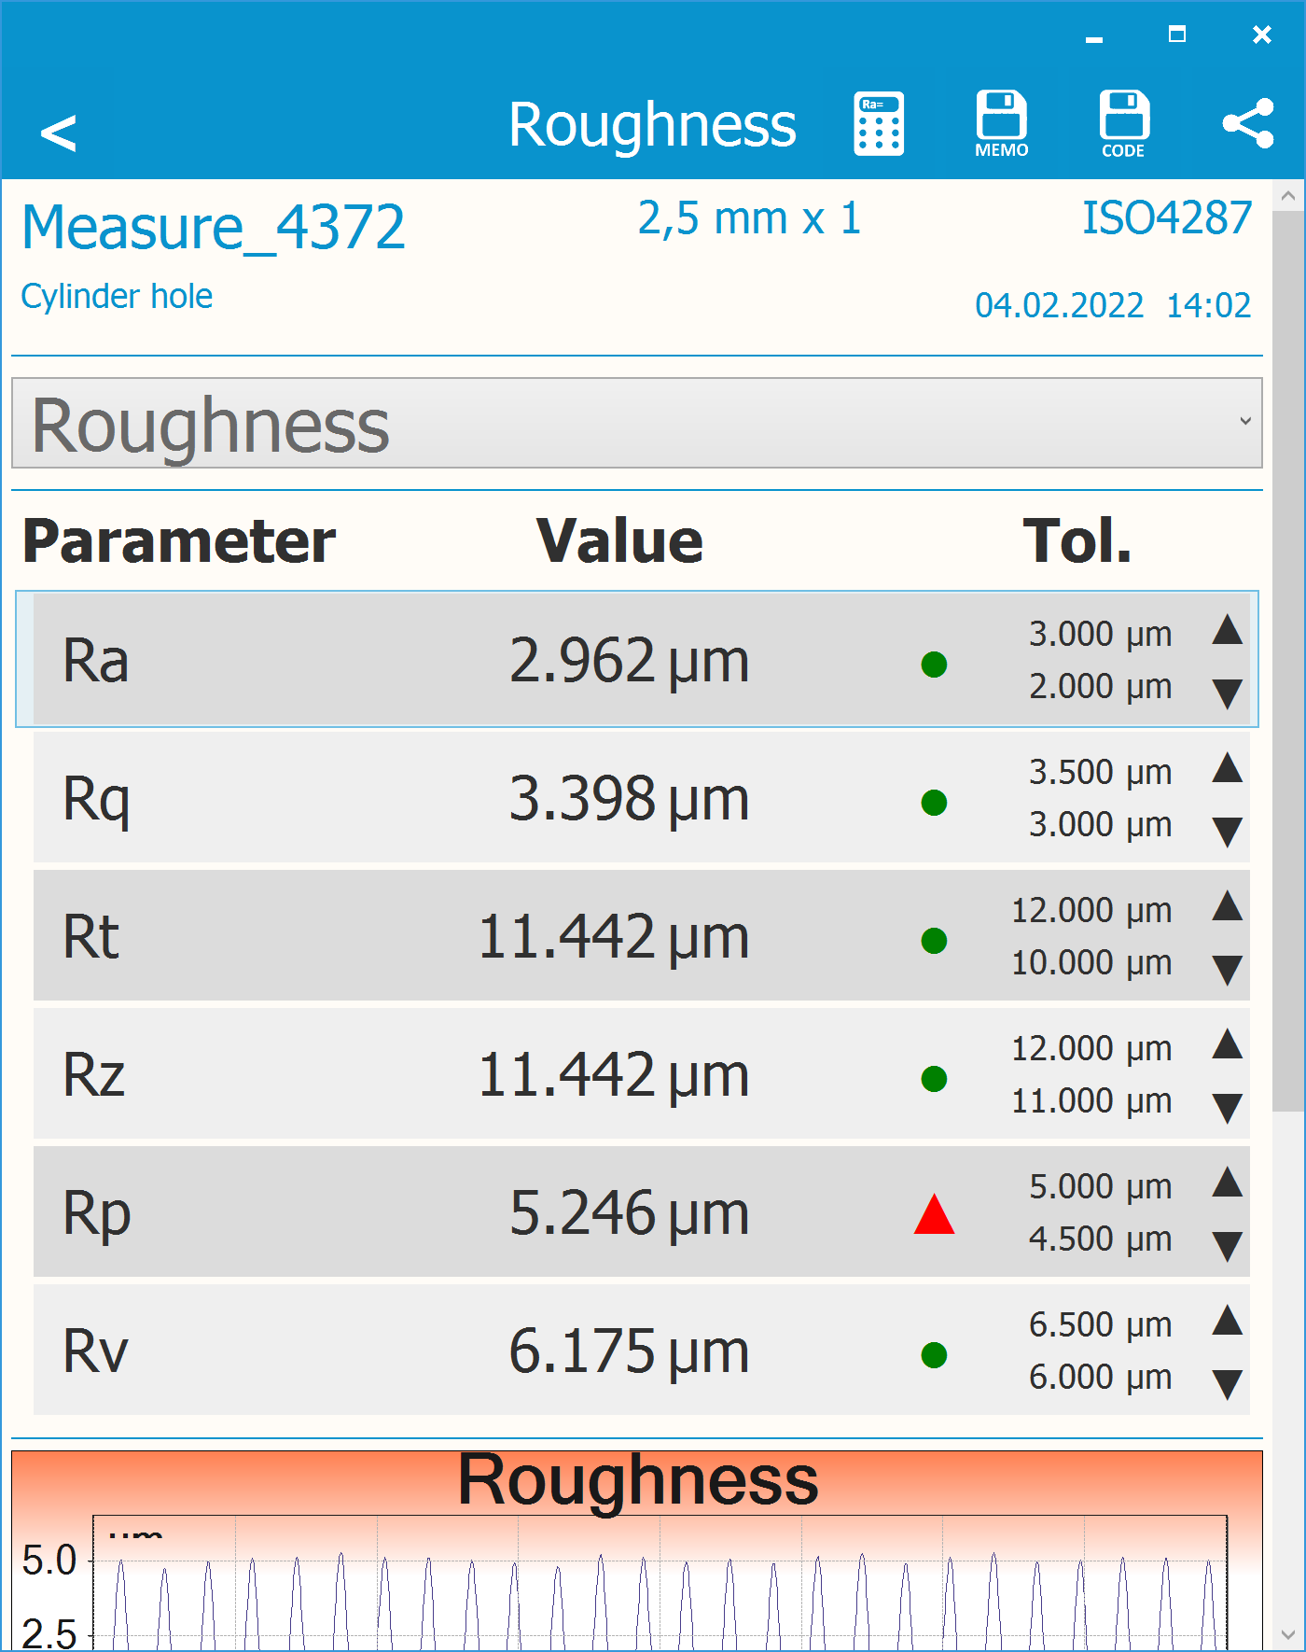
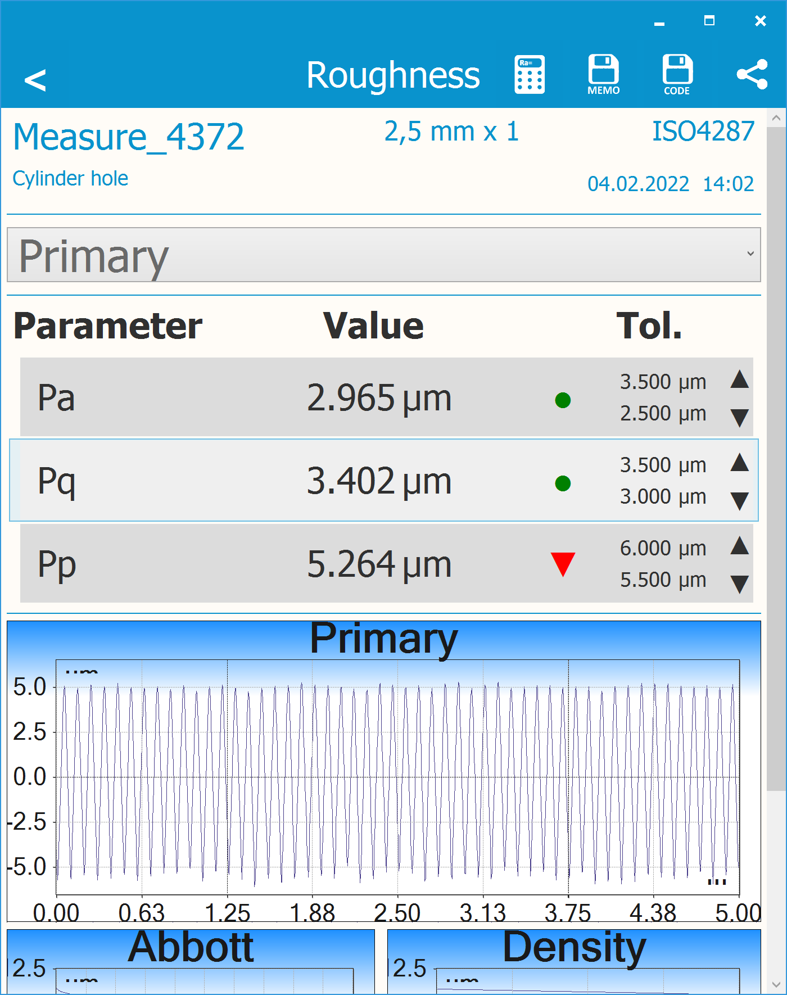
TESA DATA-STUDIO software
Display of roughness profiles

Slide 7
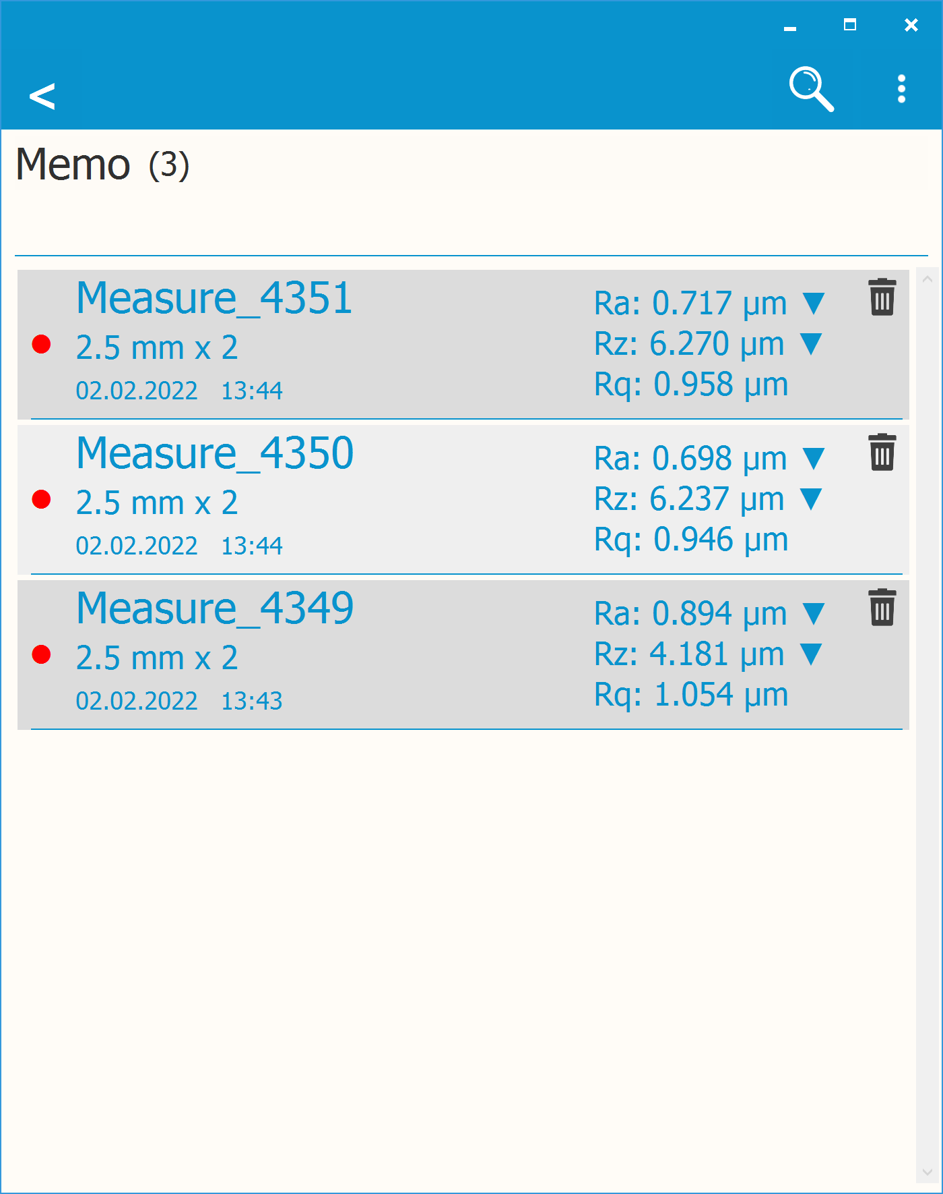
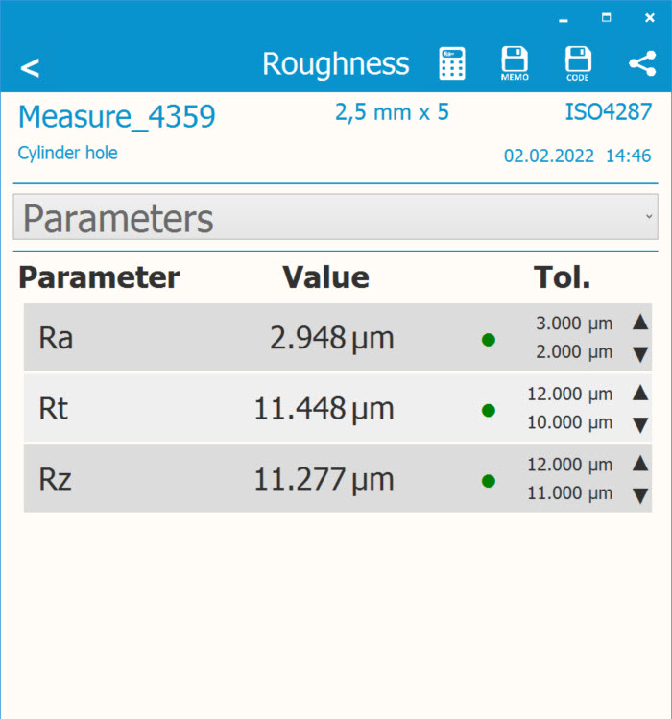
TESA DATA-STUDIO software
Store of values

Slide 8
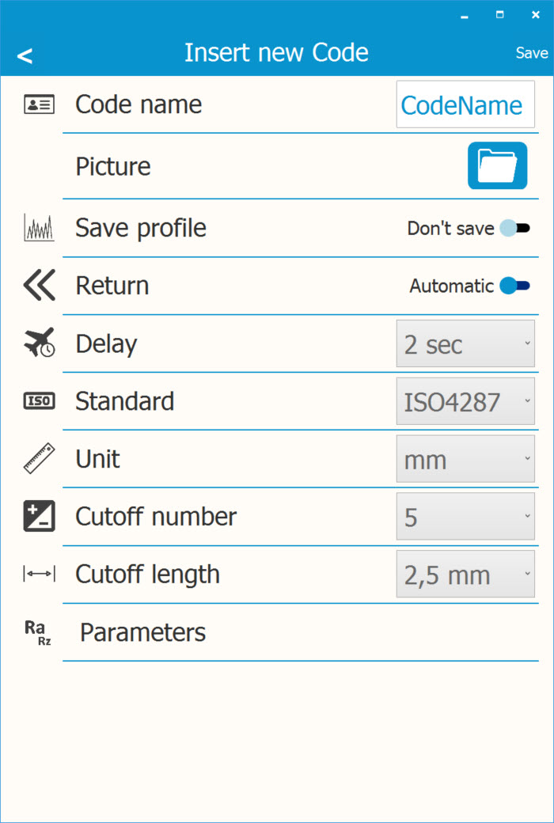
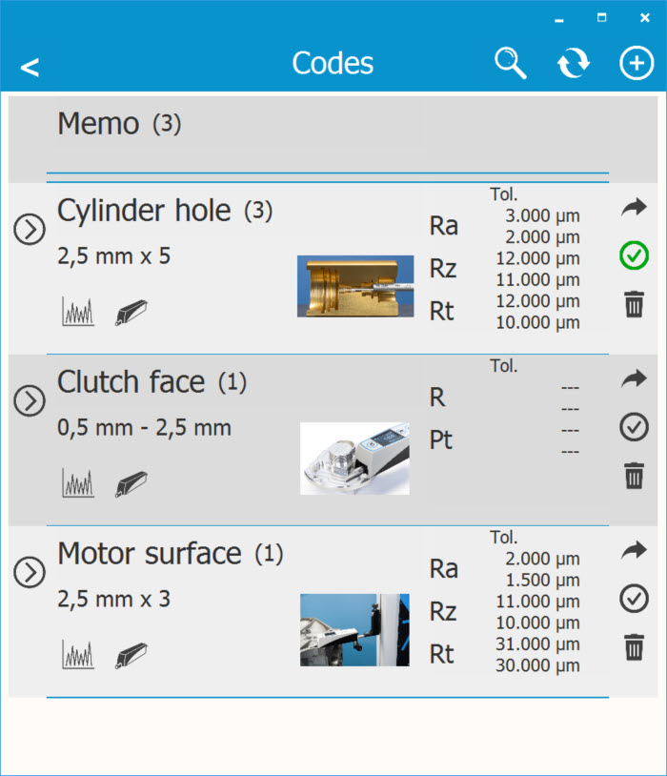
TESA DATA-STUDIO software
Save codes with custom measuring settings

Slide 9
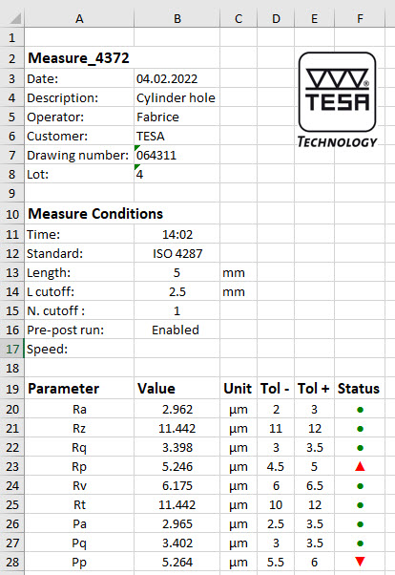
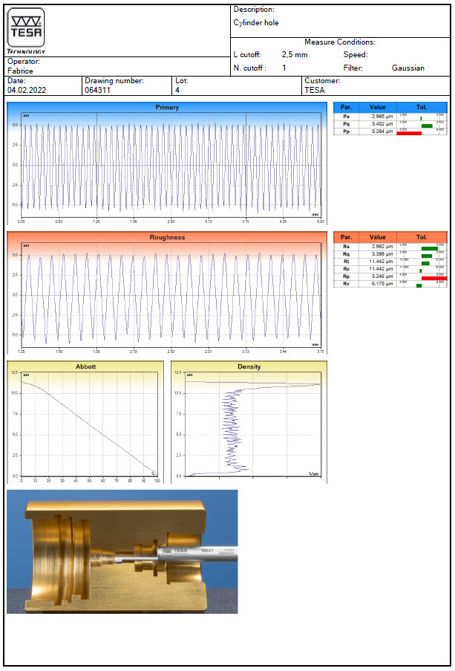
TESA DATA-STUDIO software
Customized report in EXCEL or PDF with company logo

Slide 10
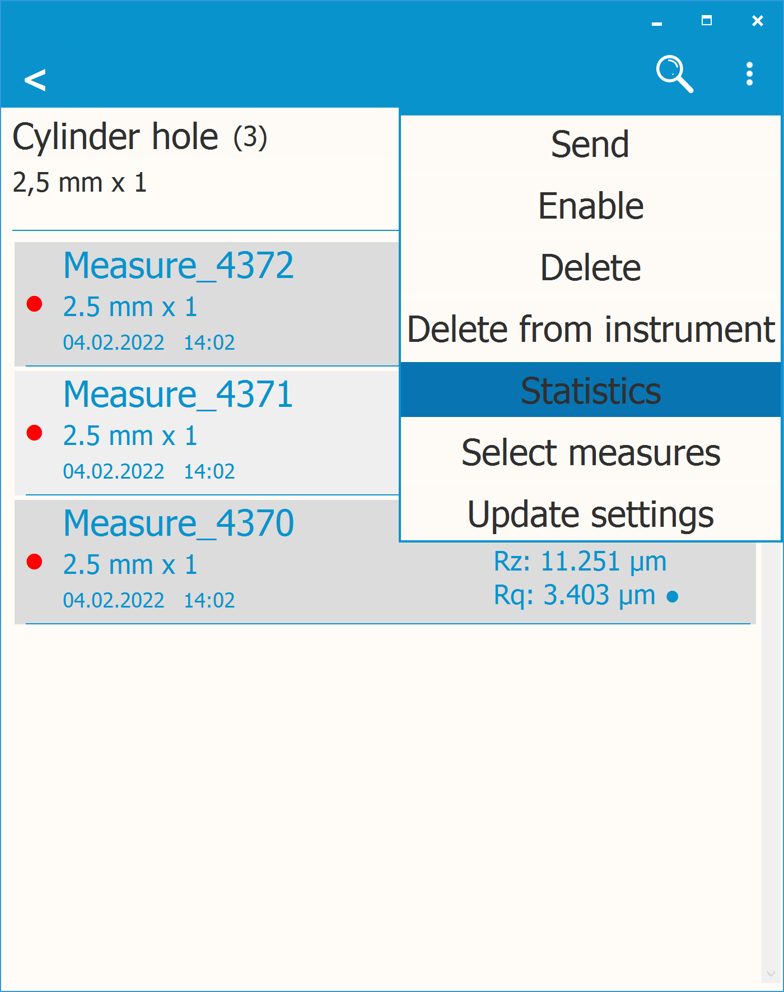
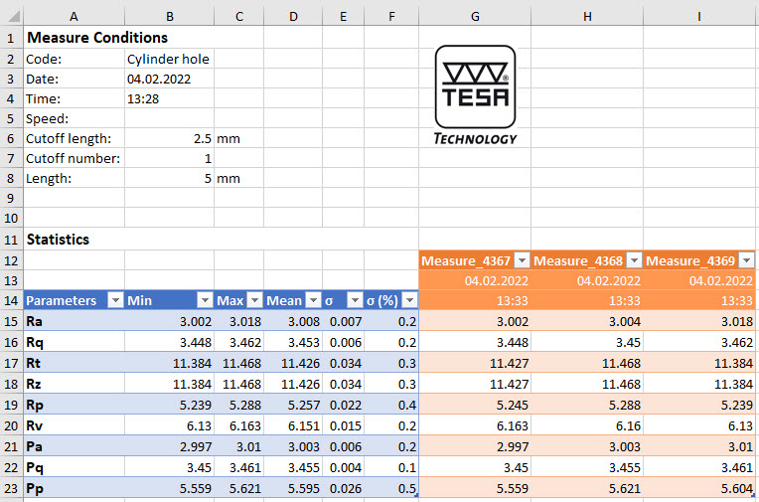
TESA DATA-STUDIO software
Statistics

Slide 12
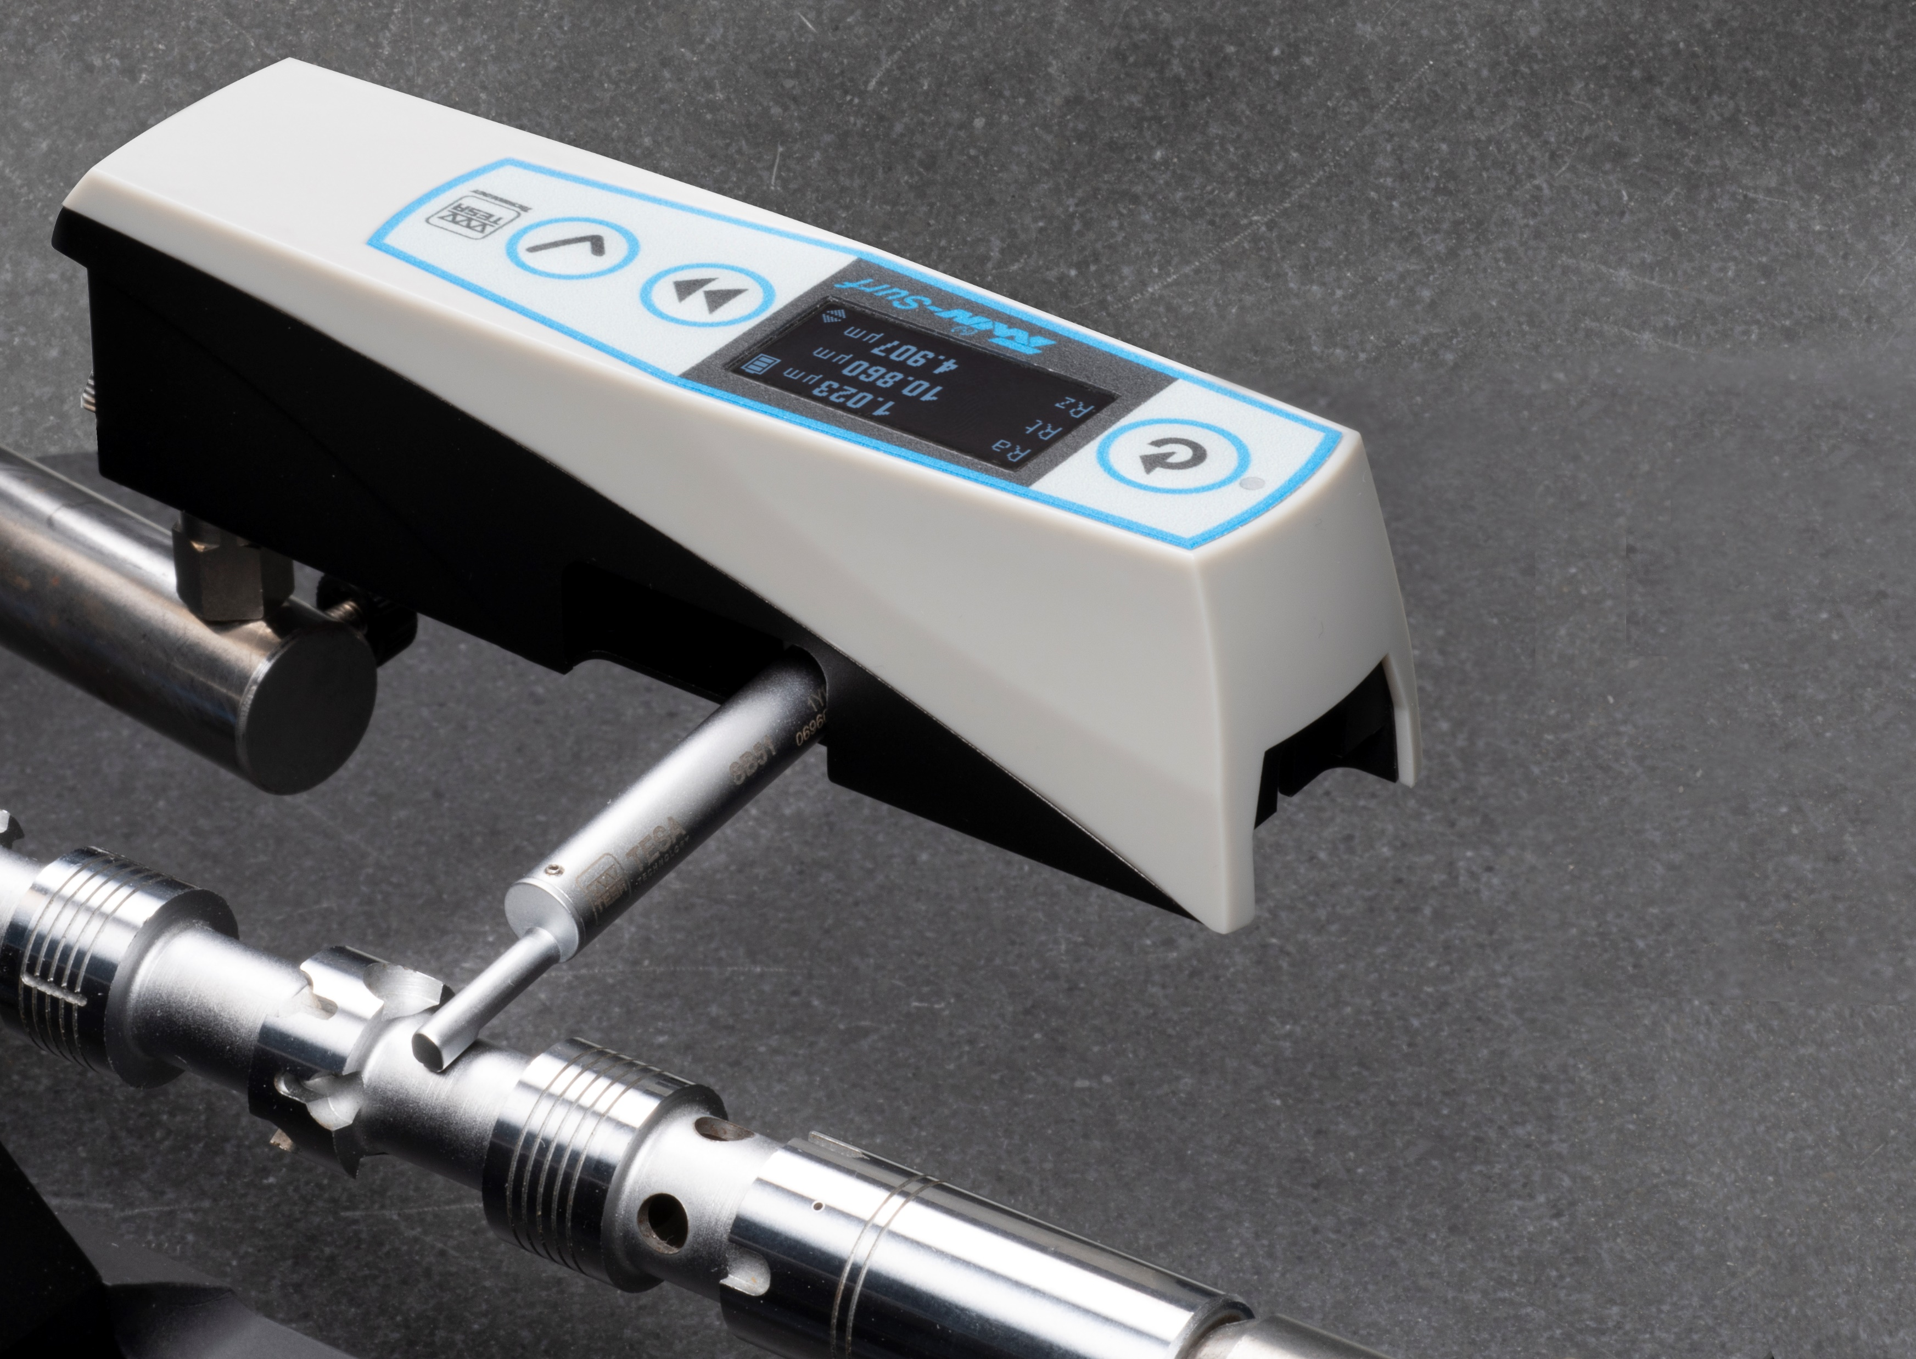
Transverse measurements SB51 probe

Slide 13
Applications
Small bores measurements
SB31 probe
Mesure transverales

Slide 14
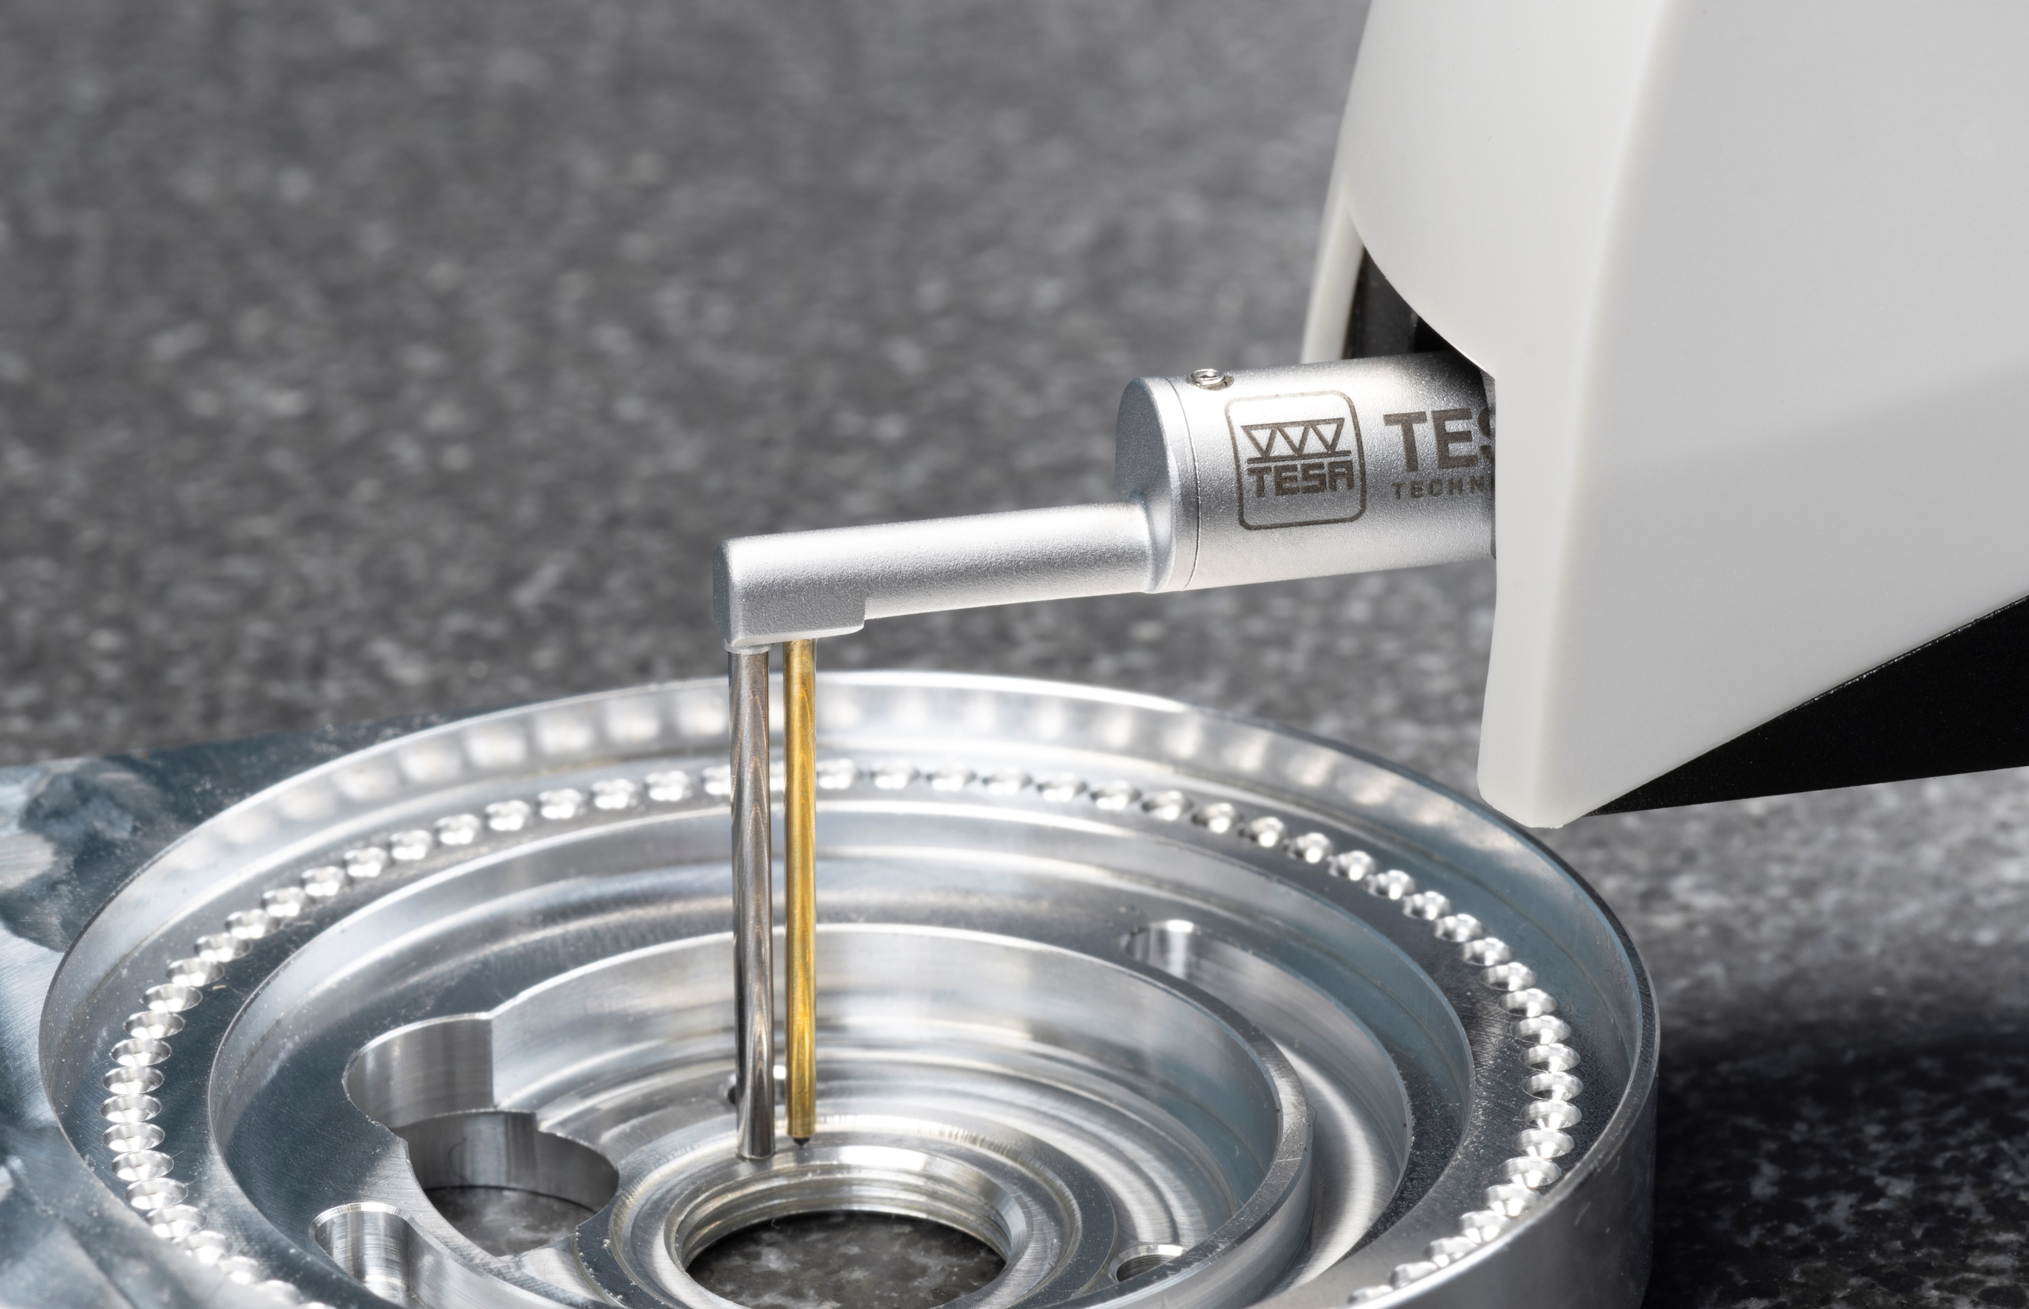
Depth groove
measurements
SB121 probe

Slide 15
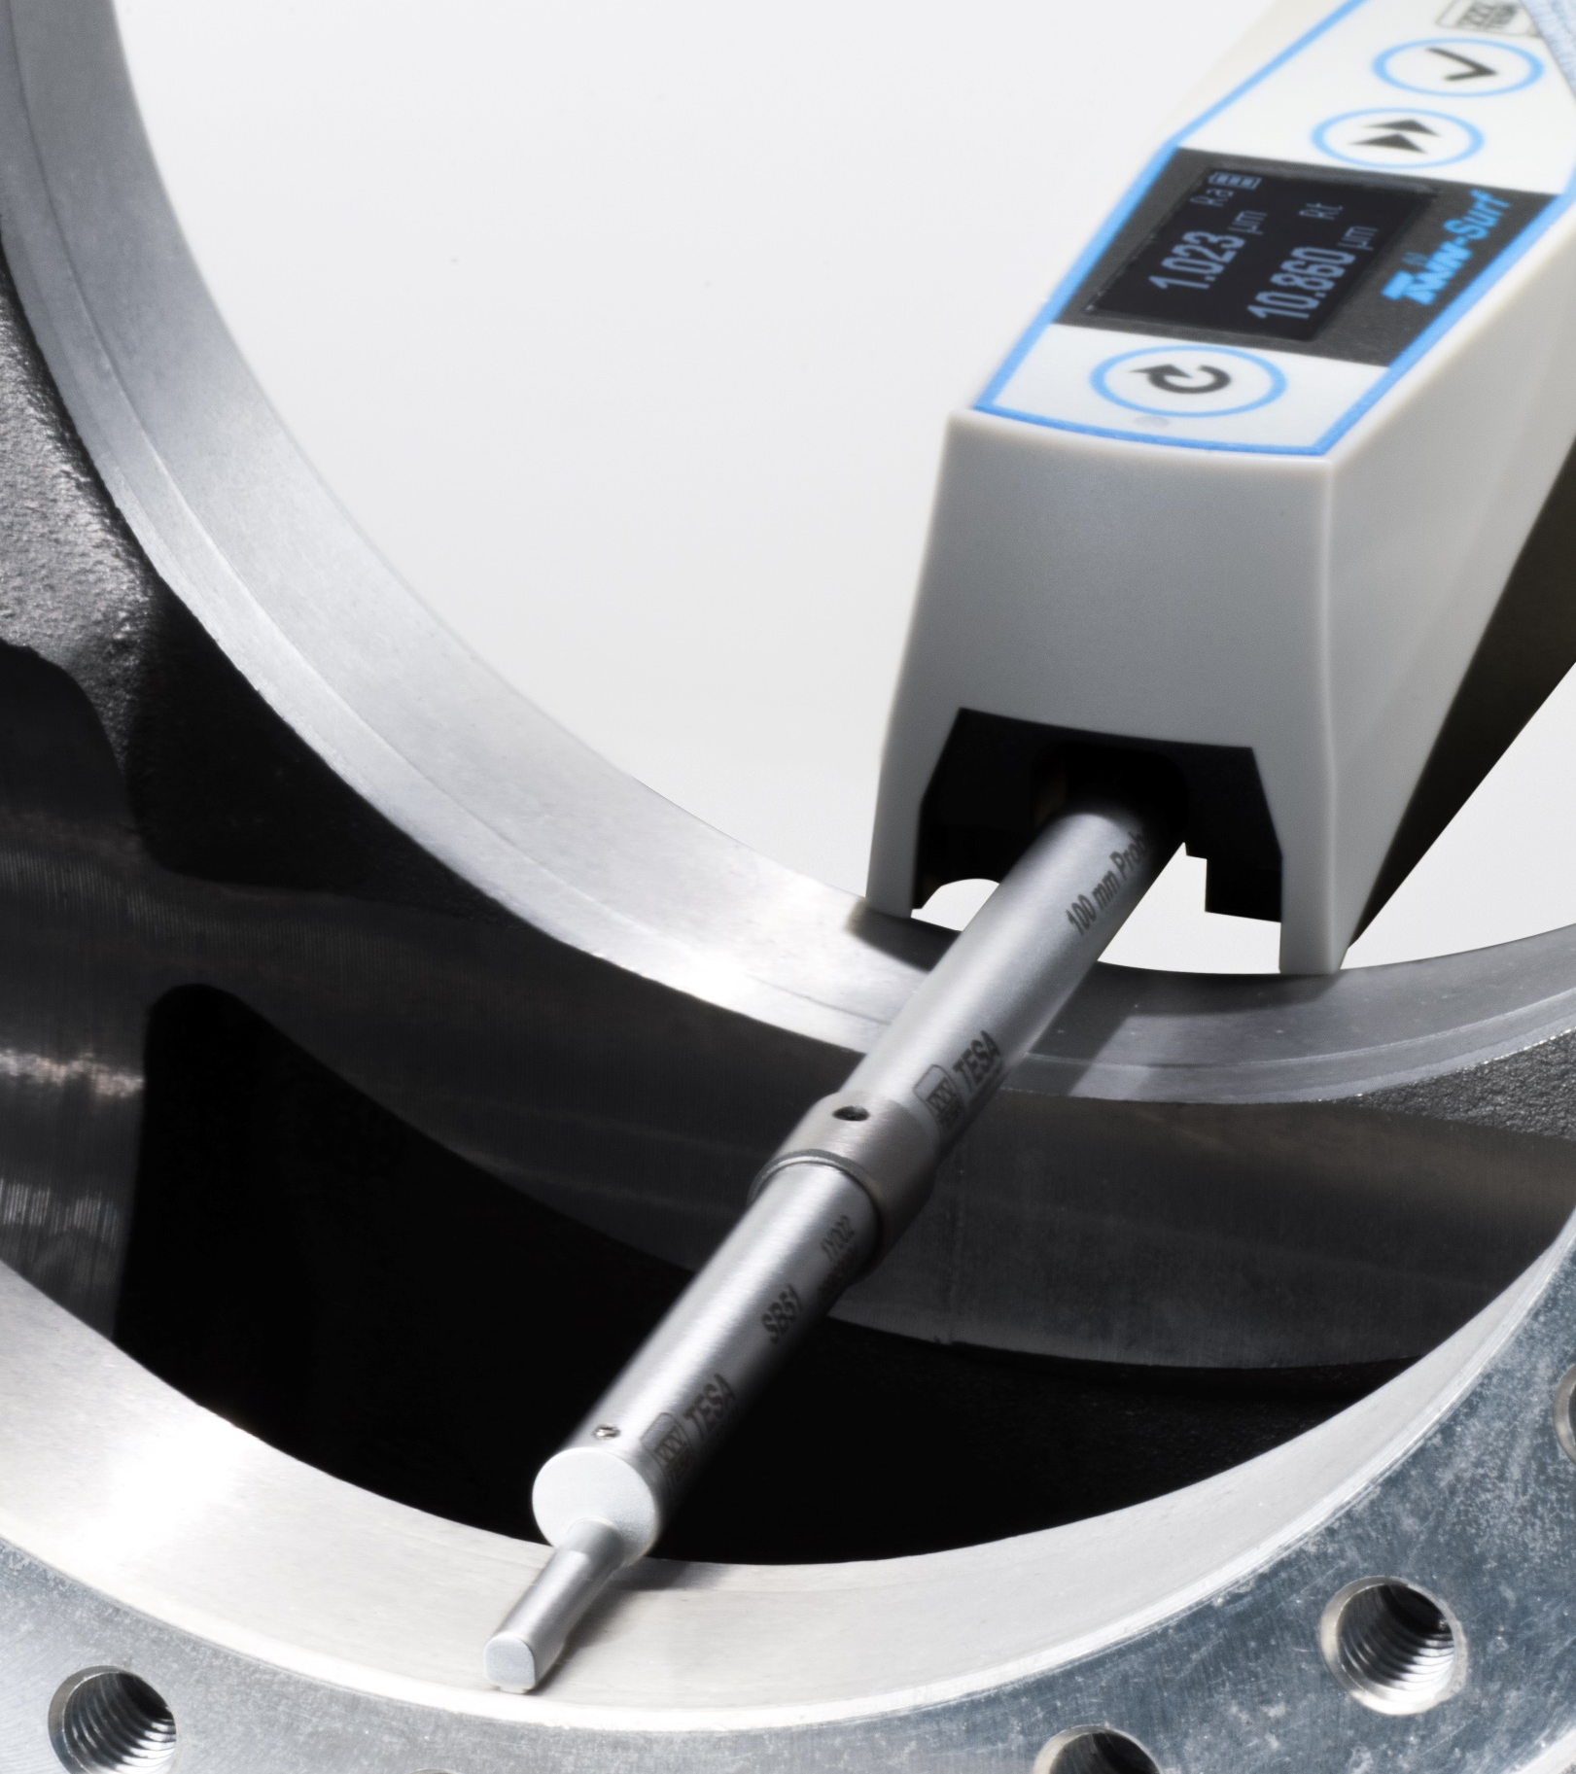
Measurement
with 100 mm extension

Slide 16
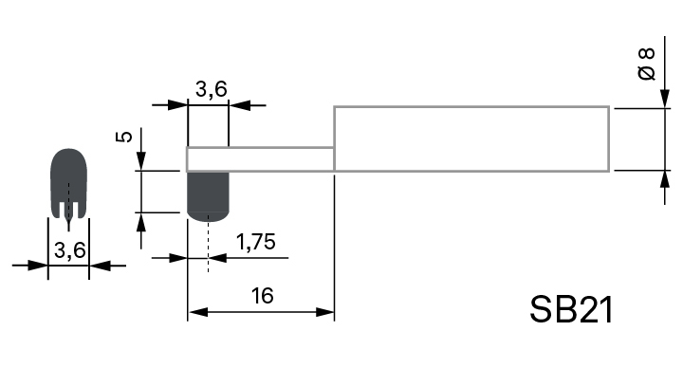
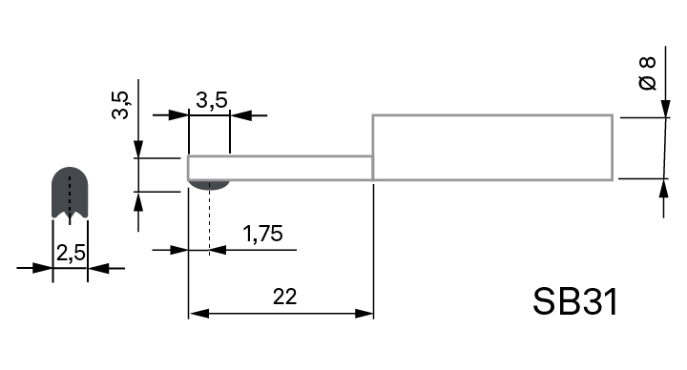
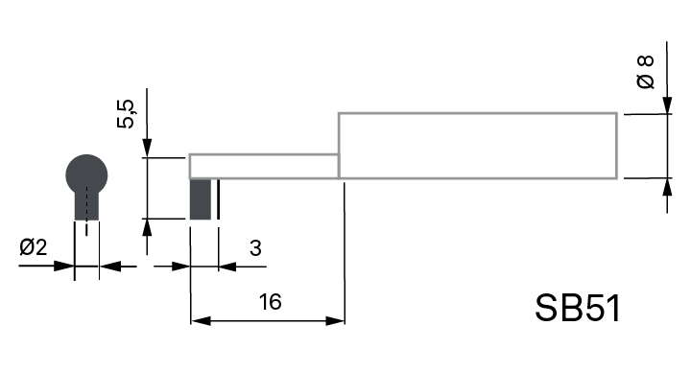
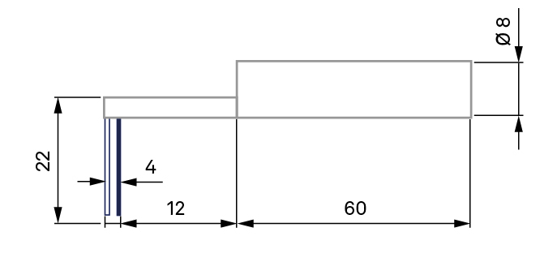
Probes
SB21 probe
SB31 probe
SB51 probe
SB121 probe
For groove of depth < 5 mm
For planes and holes
For small bores of Ø > 4 mm
Max depth 20 mm
For concave surfaces and for measuring at 90°
For groove of depth < 5 mm
For groove of depth < 20 mm

Slide 18
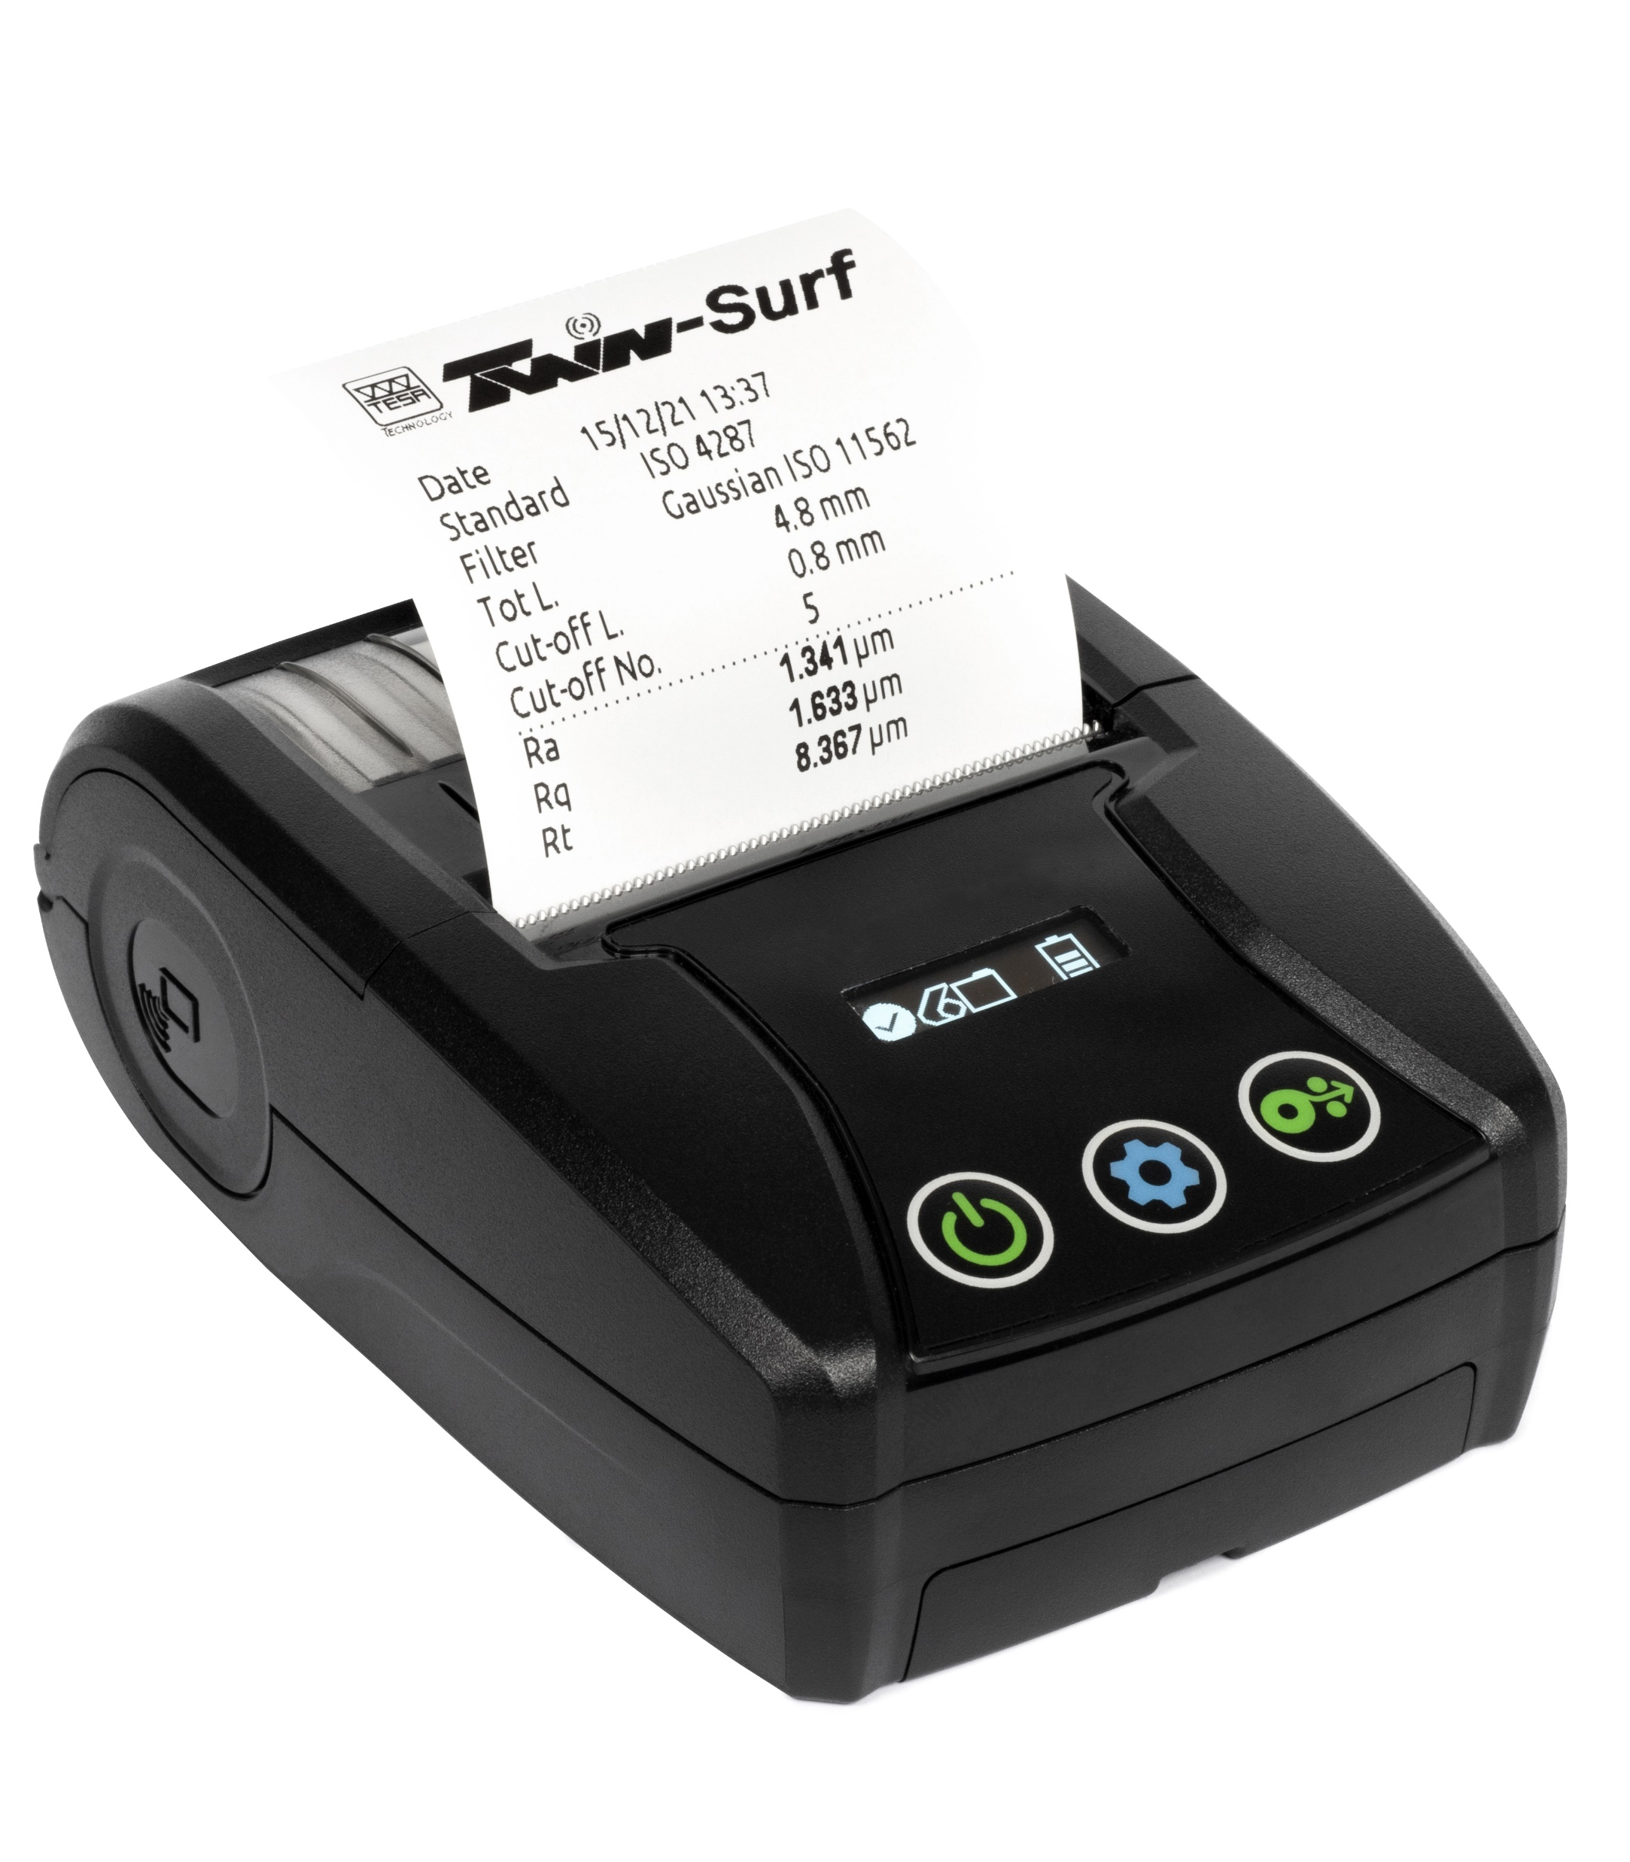
Printer
Powered with a rechargeable battery, connector USB type C
Cable USB type C included
Automatic connection to the TWIN-SURF once paired (pairing through DATA-STUDIO)
Only compatible with TWIN-SURF BT

Slide 19
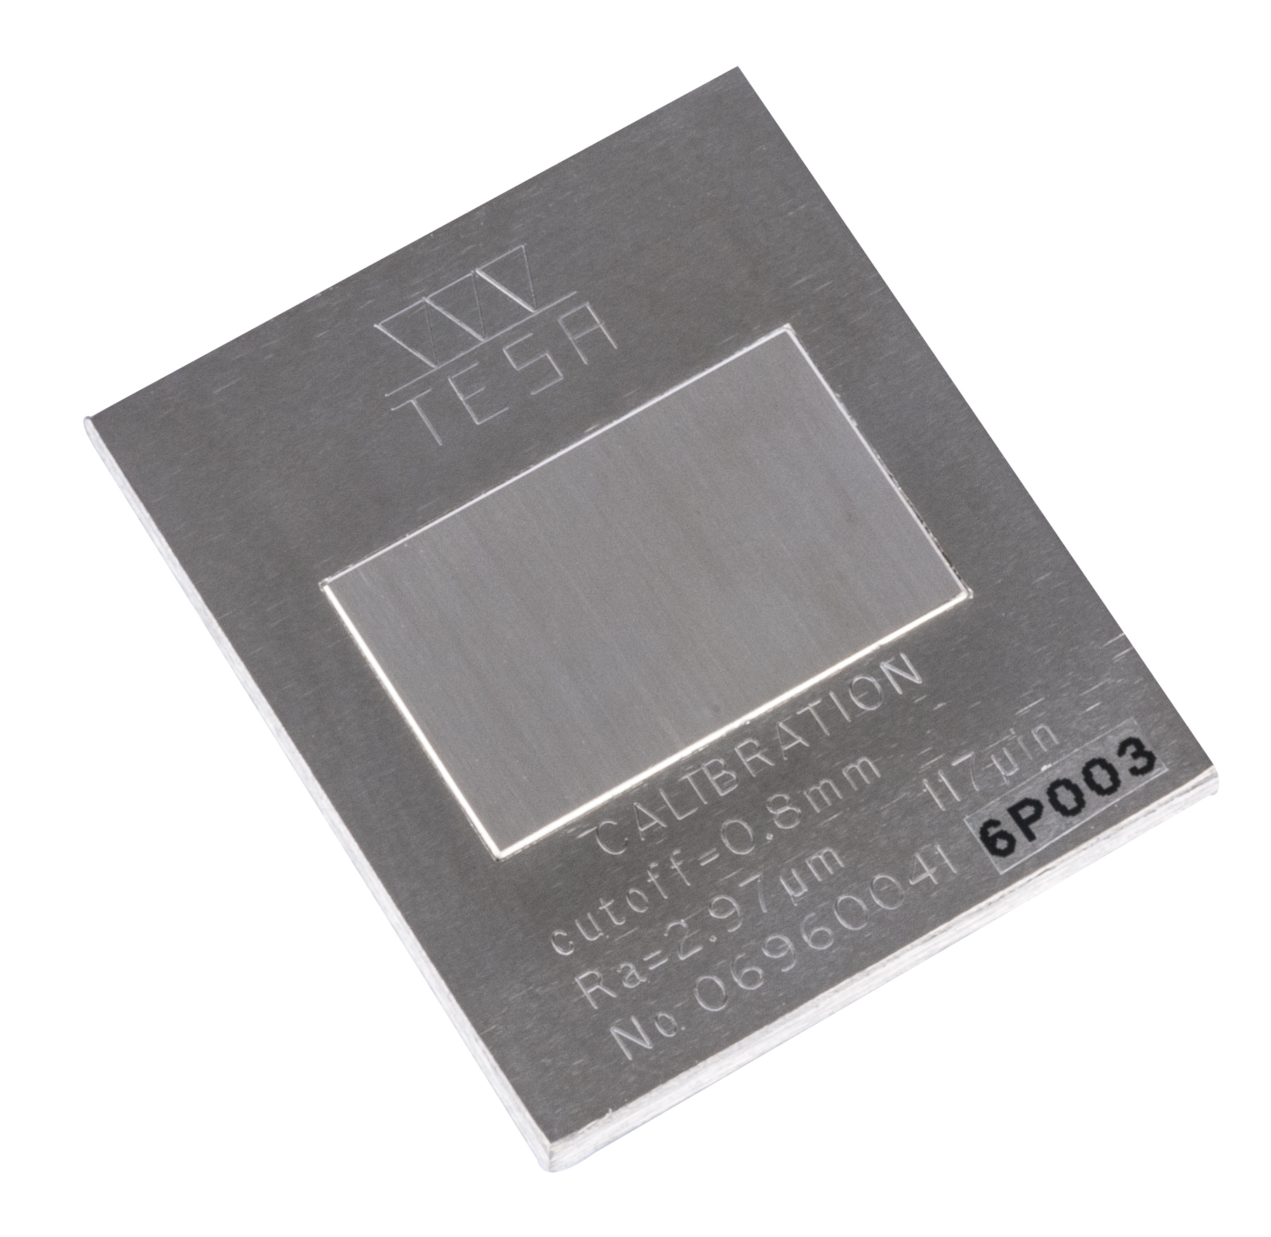
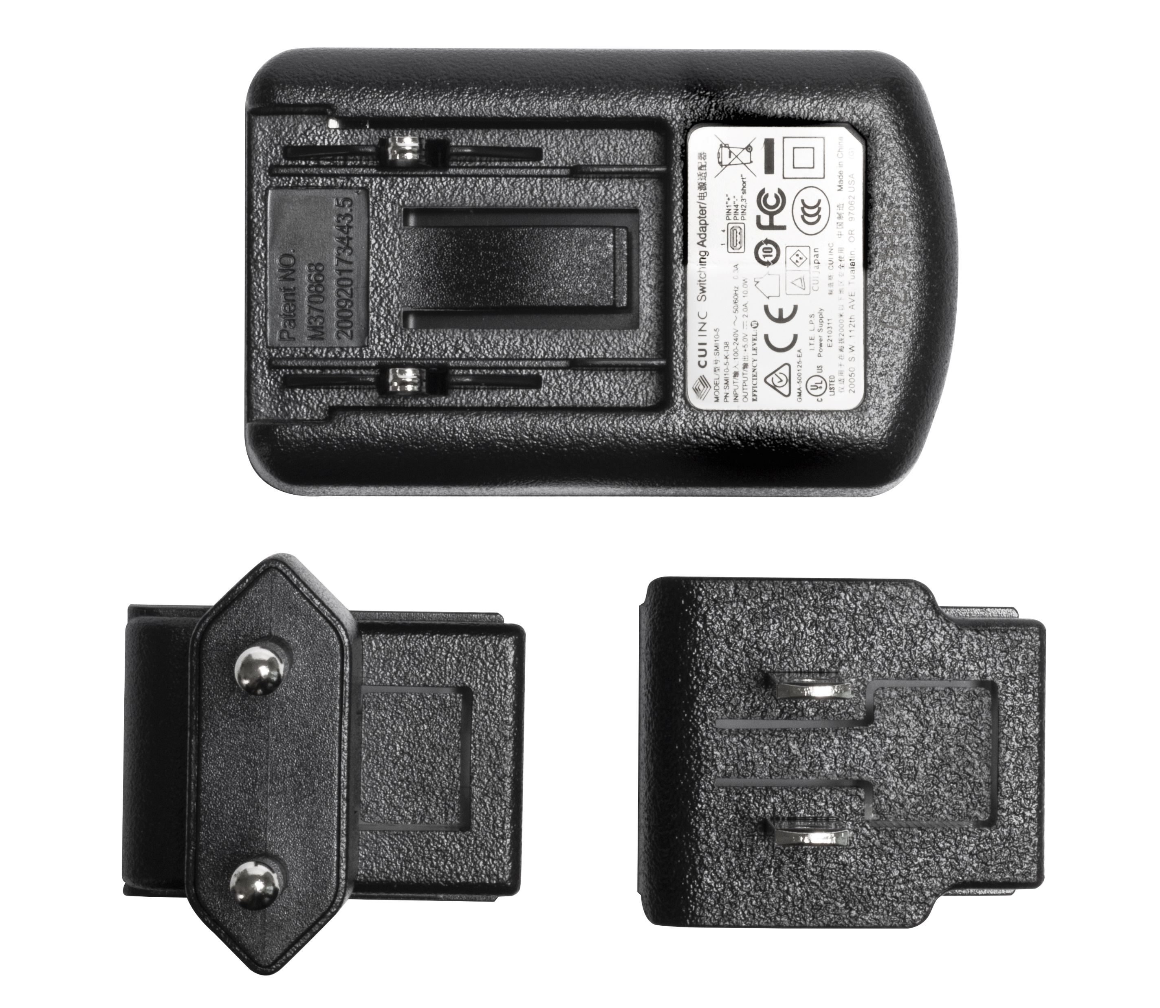
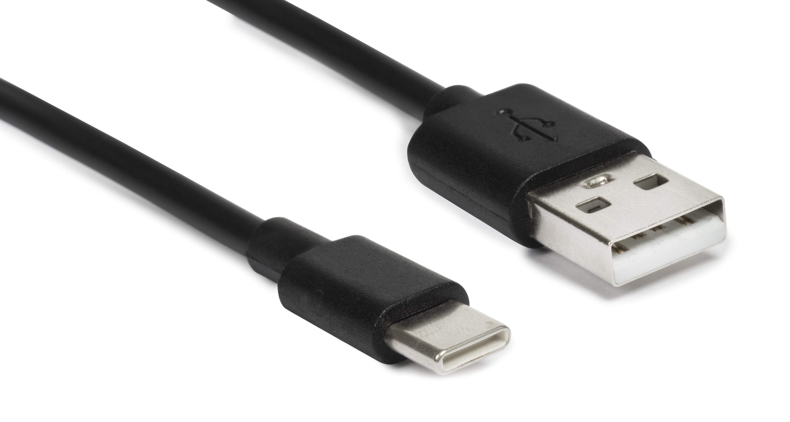
Roughness setting standard, Ra = 2.97 µm
Part number 06960041
Power supply
Part number 04760150
Extension 100 mm
Part number 06960096
Cable USB A-C
Part number 04760152

Slide 20
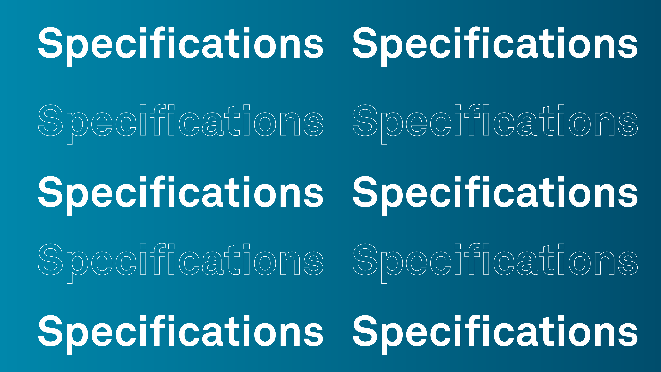

Slide 21
Specifications
Standards | According to ISO 3274 - ISO 4287 - ISO 12085
Parameters | Parameters according to ISO 4287: Ra – Rq – Rt – Rz – Rc - Rmax - RSm - RPc Parameters according to ISO 12085: Pt – R – AR – Rx – PPc Additional parameters with software TESA DATA-STUDIO Premium version (with license): Parameters according to ISO 4287: Rp – Rv – Rsk – Rku – RΔq – RΔa – Rmr rel – Rδc – Rmr(c) Pa - Pq - Pp – Pv – Pt – Pc – RPc - R3z Psk – Pku - PSm- PΔq - Pmr rel – Pδc – Pmr (c) Rk – Rpk – Rvk - A1 – A2 - Mr1 – Mr2 Parameters according to ISO 12085: Rke – Rpke – Rvke - A1e – A2e – Mr1e – Mr2e
Max permissible error | 0,05 µm + (5 % R), R = Roughness in µm
Diamond-like stylus | R=2 µm, 90°

Slide 22
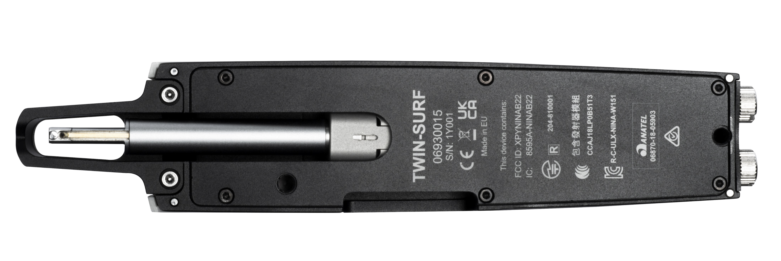
Specifications
Keyboard | Three-key tactile keyboard protected against dust particles and oil splashes IP67
Display | OLED display monochromatic 128x64 pixels
Dimensions | 160 x 34 x 34 mm (roughness gauge alone)
Poids | 200 g
Countries for which the wireless transmitter is approved (For TWIN-SURF BT 06930015) | EU, USA, Canada, Japan, China: Taiwan region only, South Korea, Brazil, Australia and New Zealand. For other countries, please contact us.

Slide 23
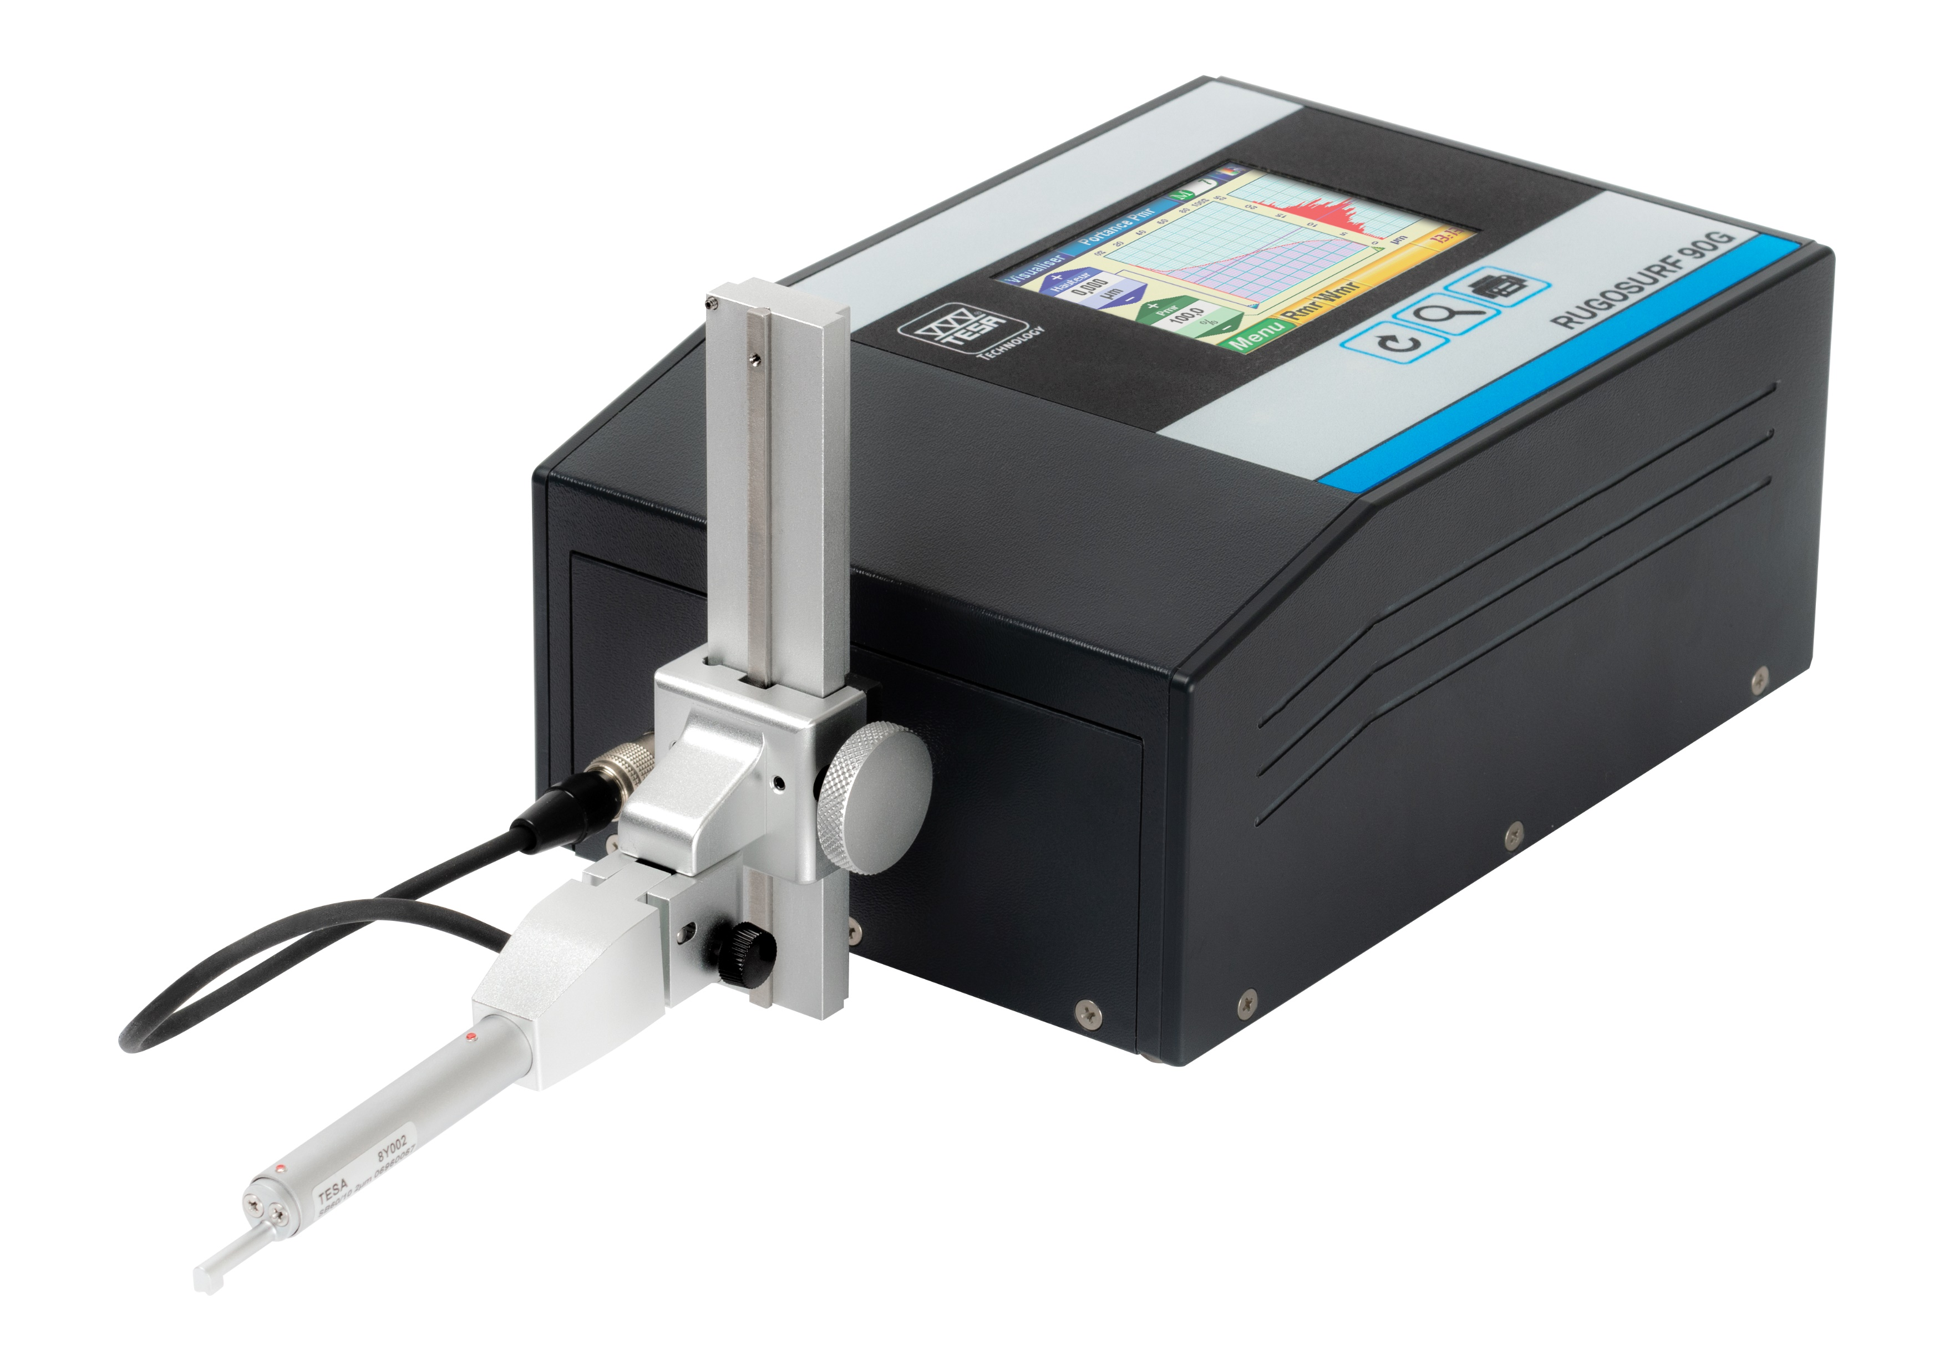
Portable Roughness tester range
 | MEASURING RANGE |  | PARAMETERS | PROFILE TYPE |  |  | SKID |  | ADDITIONALS FEATURES
 | X axis | Z axis
 |  |  |  | R | P | W | with | without
RUGOSURF 20 06930013 | 16mm | 400µm | 13 | ✓ | ✓ | ✗ | ✓ | ✗ | Compatible DATA-STUDIO
TWIN-SURF 06930014 | 16mm | 400µm | 13 | ✓ | ✓ | ✗ | ✓ | ✗ | Transversal measurements Wireless model Compatible DATA-STUDIO Compatible portable printer
RUGOSURF 90G 06930012 | 50mm | 1000µm | 47 | ✓ | ✓ | ✓ | ✓ | ✓ | Transversal measurements Compatible Meas. - STUDIO Profile Set available Special probes available

Slide 24
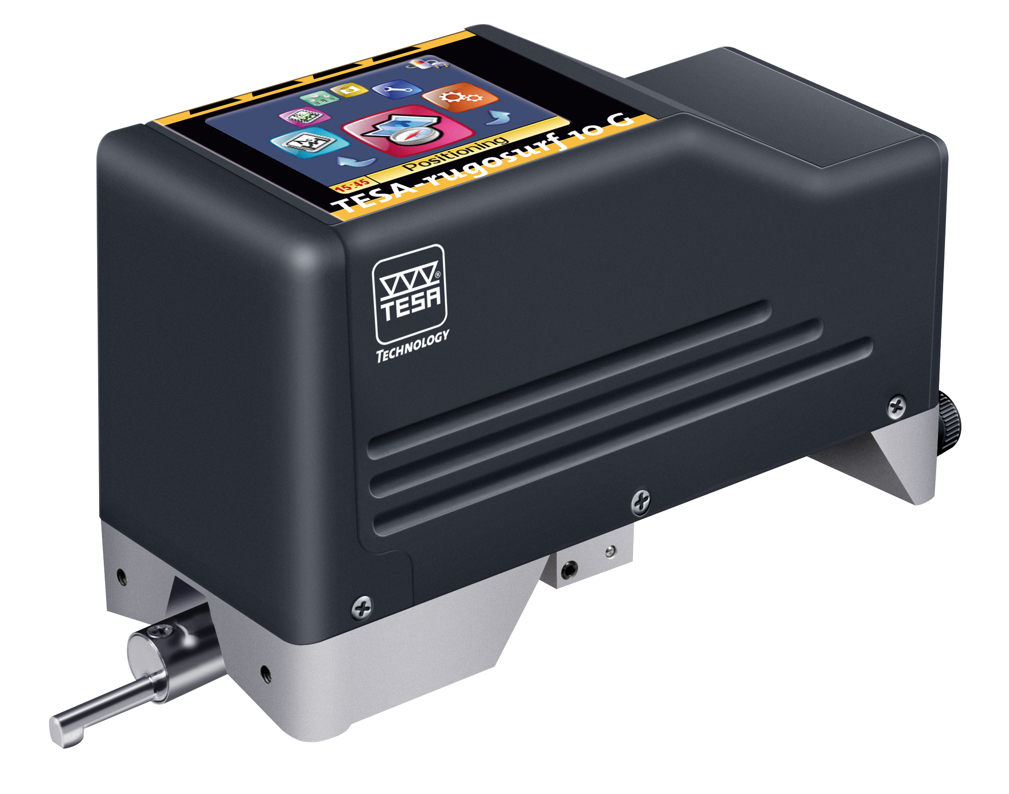
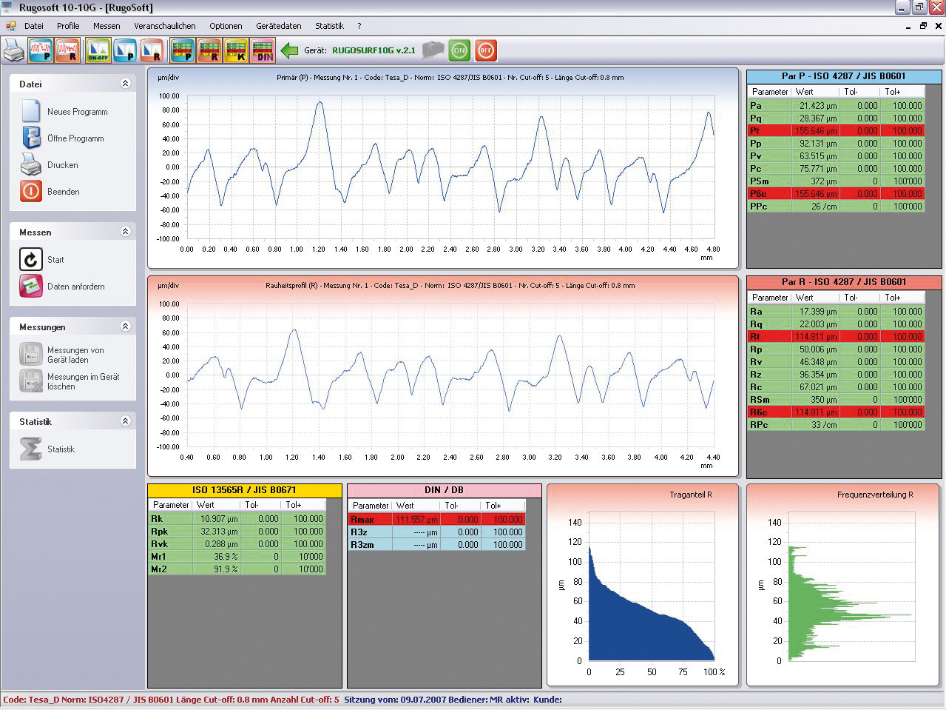
Phase IN / OUT
RUGOSURF 10G
Part number 06930011
Orders available until End of year 2022
Replaced by 06930014
Software RUGOSOFT
Part number 06960034
Order until stock Ends
Replaced by 06960091

Slide 25
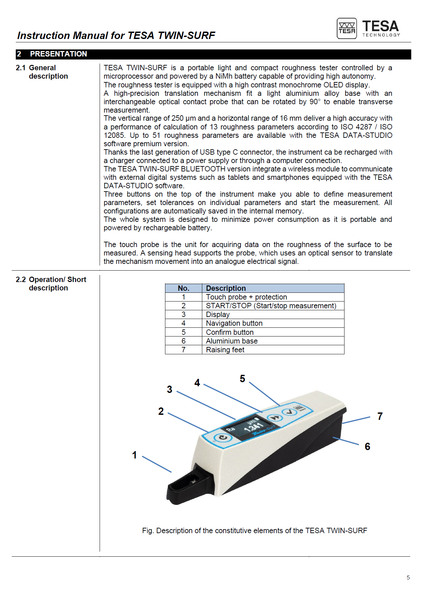
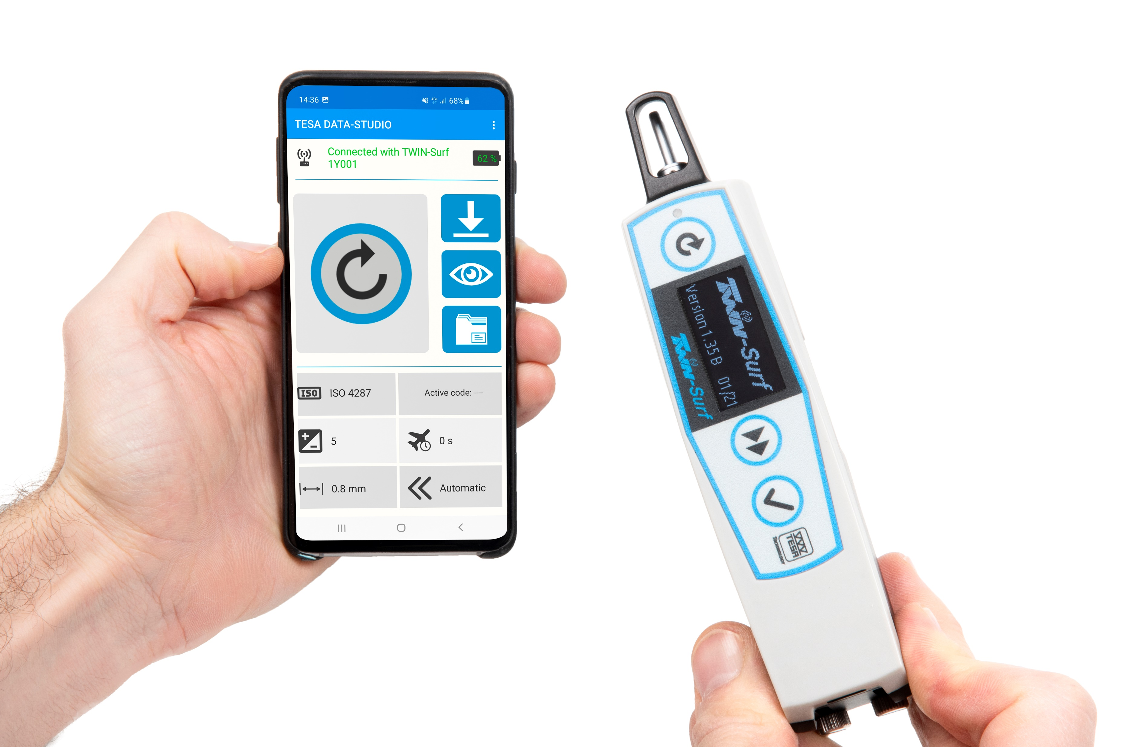
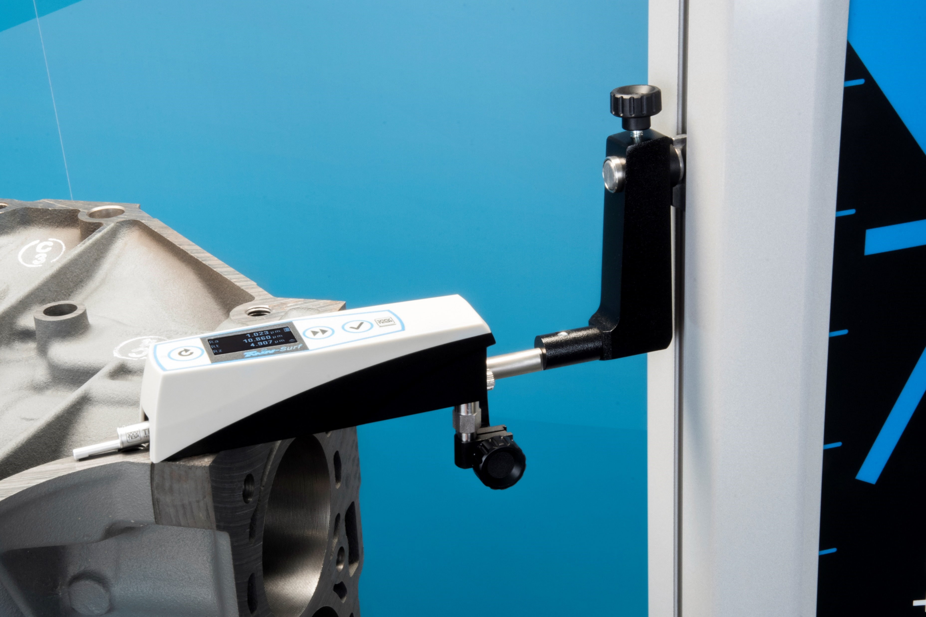
Launch pack
Onboarding document
Product info
User manual
Pictures

Slide 26
THANK YOU

