Slide 1
FULCRUM MANUAL CMM / 3D HEIGHT GAGE INTRODUCTION
Contact Fowler Preferred Distributor:
Willrich Precision: 866-945-5742 / sales@willrich.com

Slide 2
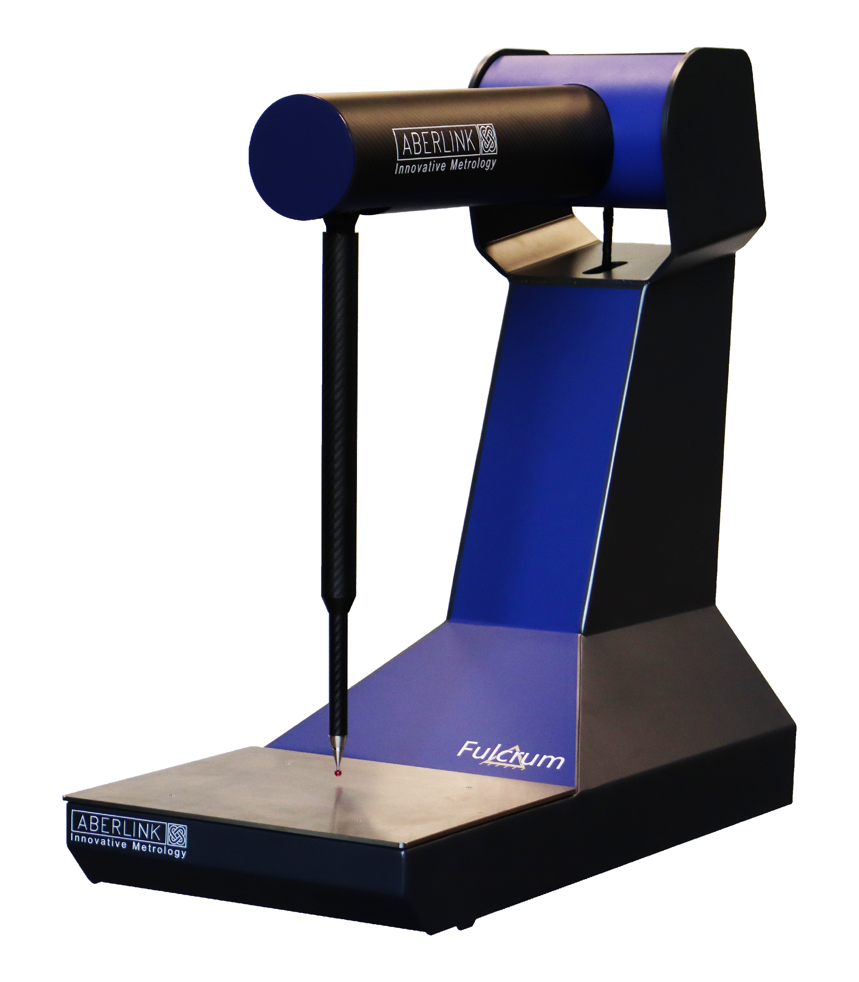
FULCRUM
Revolutionary manual CMM with 3 rotary axis
Complete turnkey package ready out of the box
Compact and portable design for easy use
Optimize inspection as parts come off the machine
One op at a time
Bespoke software interface provides quick and easy measurement.
Programmable magnetic soft buttons allow changes between software features without using a mouse.
Universal magnetic fixture frame enables you to quickly fixture your part, ensuring all points are taken accurately.
Instant feedback before final inspection
Budget friendly way to reduce scrap and lost time
Minimal setup with single USB cable & no air requirement

Slide 3
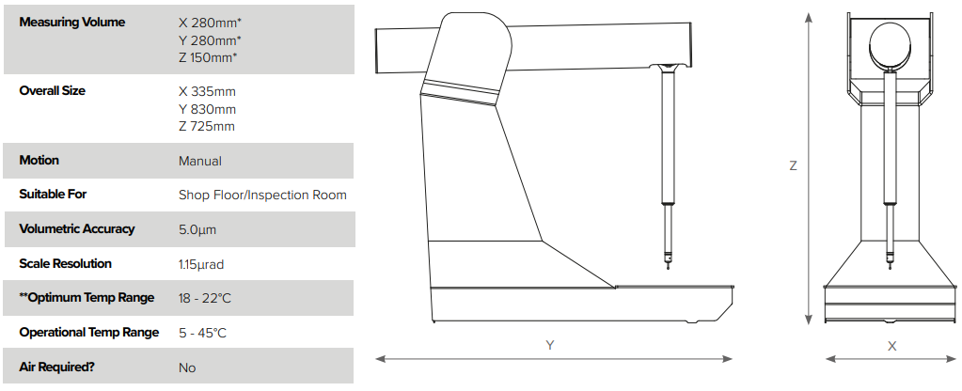
SPECIFICATIONS

Slide 4
PACKAGE
3D measurement software for touch probe feature inspection
Windows based all-in-one controller
Stylus kit
Magnetic Fixture kit
12 months full parts and labor warranty
Free software upgrades - no maintenance fees or contracts
Contact Fowler Preferred Distributor:
Willrich Precision: 866-945-5742 / sales@willrich.com

Slide 5
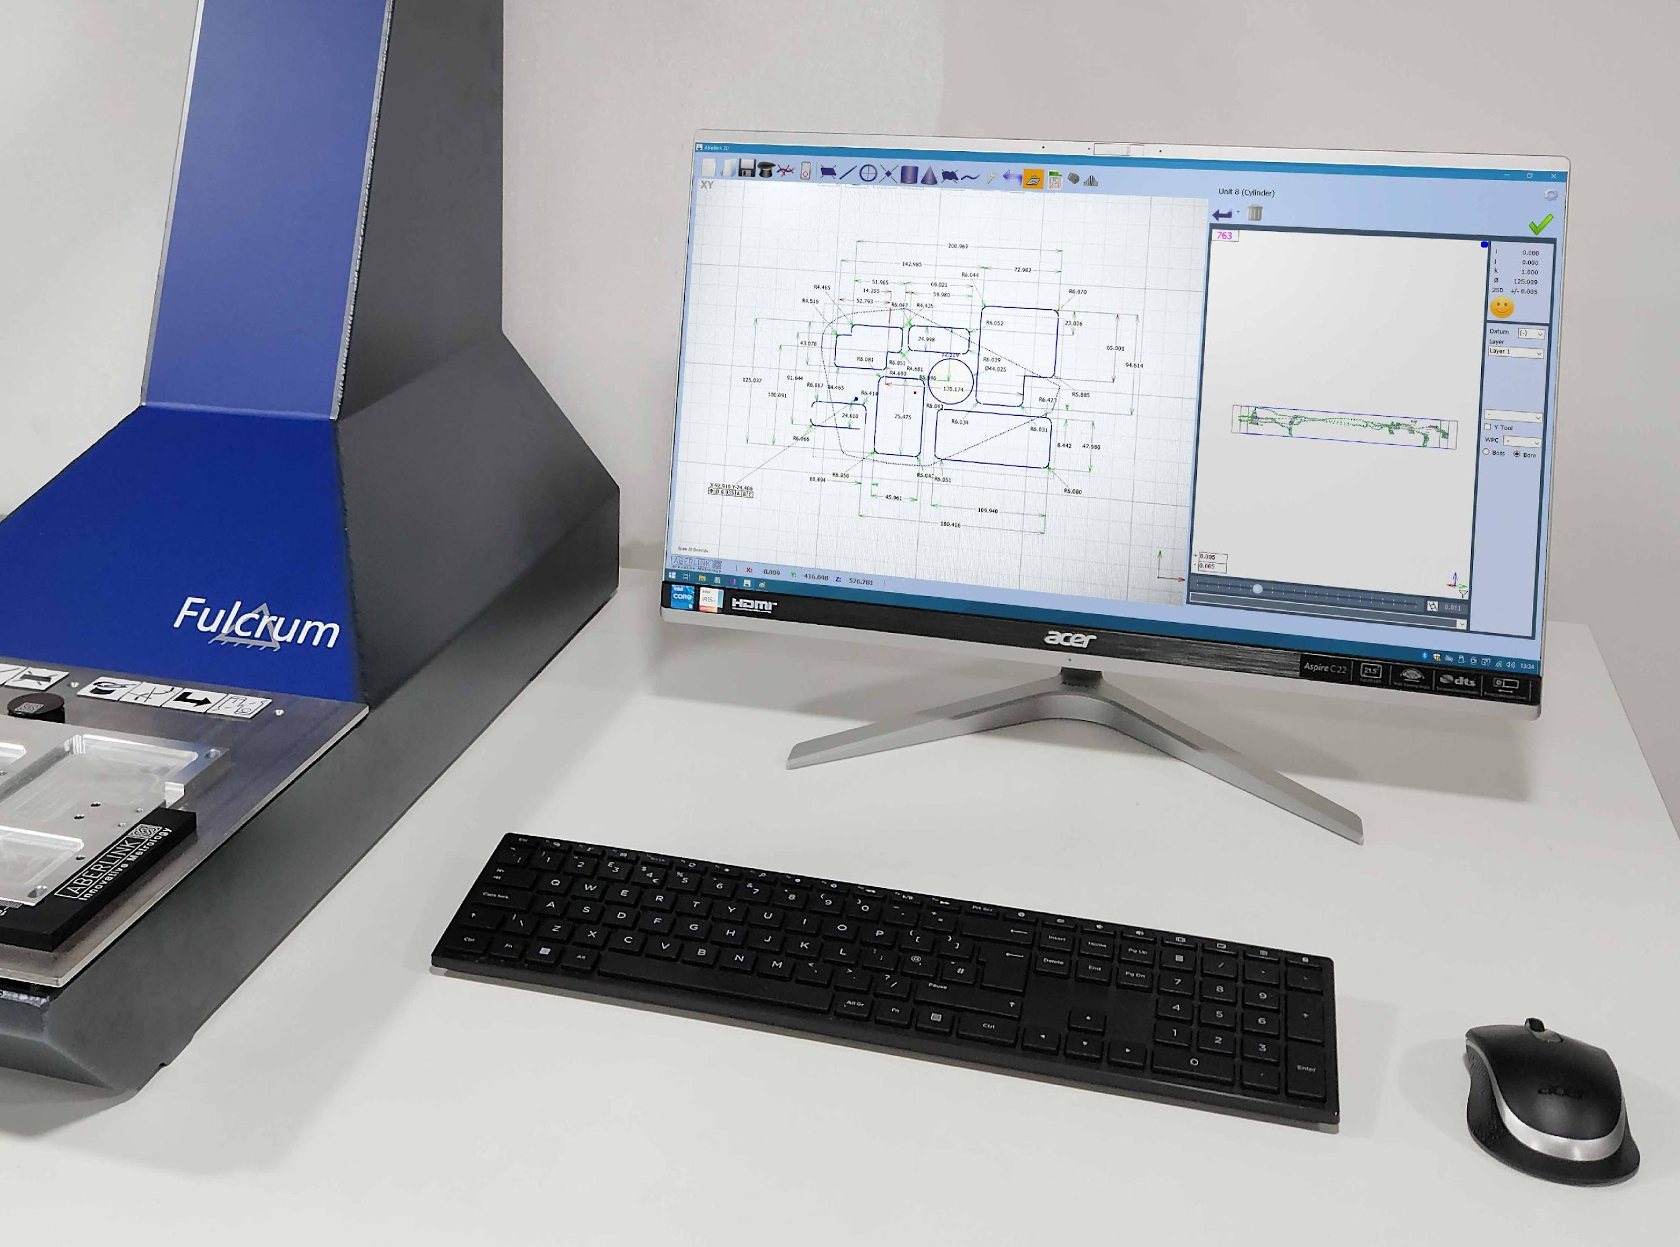
KEY FEATURE – PLUG & PLAY
No on-site installation and training required
Online tutorial video available for unboxing, setup & training
Ready to measure out of the box
Simply plug Fulcrum into the supplied PC
Start measuring parts and improve your efficiency
Contact Fowler Preferred Distributor:
Willrich Precision: 866-945-5742 / sales@willrich.com

Slide 6
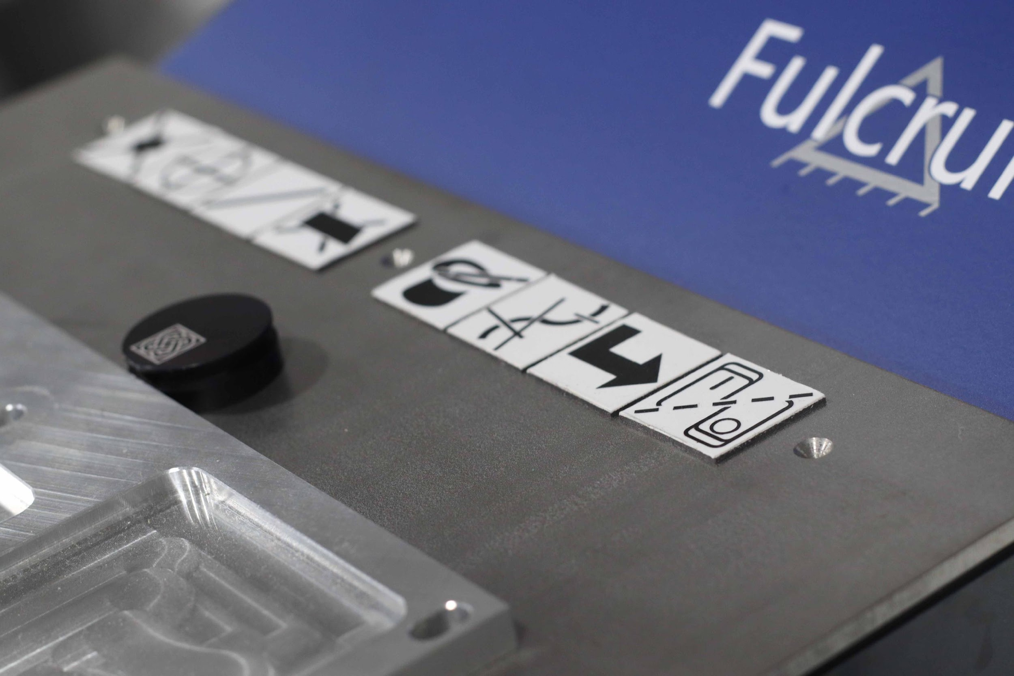
KEY FEATURE – MAGNETIC SOFT BUTTONS
Quickly change between features without using the mouse
Can be placed anywhere on the measuring surface
Custom program to perform any function in the software
Contact Fowler Preferred Distributor:
Willrich Precision: 866-945-5742 / sales@willrich.com

Slide 7
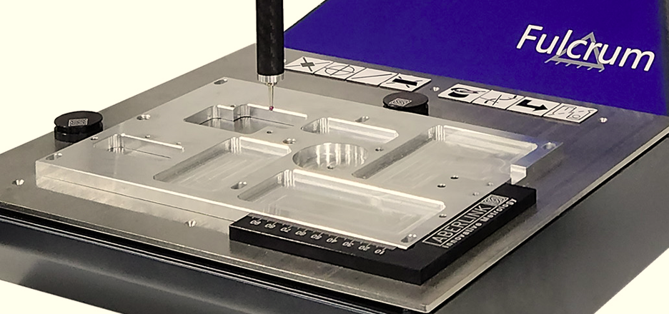
KEY FEATURE – EFFORTLESS FIXTURING
Magnetic fixture templates allow you to quickly fixture your part, making sure that all points are taken accurately.
Contact Fowler Preferred Distributor:
Willrich Precision: 866-945-5742 / sales@willrich.com

Slide 8
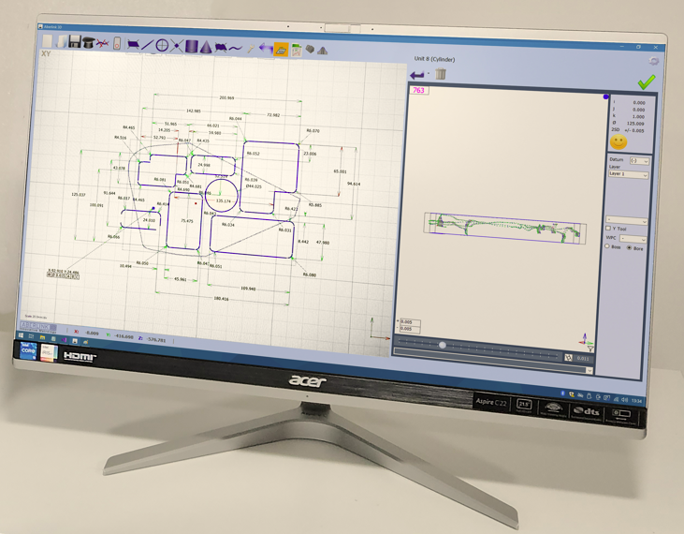
KEY FEATURE – PROGRAM PLAY BACK
3D measurement software with play back function for efficient inspection.
Contact Fowler Preferred Distributor:
Willrich Precision: 866-945-5742 / sales@willrich.com

Slide 9
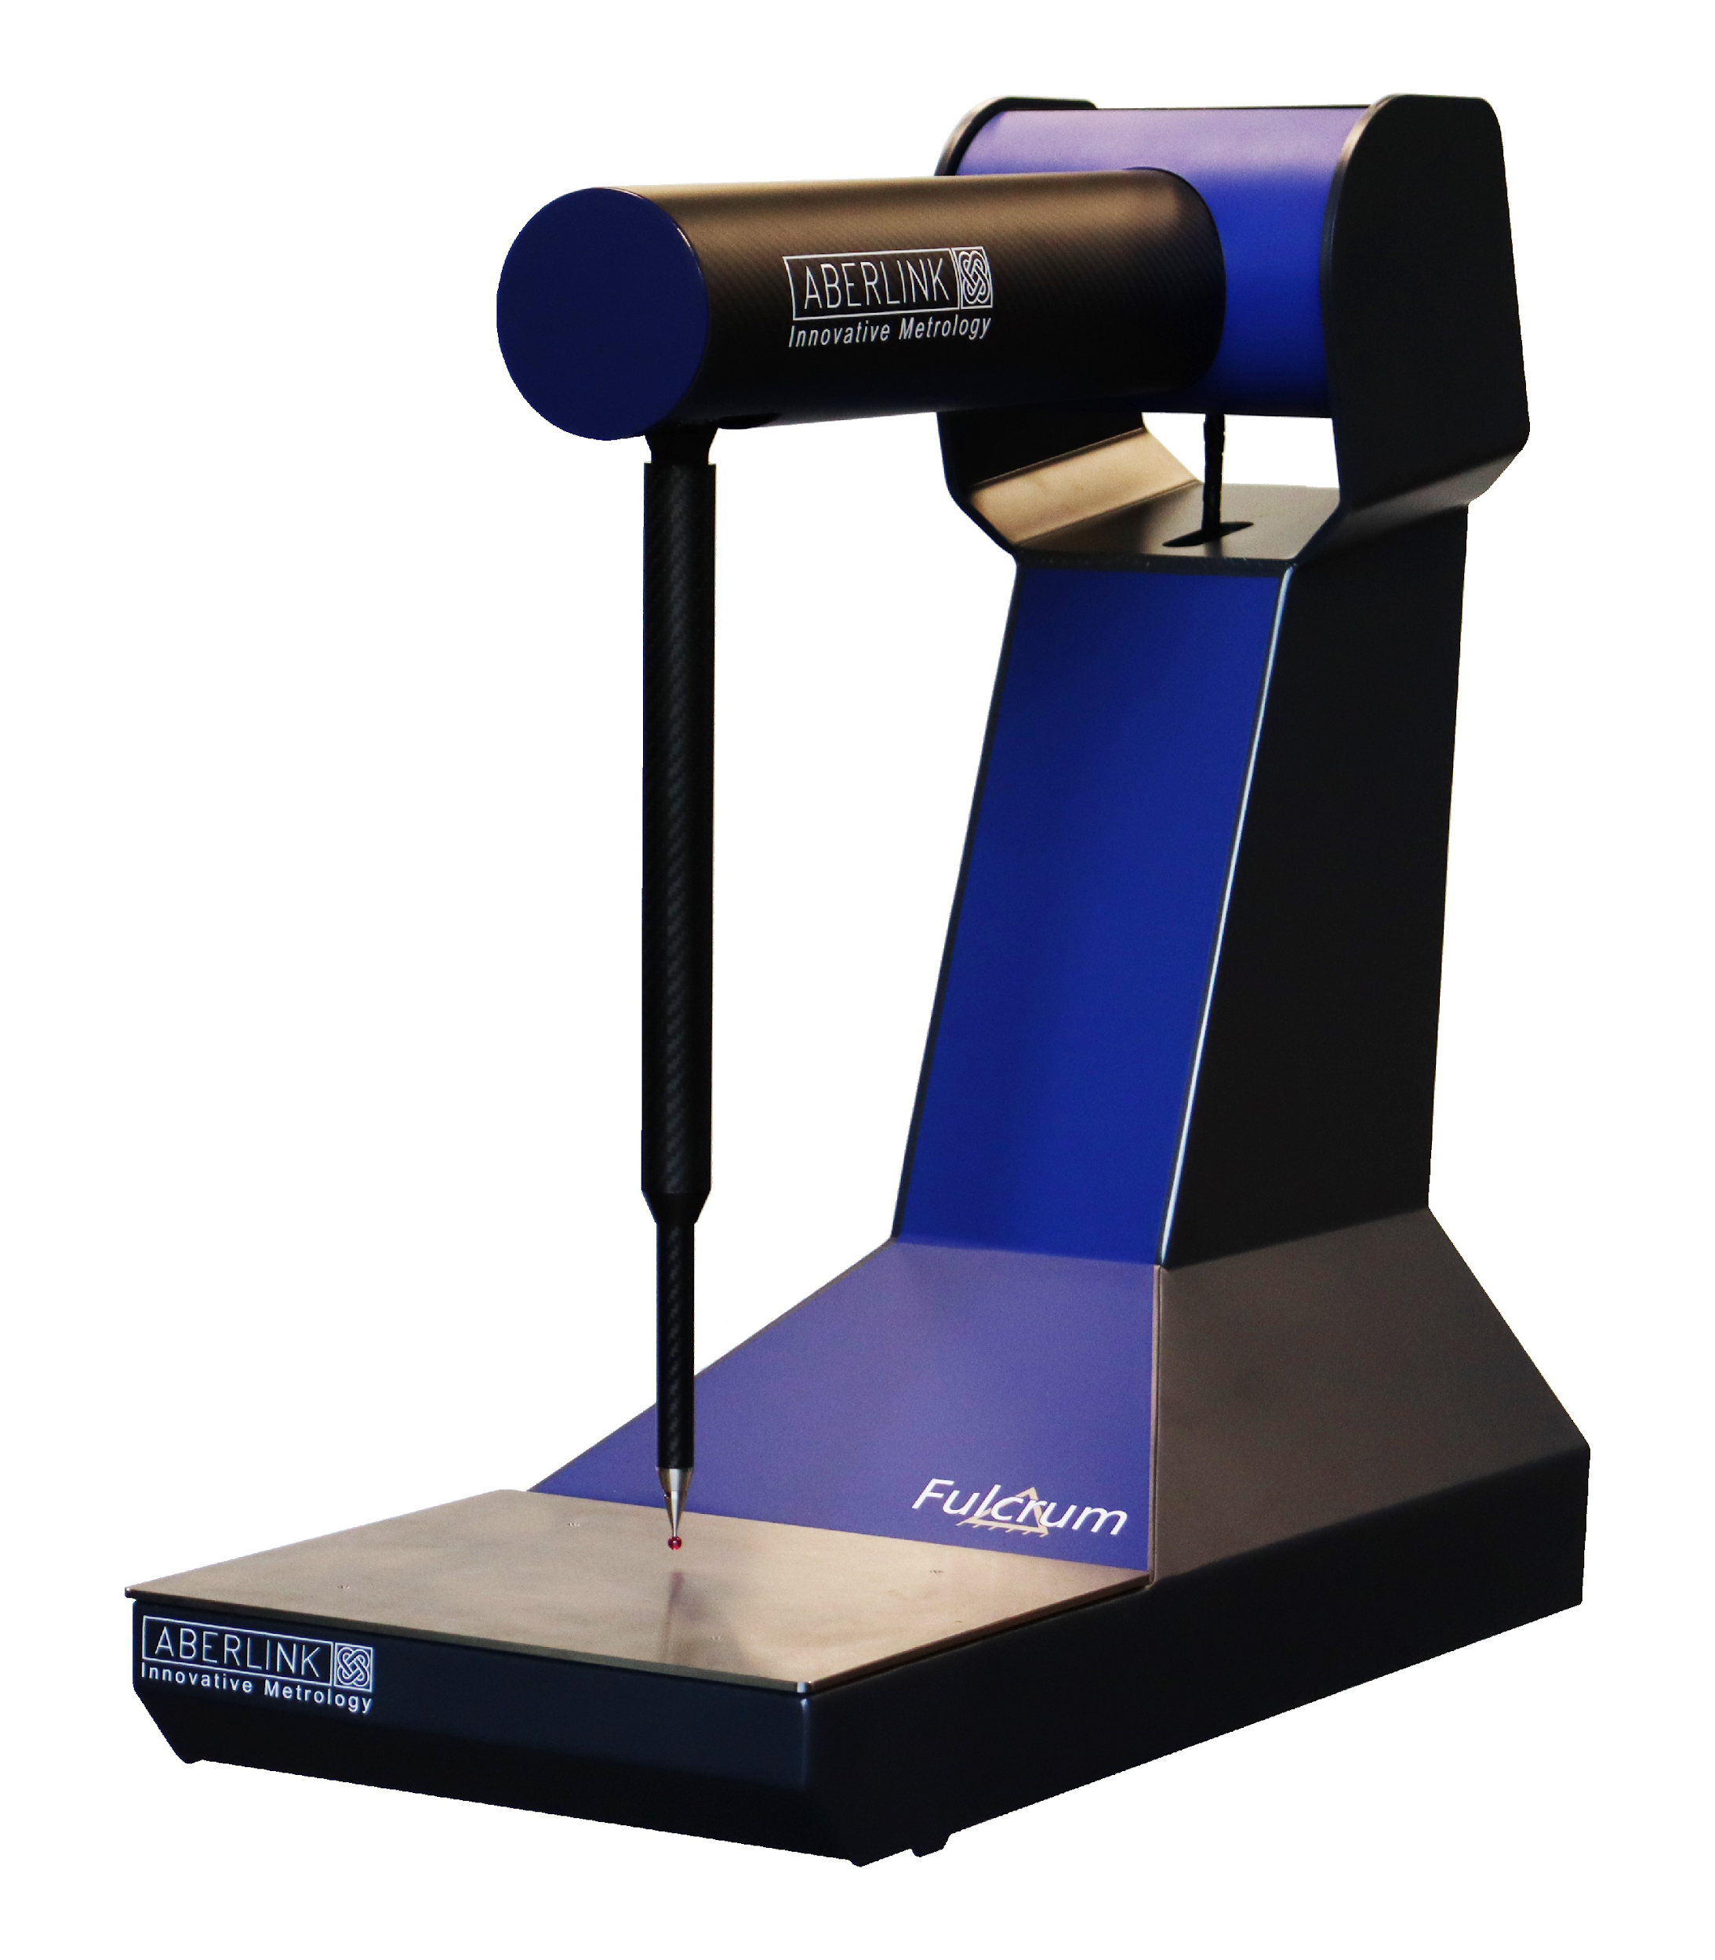
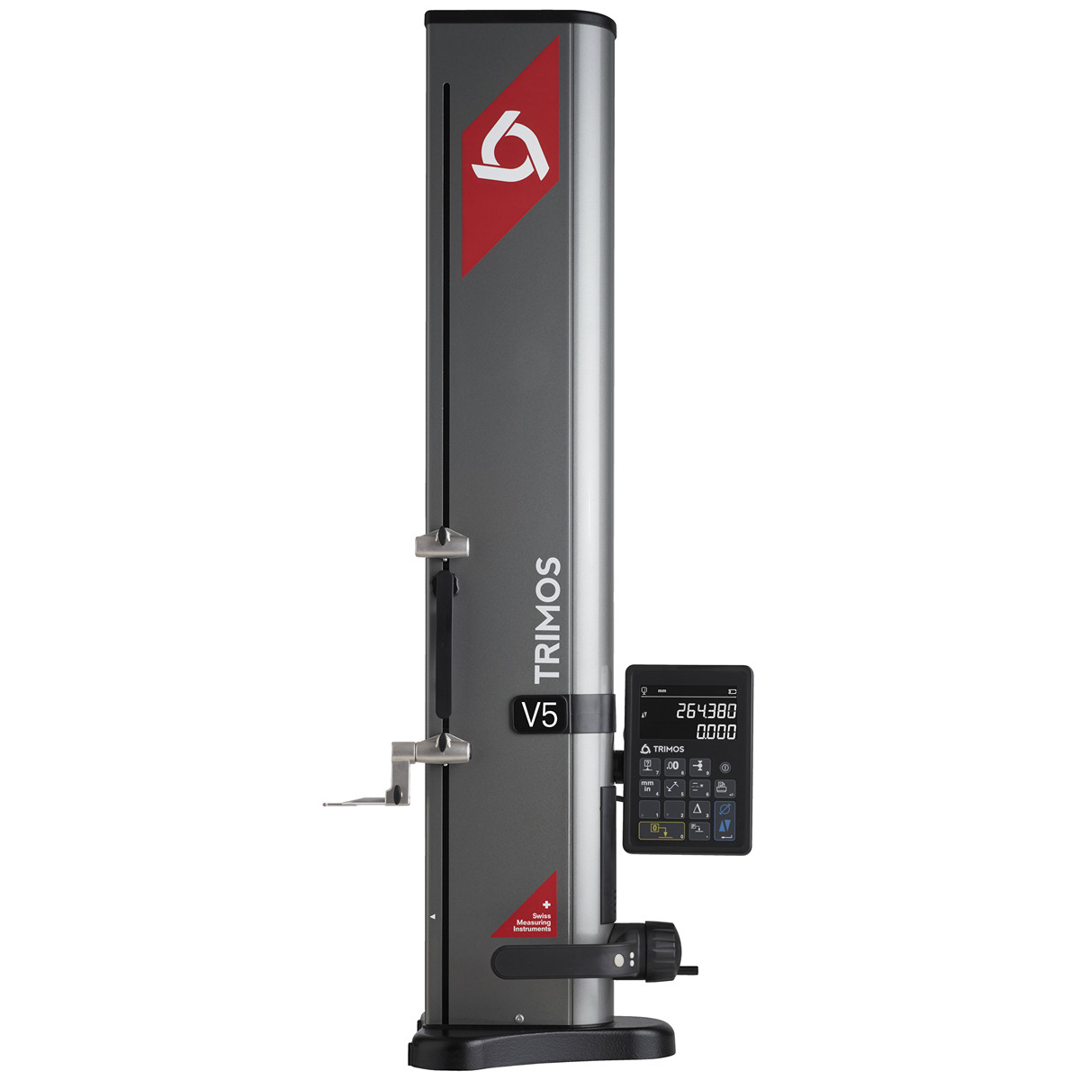
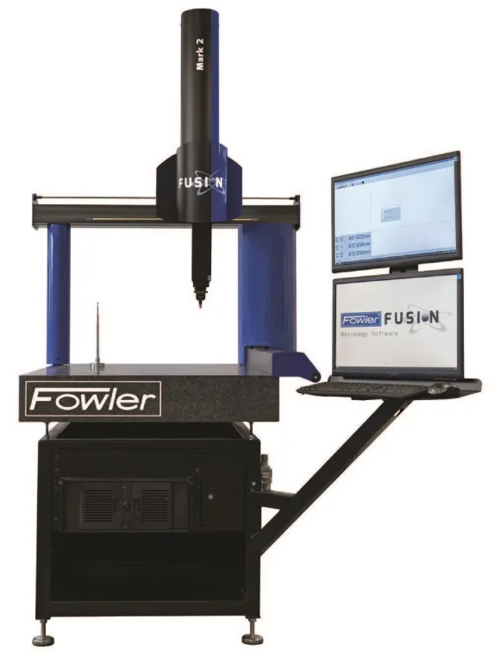
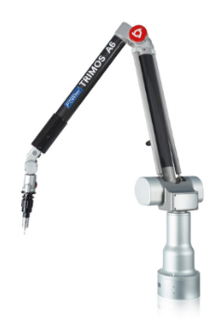
FULCRUM ADVANTAGES
 | Fulcrum | Height Gage | Bridge CMM | Arm
Size | Small & Compact | Small | Large | Medium to Large
Portable | Yes | Yes | No | Yes
Programmable | Yes | No | Yes | Yes
Price | Low | Low | High | High
Operation | Easy | Easy | Difficult | Difficult
Fixture included | Yes | No | No | No
Advanced measuring | Yes | No | Yes | Yes
On-site installation | No | No | Yes | Yes
Contact Fowler Preferred Distributor:
Willrich Precision: 866-945-5742 / sales@willrich.com

Slide 10
PRICING
P/N | 54-960-400-0
Introductory Price | $19,750.00 (Until: end of 2023)
Regular List Price | $25,000.00 (Starting 2024)
Availability | August 2023
* No on-site installation
Contact Fowler Preferred Distributor:
Willrich Precision: 866-945-5742 / sales@willrich.com

Slide 11
FULCRUM SETUP PROCEDURE
STEP 1
Scan the QR code outside the box
STEP 2
Register Fulcrum on the website
STEP 3
Watch the unboxing video
STEP 4
Unbox per instructions
STEP 5
Plug Fulcrum to the PC
STEP 6
Watch the tutorial video
STEP 7
Ready to measure !
Contact Fowler Preferred Distributor:
Willrich Precision: 866-945-5742 / sales@willrich.com

Slide 12
THANK YOU
Contact Fowler Preferred Distributor:
Willrich Precision: 866-945-5742 /sales@willrich.com

