Slide 1
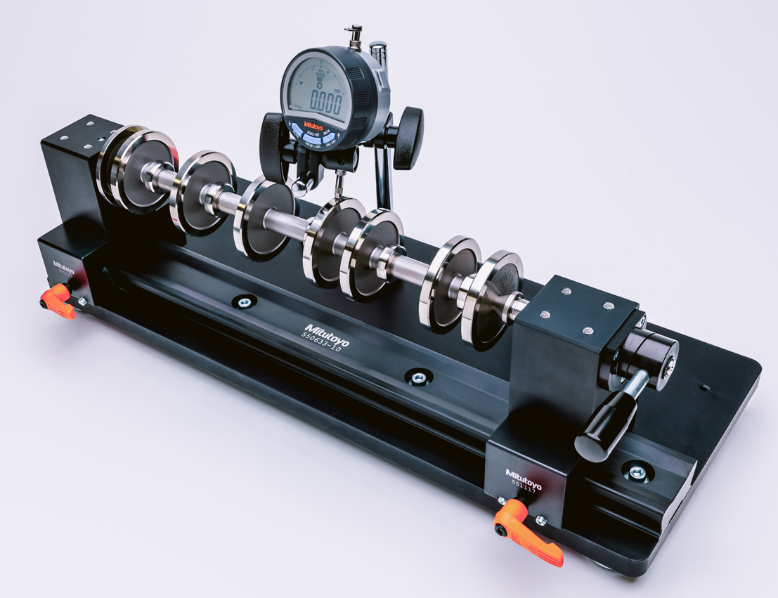
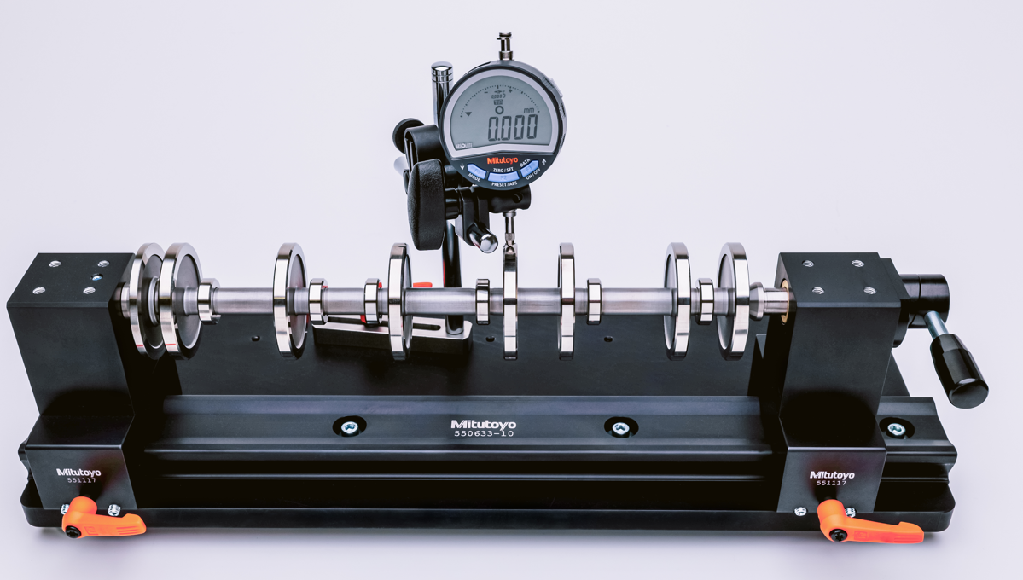
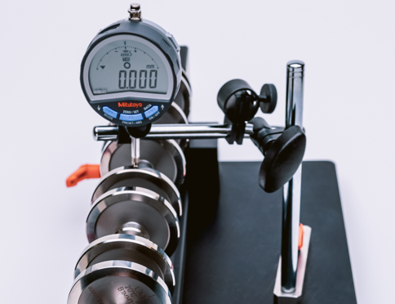
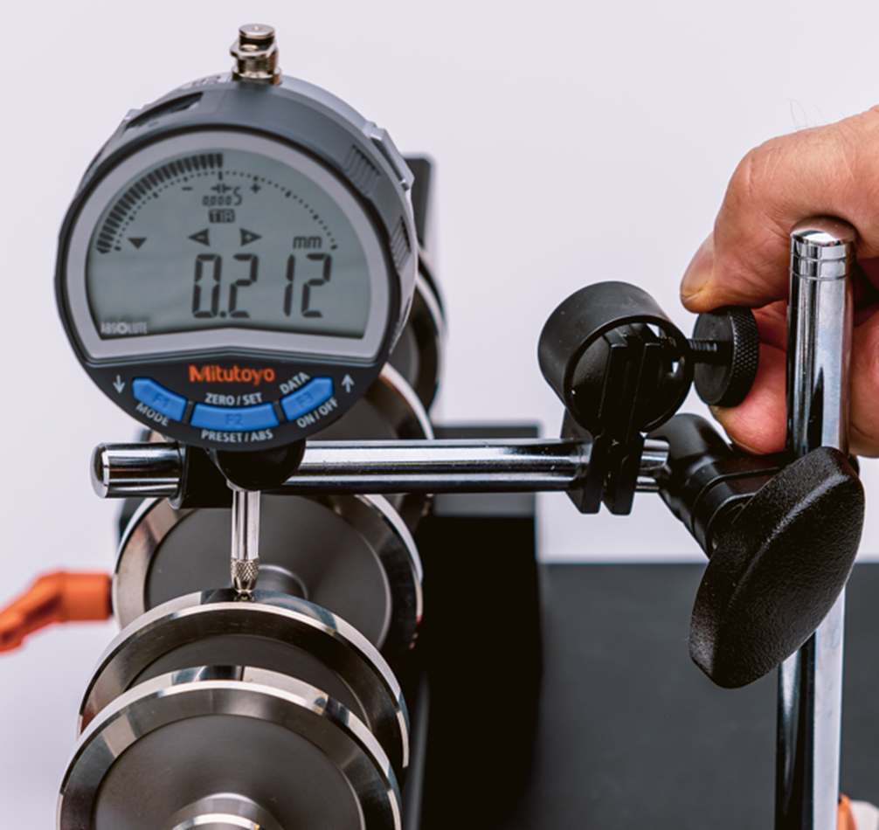
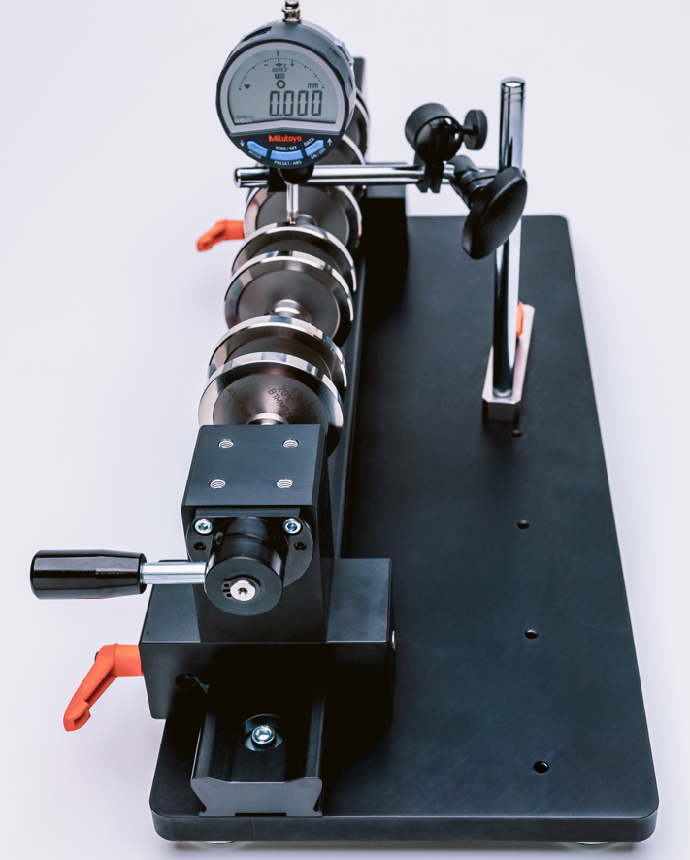
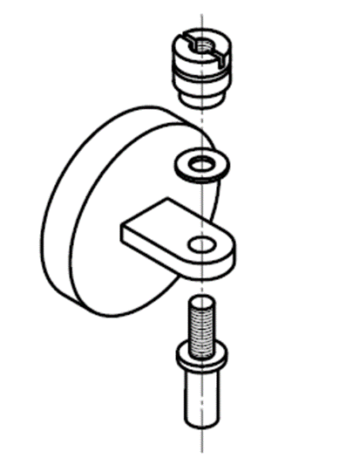
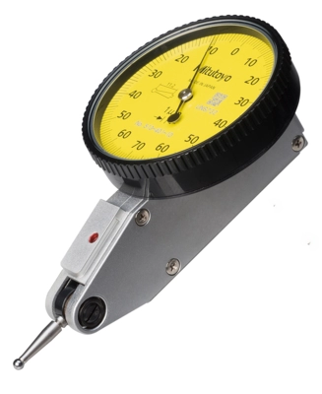
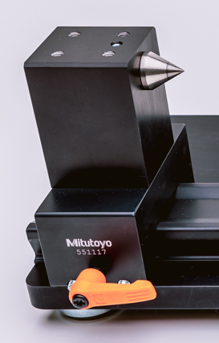
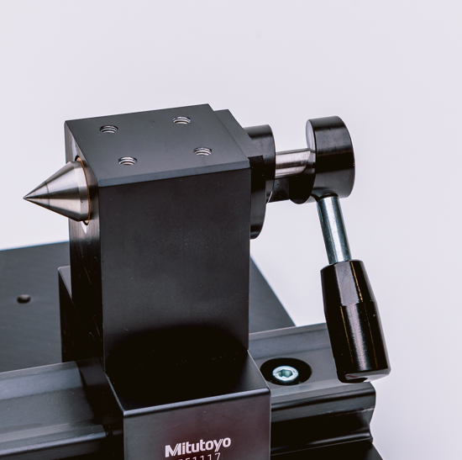
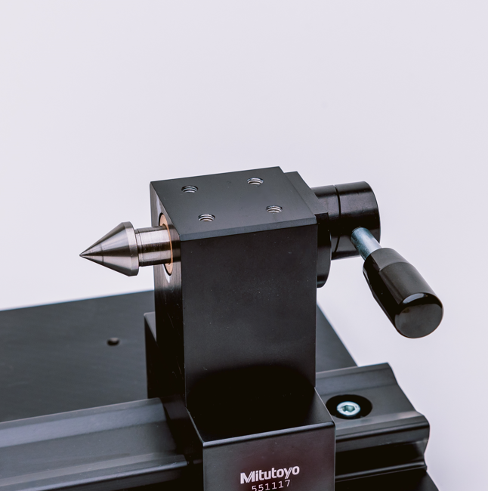
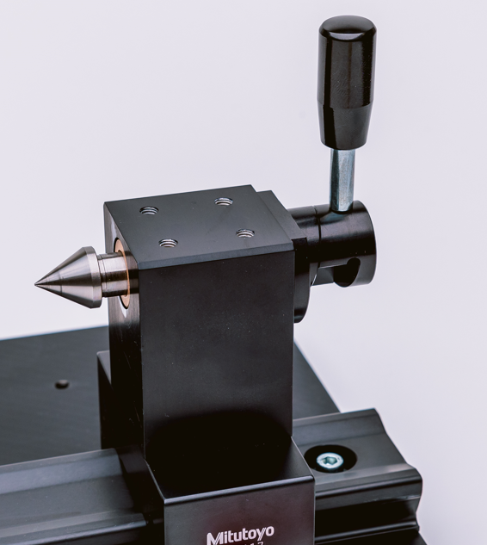
Quick Check - Bench Centers
Quick Check - Bench Centers
Main Unit Features
Indicator Stand Features
The Quick-Check center bench line comprises of a mix of standards parts from the well known multiflex^{profile} line , Mitutoyo indicator holders and dedicated parts. This keeps the prices affordable. The range starts out with 3 lengths with two variations each.
Support of Dial- and Lever indicators with stems Ø 4 mm, Ø 8 mm and Ø 9,53 mm.
Fine adjustment of indicator position by 20° for smooth workpiece approach.
Indicator support bar L = 150mm
Holder bar H = 177 mm
20°
Indicator fine adjustment mechanism

Slide 2
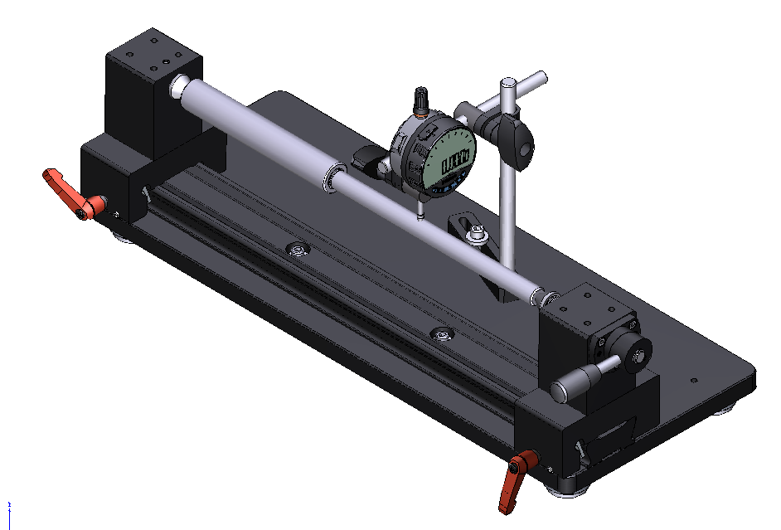
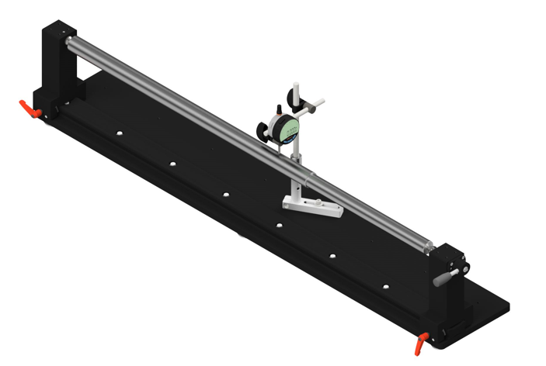
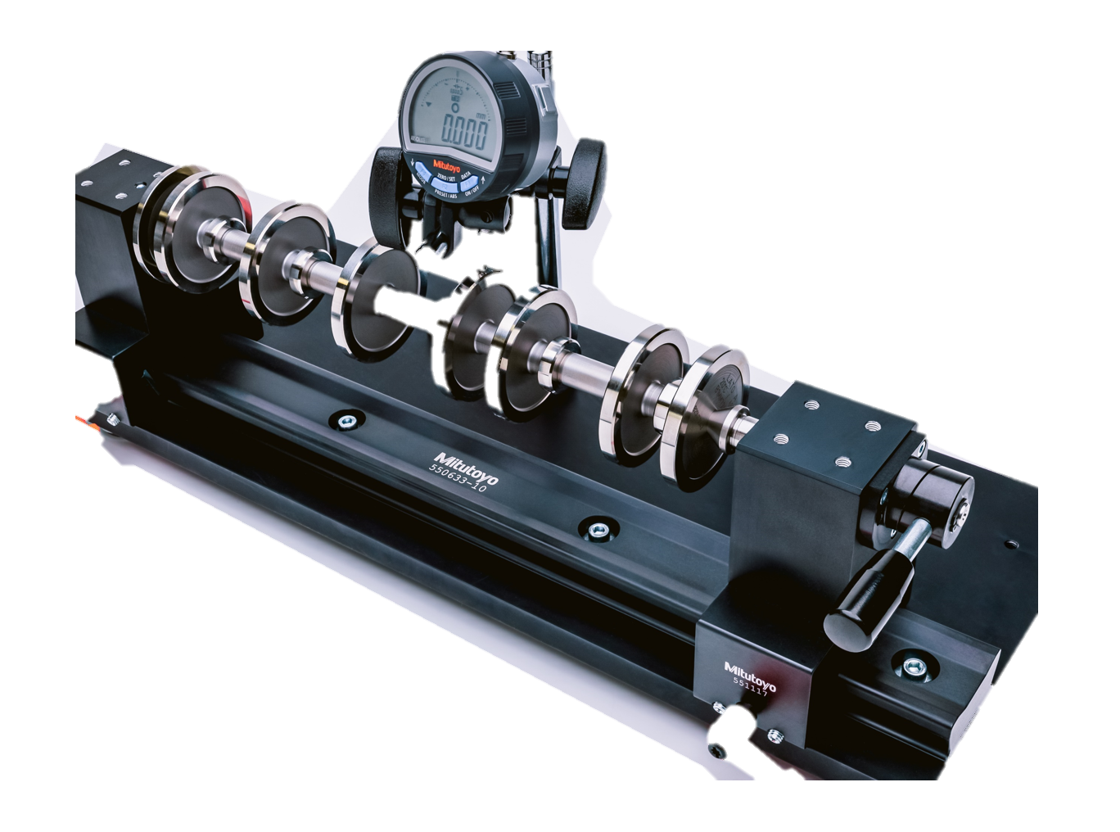
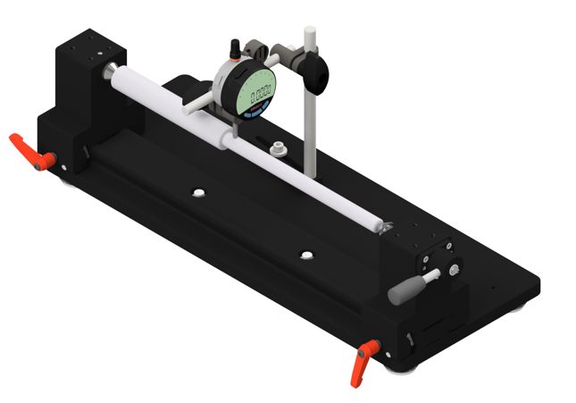
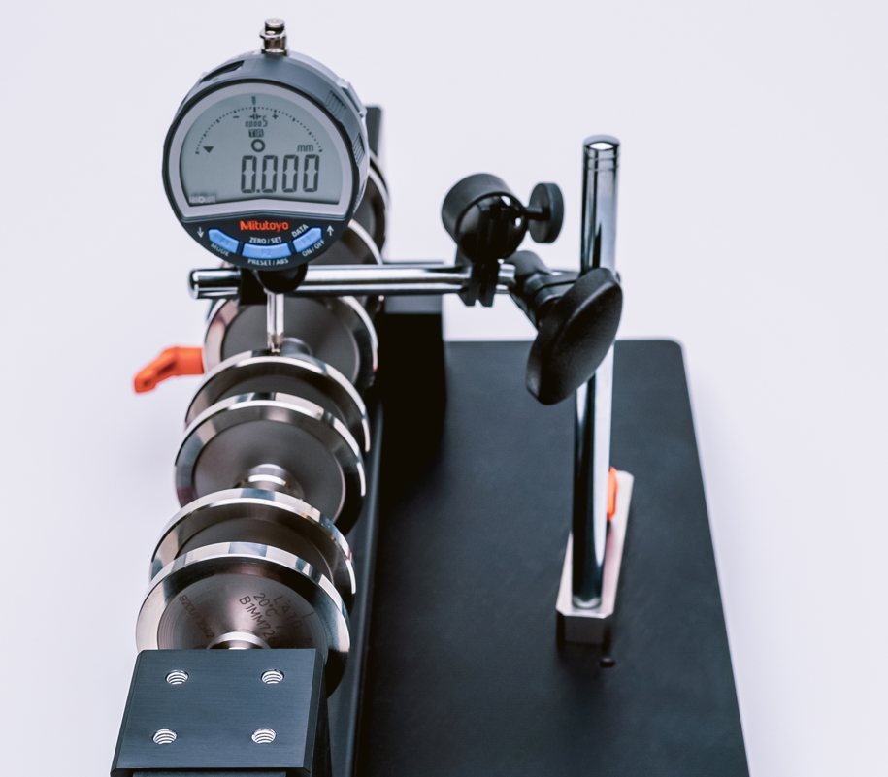
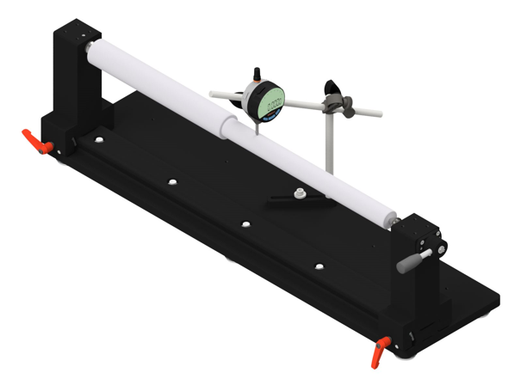
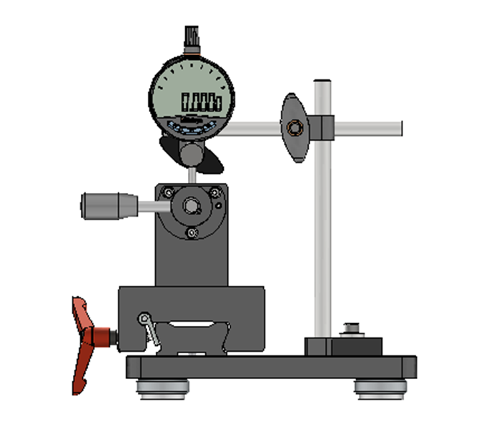
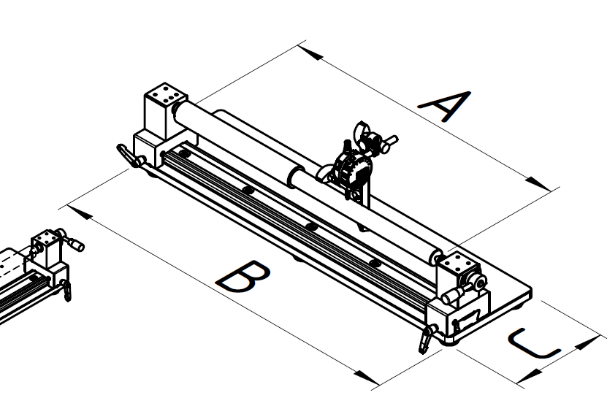
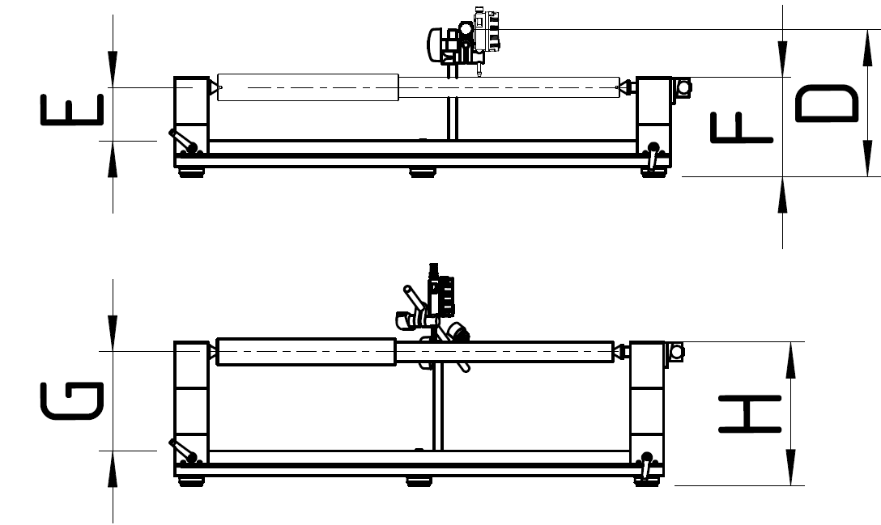
Quick Check - Bench Centers Single-Rail Models
Quick Check - Bench Centers Single-Rail Models
Quick Check Mono-Rail
The Quick-Check center bench line comprises of a mix of standards parts from the well known multiflex^{profile} line , Mitutoyo indicator holders and dedicated parts. This keeps the prices affordable. The range starts out with 3 lengths with two variations each.
Dimensions: Single-Rail Types
Quick Check Bench Centers: Single-Rail Types
Eccentricity check
One touch lever in/out support of shaft
Single-rail Types can be converted to Twin-Rail Types by adding the extension sets.
Sliders with additional indicator holders can be added for the positioning of multiple indicators.
Extend the height to 150mm by using the optional height extension set K551439.
Material | Distance between centers | Center height | Centre point angle | Indicator stand column height | Measuring arm length | Base plate | Load | weight
K551399 | 360 mm | 80 mm | 60° | 177 mm | 150 mm | 500 x 200 mm | 10 kg | 9,6 kg
K551425 | 600 mm | 80 mm | 60° | 177 mm | 150 mm | 740 x 200 mm | 10 kg | 12 kg
K551426 | 1.000 mm | 80 mm | 60° | 177 mm | 150 mm | 1.150 x 200 mm | 10 kg | 16,5 kg
Part No. | Range between centers | Length of Base | Width of Base | Height of Rod | Standard Height |  | With Height Extension*
 |  |  |  |  | Center Height | Tailstock Height | Center Height | Tailstock Height
Single-Rail | A | B | C | F | D | E | G | H
K551399 | 360 | 500 | 200 | 219,5 | 80 | 148 | 150 | 218
K551425 | 600 | 740 | 200 | 219,5 | 80 | 148 | 150 | 218
K551426 | 1000 | 1150 | 200 | 219,5 | 80 | 148 | 150 | 218
*K551439 Height extension set

Slide 3
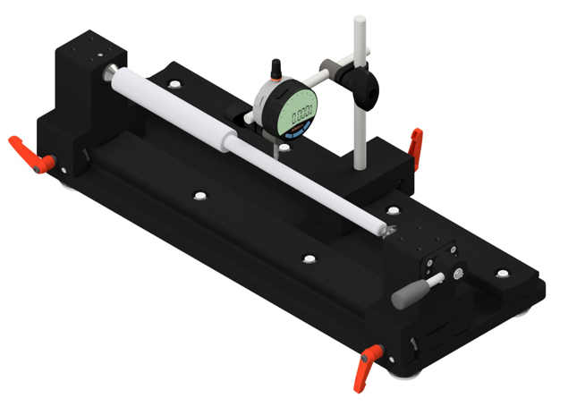
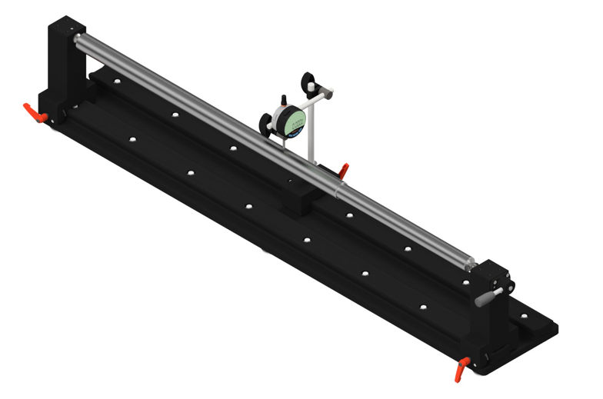
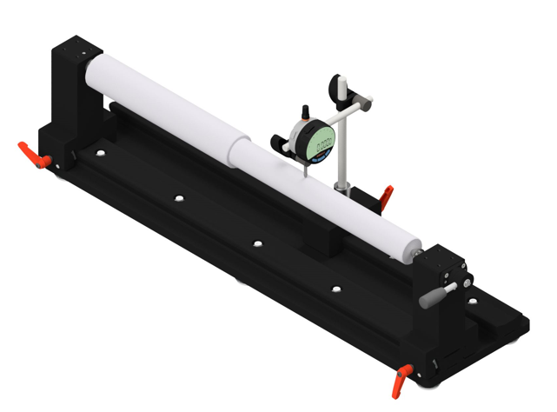
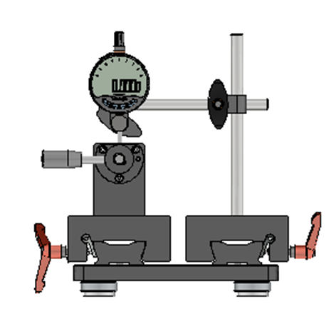
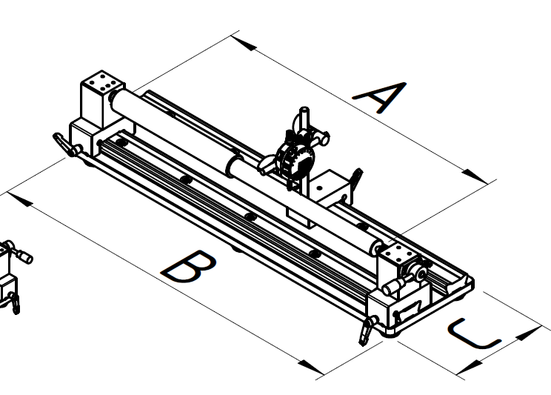
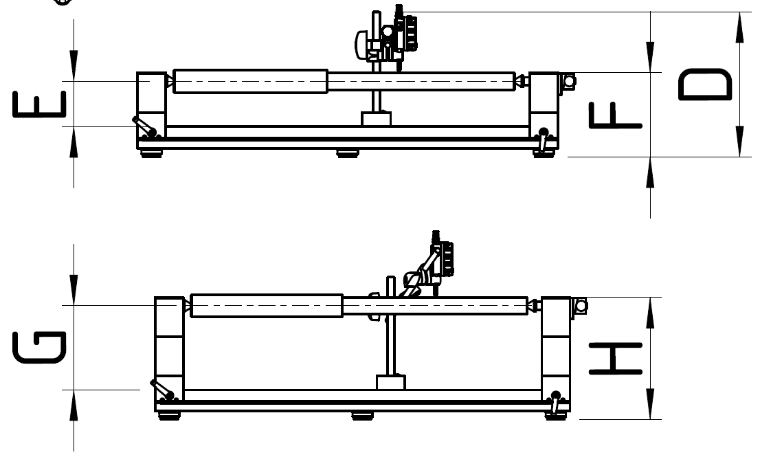
Quick Check - Bench Centers Twin-Rail Models
Quick Check - Bench Centers Twin-Rail Models
Quick Check Twin-Rail
The Quick-Check center bench line comprises of a mix of standards parts from the well known multiflex^{profile} line , Mitutoyo indicator holders and dedicated parts. This keeps the prices affordable. The range starts out with 3 lengths with two variations each.
Dimensions: Twin-Rail Types
Quick Check Bench Centers: Twin-Rail Types
Eccentricity check
One touch lever in/out support of shaft
Enables free positioning of the indicator along the part axis
Several sliders with indicator holders can be mounted optionally
Extend the height to 150mm by using the optional height extension set K551439.
Material | Distance between centers | Center height | Centre point angle | Indicator stand column height | Measuring arm length | Base plate | Load | weight
K551424 | 360 mm | 80 mm | 60° | 177 mm | 150 mm | 500 x 200 mm | 10 kg | 11,4 kg
K551429 | 600 mm | 80 mm | 60° | 177 mm | 150 mm | 740 x 200 mm | 10 kg | 14,5 kg
K551430 | 1.000 mm | 80 mm | 60° | 177 mm | 150 mm | 1.150 x 200 mm | 10 kg | 20 kg
Part No. | Range between centers | Length of Base | Width of Base | Height of Rod | Standard Height |  | With Height Extension *
 |  |  |  |  | Center height | Tailstock Height | Center height | Tailstock Height
Twin-Rail | A | B | C | F | D | E | G | H
K551424 | 360 | 500 | 200 | 255 | 80 | 148 | 150 | 218
K551429 | 600 | 740 | 200 | 255 | 80 | 148 | 150 | 218
K551430 | 1000 | 1150 | 200 | 255 | 80 | 148 | 150 | 218
*K551439 Height extension set

Slide 4
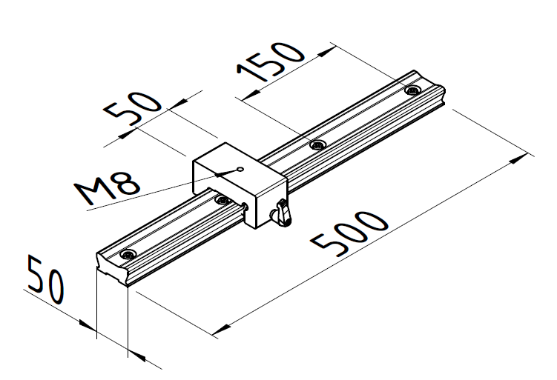
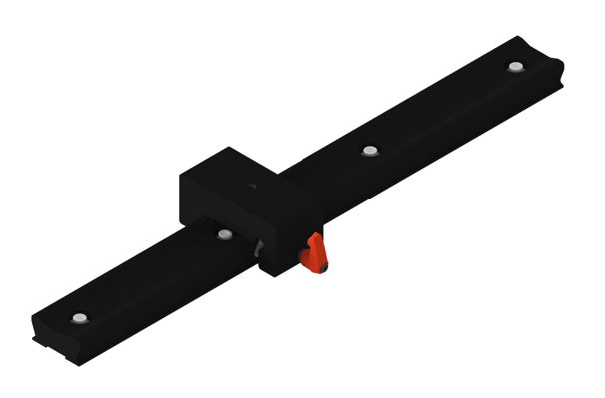
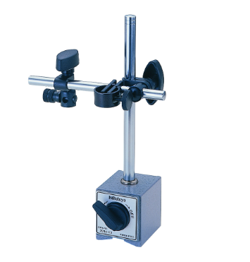

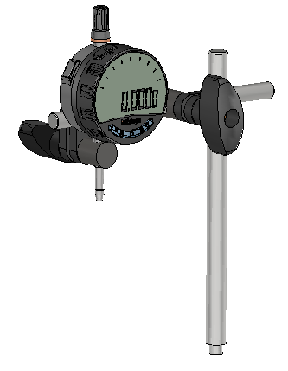
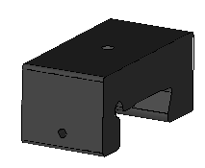
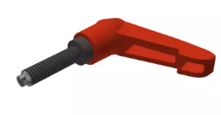
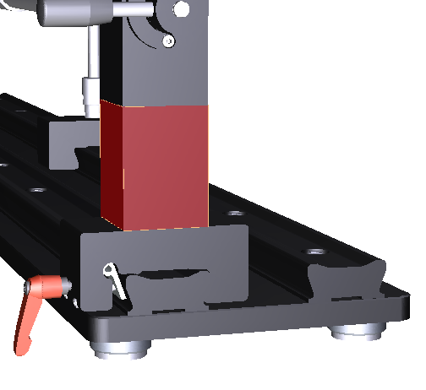
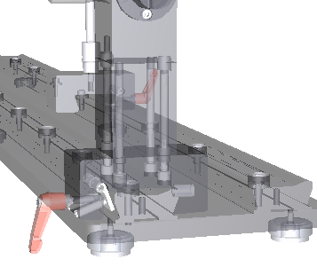
Quick Check - Bench Center Accessories
Quick Check - Bench Center Accessories
Twin-Rail Conversion Sets
Part No. |  | Compatibility | Length A | Indicator stand | weight
K551422 | Indicator positioning rail set | K551399 | 500 mm | not included | 1,8 kg
K551428 | Indicator positioning rail set | K551429 | 740 mm | not included | 2,5 kg
K551427 | Indicator positioning rail set | K551426 | 1.150 mm | not included | 3,5 kg
Scope of delivery
K551428
K551427
K551422
Part No. | Qty. | Part name
K551432 | 1 | Slider unit for Quick Check
K502620 | 1 | Clamp lever for slider components
K550633 | 1 | multiflex^{profile} rail 500 mm
K550110 | 4 | Cylinder head screw M6 x 20 mm
K550591 | 4 | Washer M6
K550561 | 4 | Spring washer Ø 6 mm
Total qty. | 15
Part No. | Qty. | Part name
K551432 | 1 | Slider unit for Quick Check
K502620 | 1 | Clamp lever for slider components
K550833 | 1 | multiflex^{profile} rail 740 mm
K550563 | 4 | Cylinder head screw M6 25 mm
K550591 | 4 | Washer M6
K550561 | 4 | Spring washer Ø 6 mm
Total qty. | 15
Part No. | Qty. | Part name
K551432 | 1 | Slider unit for Quick Check
K502620 | 1 | Clamp lever for slider components
K550822 | 1 | multiflex^{profile} rail 1.150 mm
K550563 | 4 | Cylinder head screw M6 25 mm
K550591 | 4 | Washer M6
K550561 | 4 | Spring washer Ø 6 mm
Total qty. | 15
Height extension set
The height of the Quick Check Bench Center can easily be extended from 80 mm to 150 mm, by adding the height extension set K551439. It comprises of two extension blocks and a 300 mm measuring arm rod, to easily reach the workpiece feature.
Part No. |  | Compatibility | Center height | Measuring arm length
K551439 | Height extension set for Quick Check 70 mm to increase center height from 80 mm to 150 mm | all Quick Check models | 150 mm | 300 mm
Scope of delivery
Slider Unit and Indicator Stand
Part No. | Qty. | Part name
K580819 | 2 | Center raise block for Quick Check 70 mm 1 pc.
02AZC390 | 1 | 300 mm Extension rod for indicator holder
K916185 | 8 | Cylinder head screw M6
K551136 | 4 | Positioning bushing 10 mm multiflex^{profile}
K550561 | 8 | Spring washer Ø 6 mm
Total qty. | 23
Part No. |  | Compatibility | Indicator stand | Indicator stand column height | Measuring arm length
K551432 | Slider unit for Quick Check | Quick Check twin- rail models | not included
K502620 | Clamp lever for slider components | K551432
K916026 | Indicator stand for Quick Check slider | K551432 |  | 177 mm | 150 mm
02AZC390 | Extension rod for indicator holder 300 mm | K916026 |  |  | 300 mm

